Slide 1
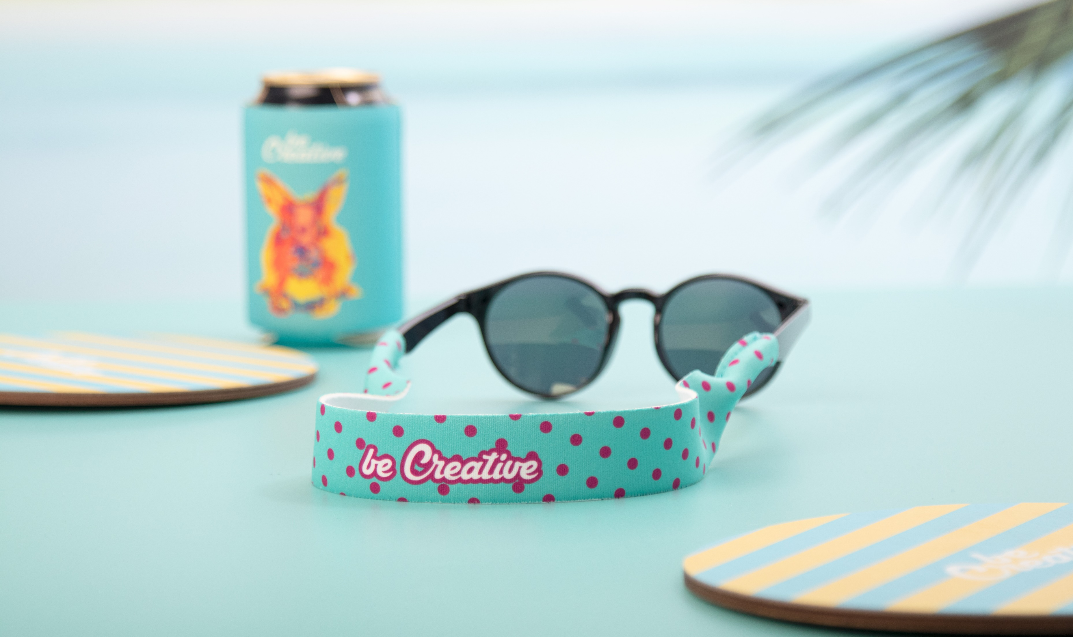
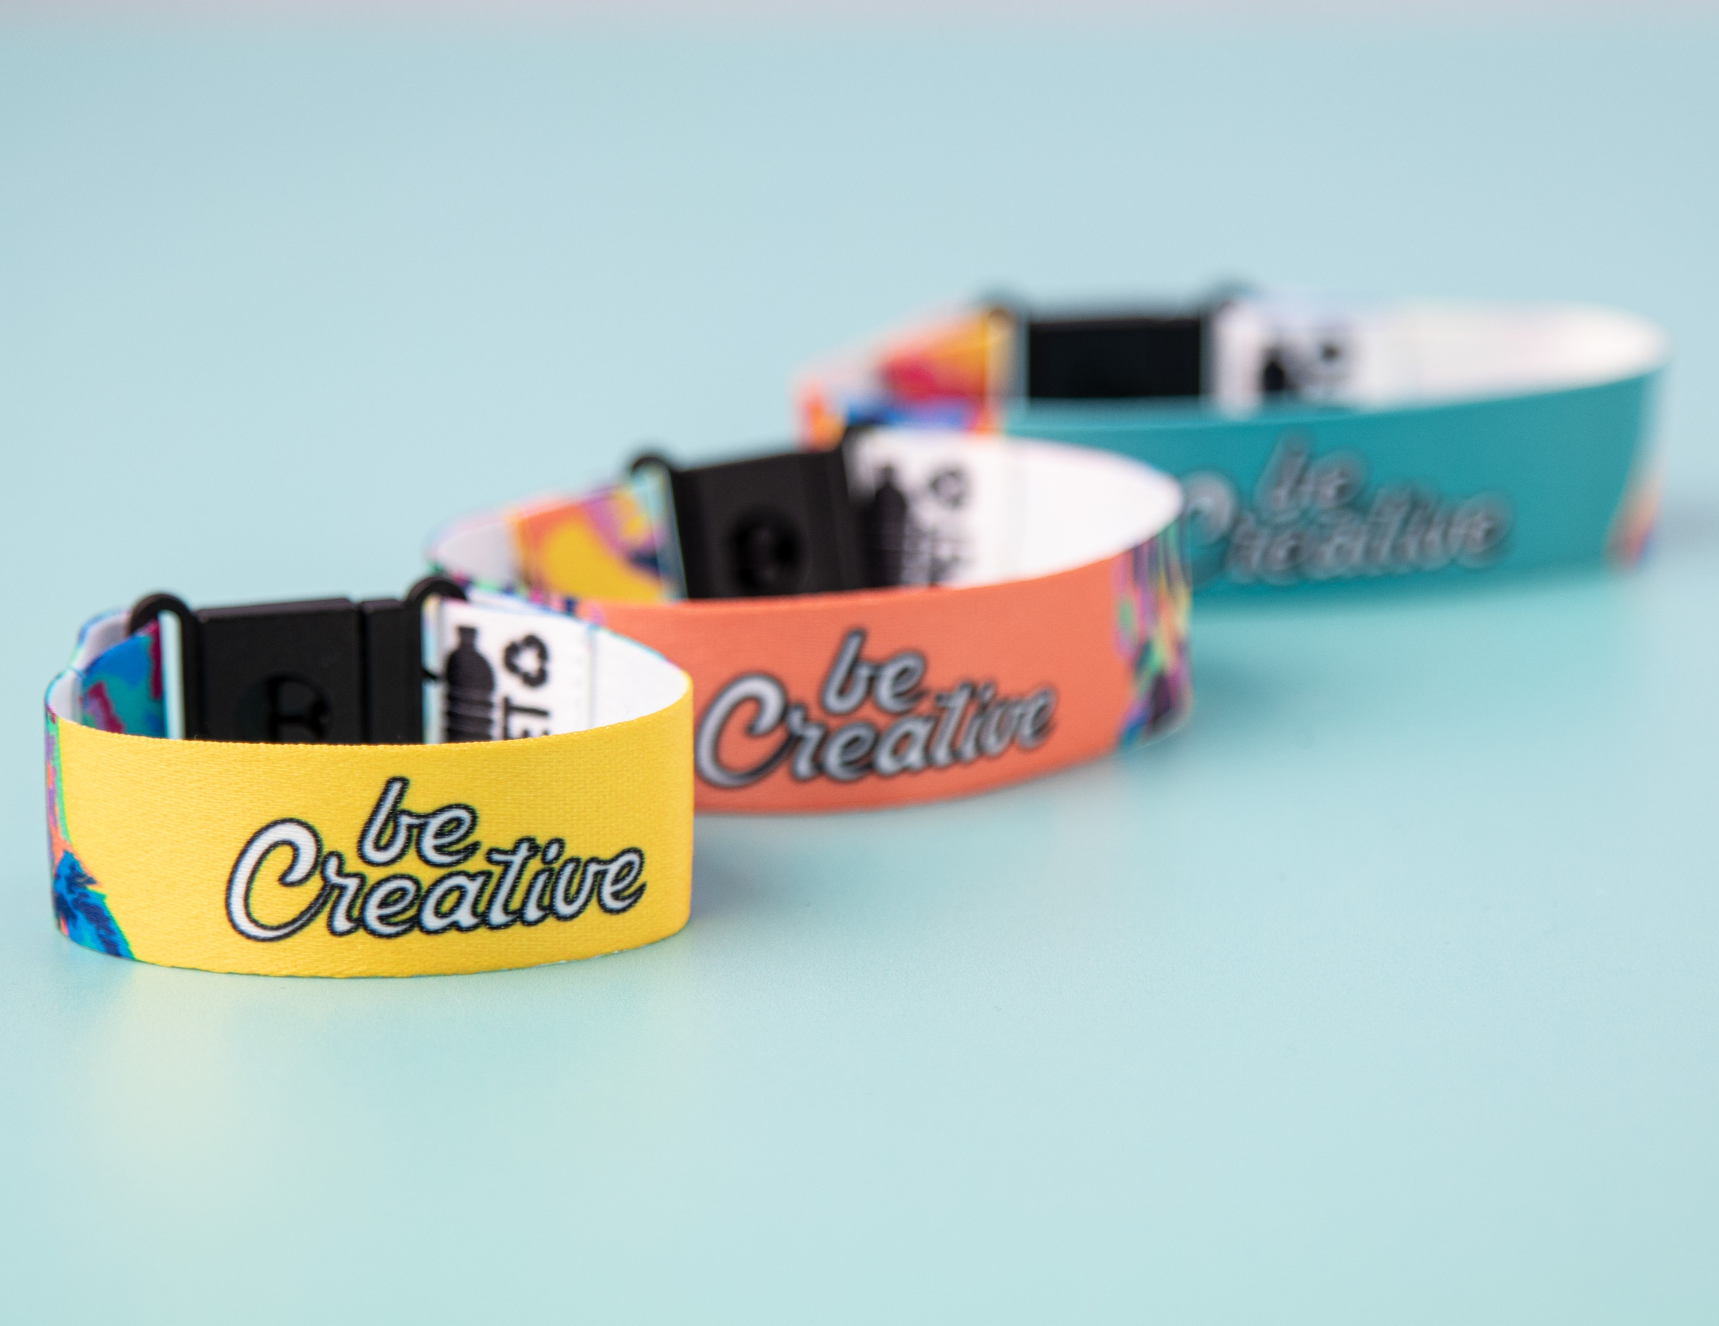
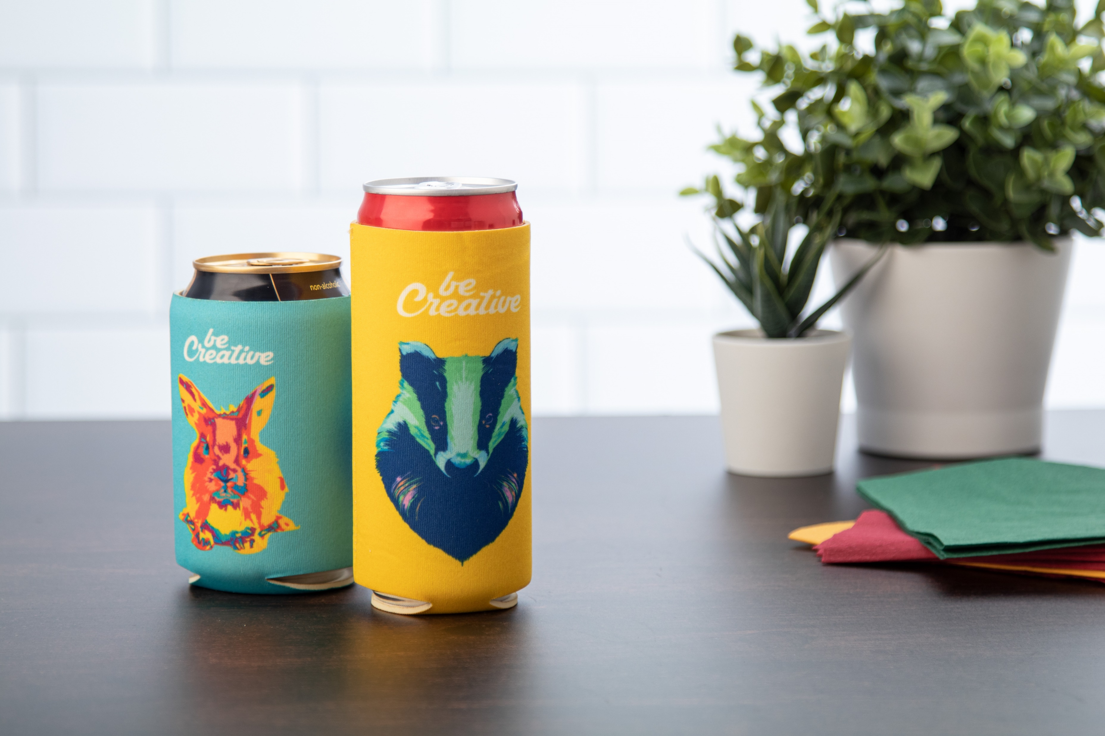
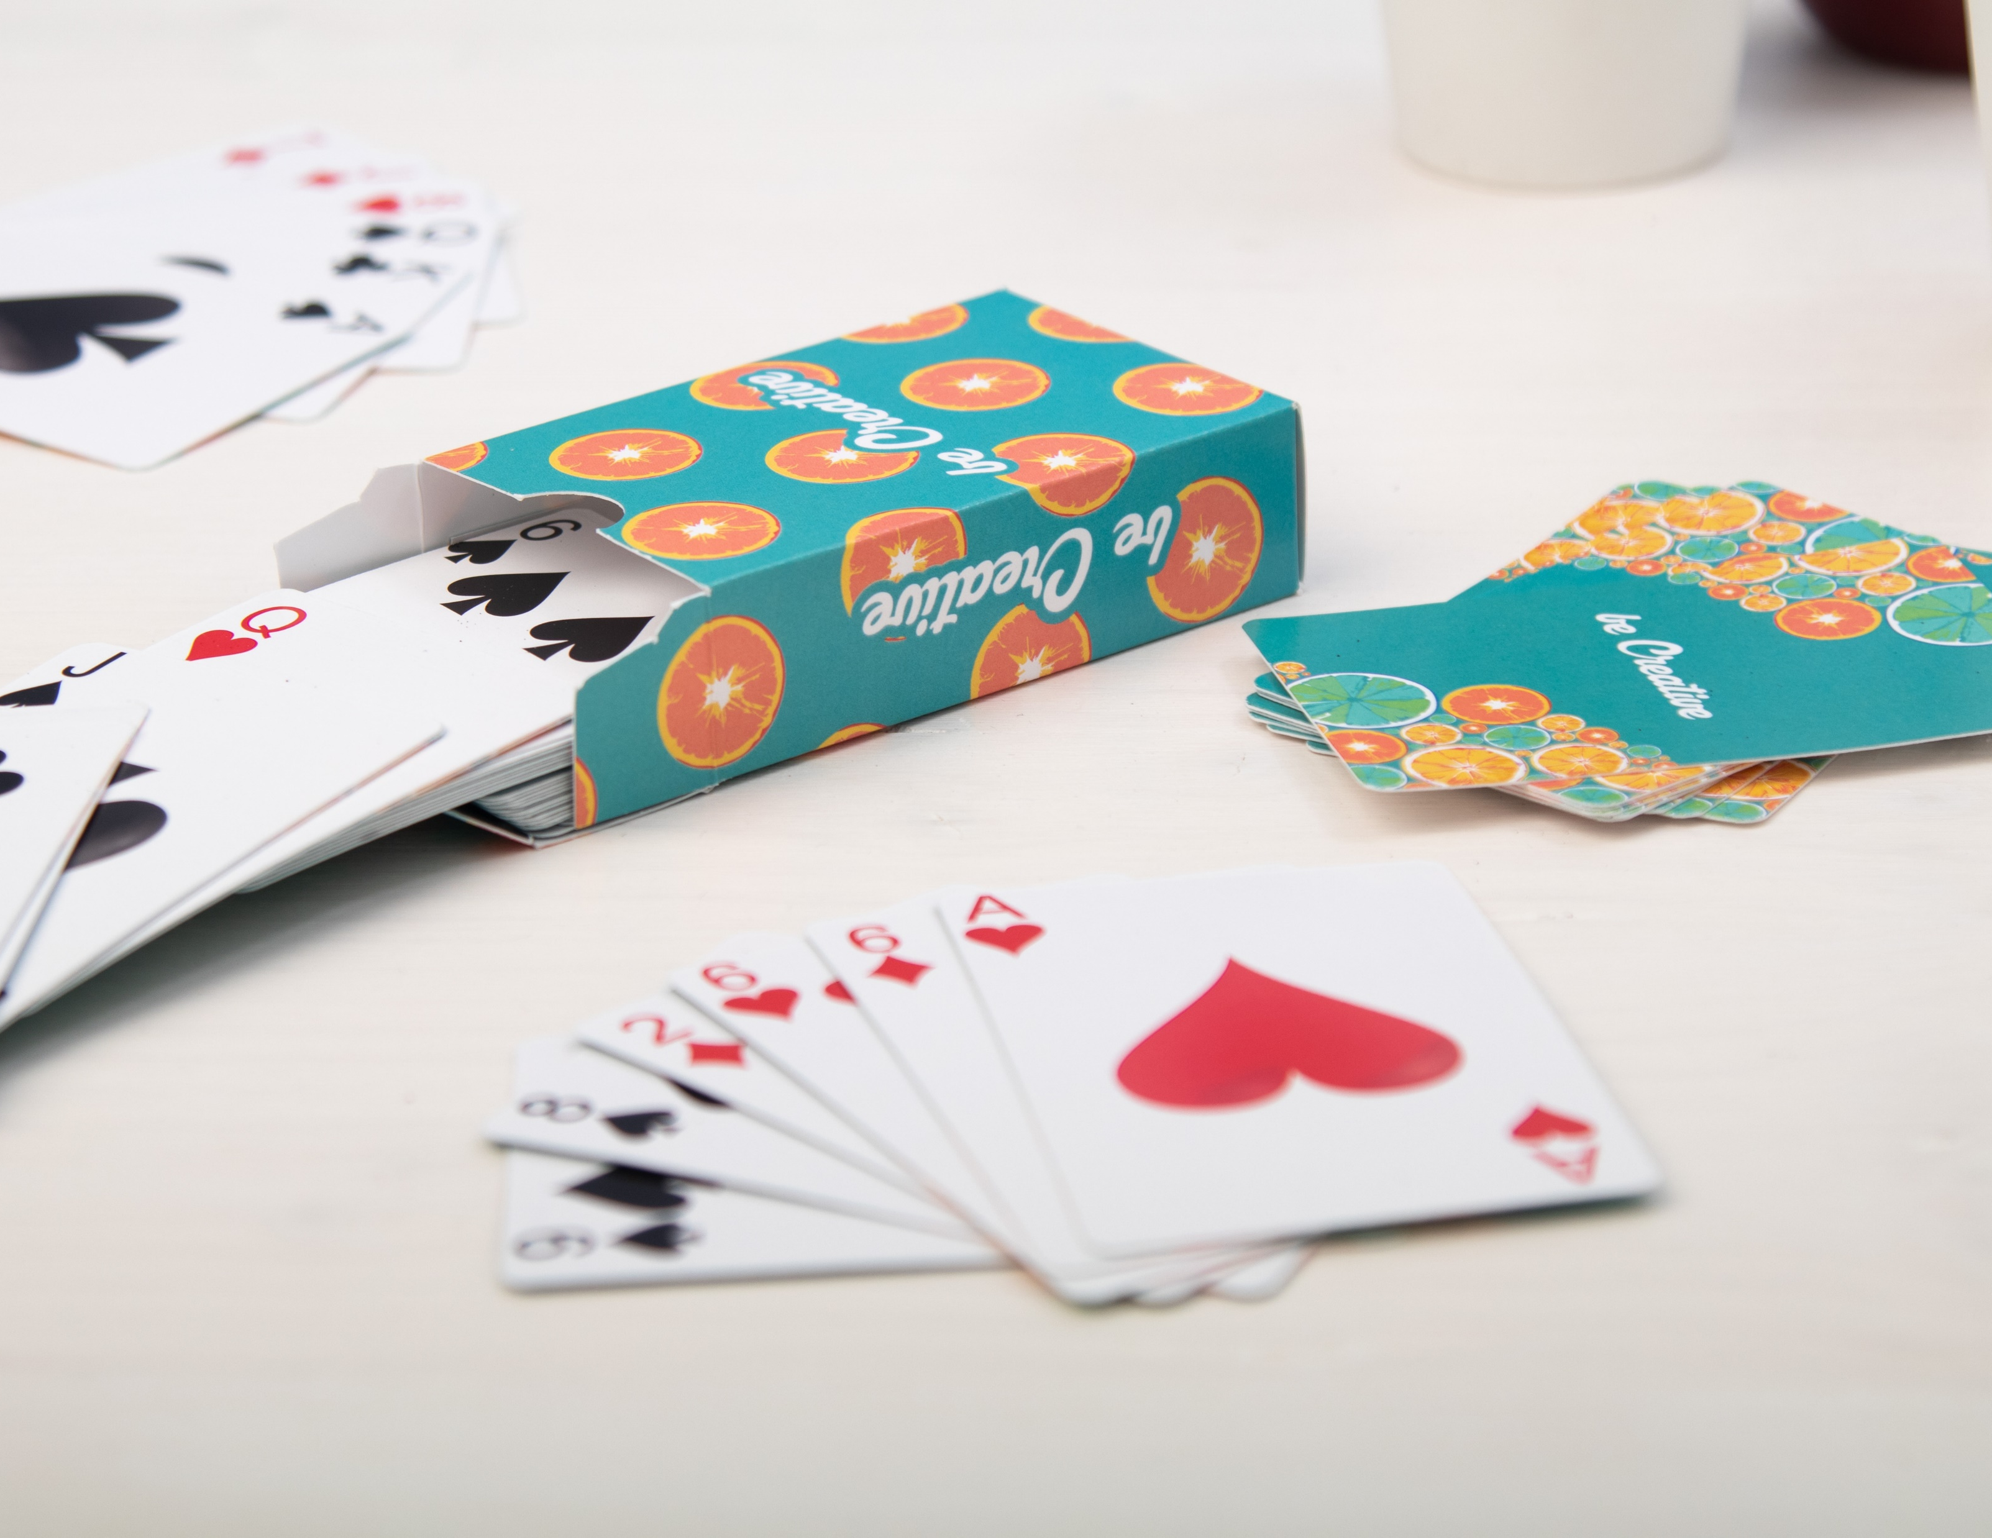
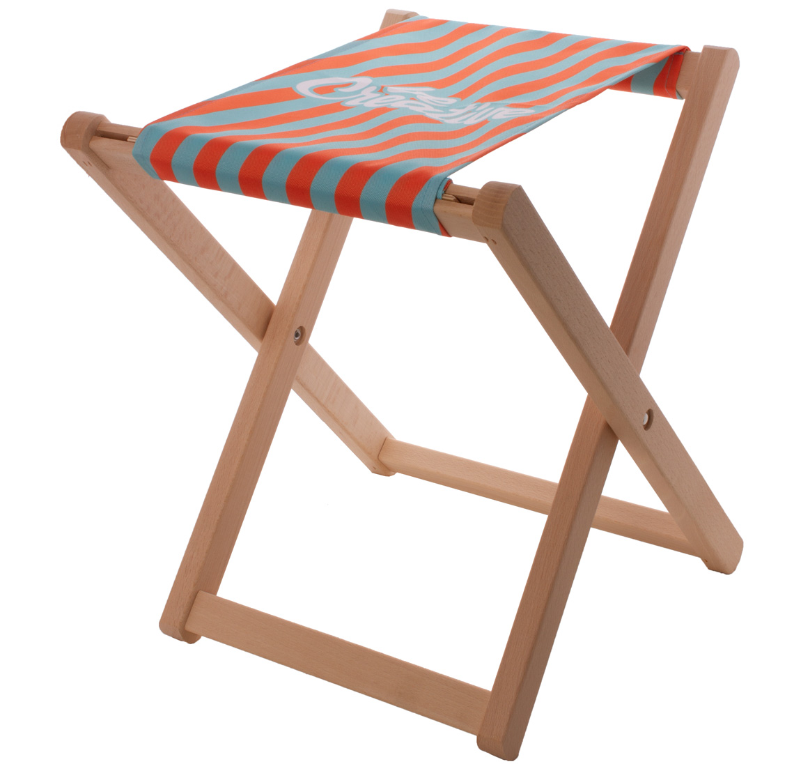
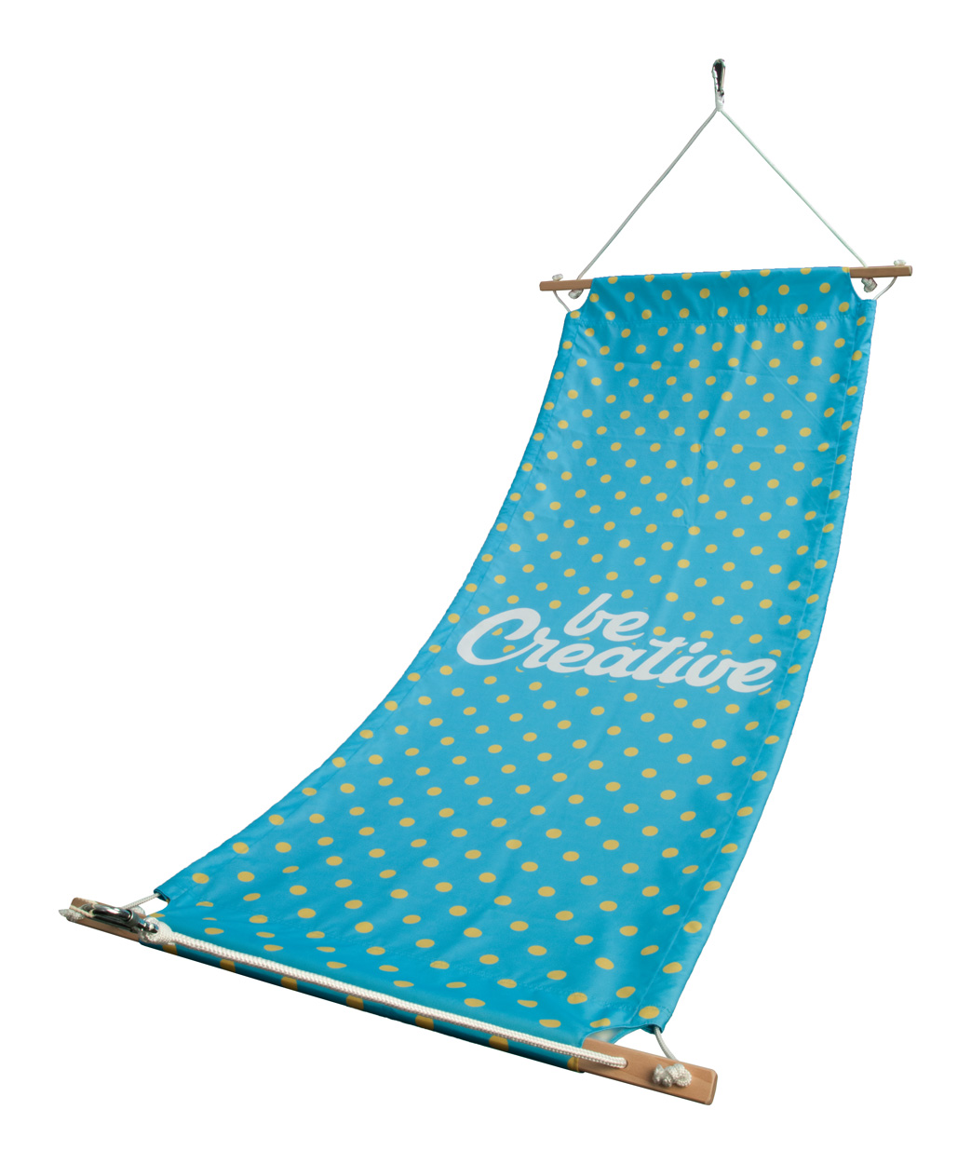
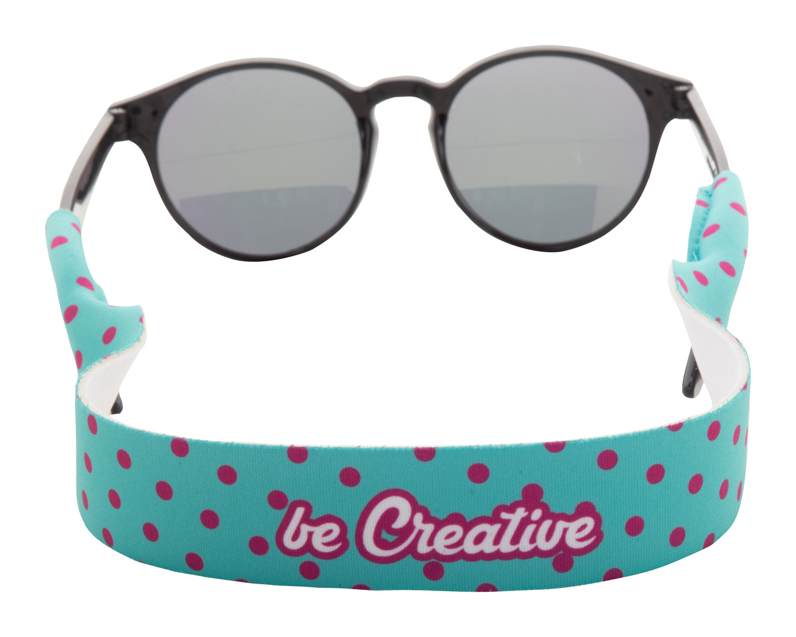
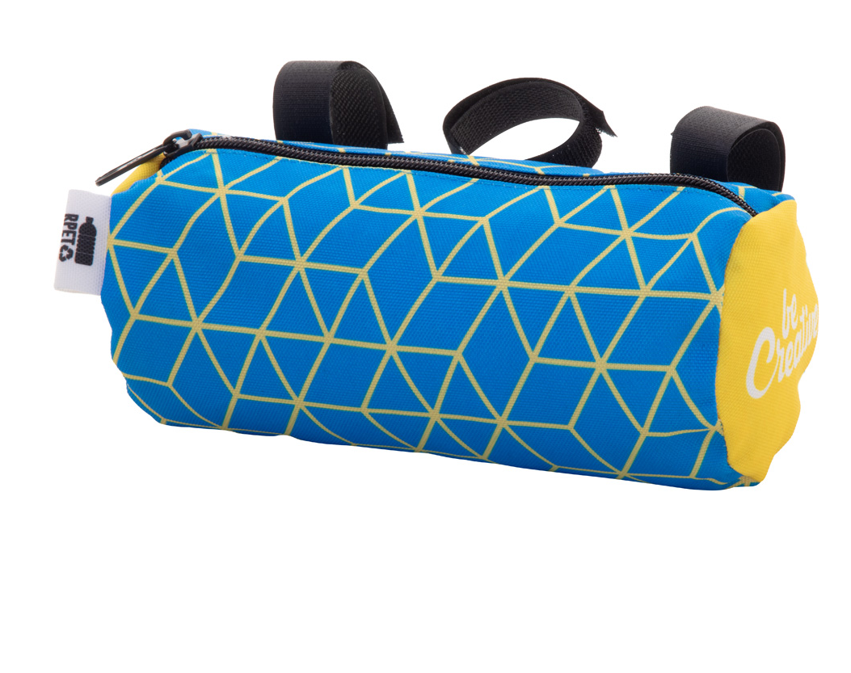
Place your contact details here!
embark on a new adventure
Summer is finally here and the weather is perfect for spending time outdoors with your favourite activities like cycling or relaxing on the beach. Take our custom-made accessories with you to make the most out of every second.
SuboBike Handle AP716661
Custom made, zipped bicycle handlebar bag in 600D RPET polyester with adjustable velcro straps.
00,00 EUR
PrintCan AP716426
Custom made neoprene cooler cover for 0,33 L standard-type aluminium can.
00,00 EUR
CreaCard AP716550
Custom made, French playing cards in paper box.
00,00 EUR
Nissi
AP716645
Wooden beach stool with sublimation printed 600D RPET polyester fabric. 00,00 EUR
Mayaba
AP716644
Custom made hammock with full colour printed 600D RPET polyester fabric and wooden frame. 00,00 EUR
Fanseat Fold
AP716666
Custom made, neoprene sunglasses strap. With all over sublimation printed graphics.
00,00 EUR
SuboBike Handle
AP716661
Custom made, zipped bicycle handlebar bag in 600D RPET polyester with adjustable velcro straps.
00,00 EUR
Place your promotional conditions here!
.......
.......
.......
www.WriteYourWebsiteHere.com

