Slide 1
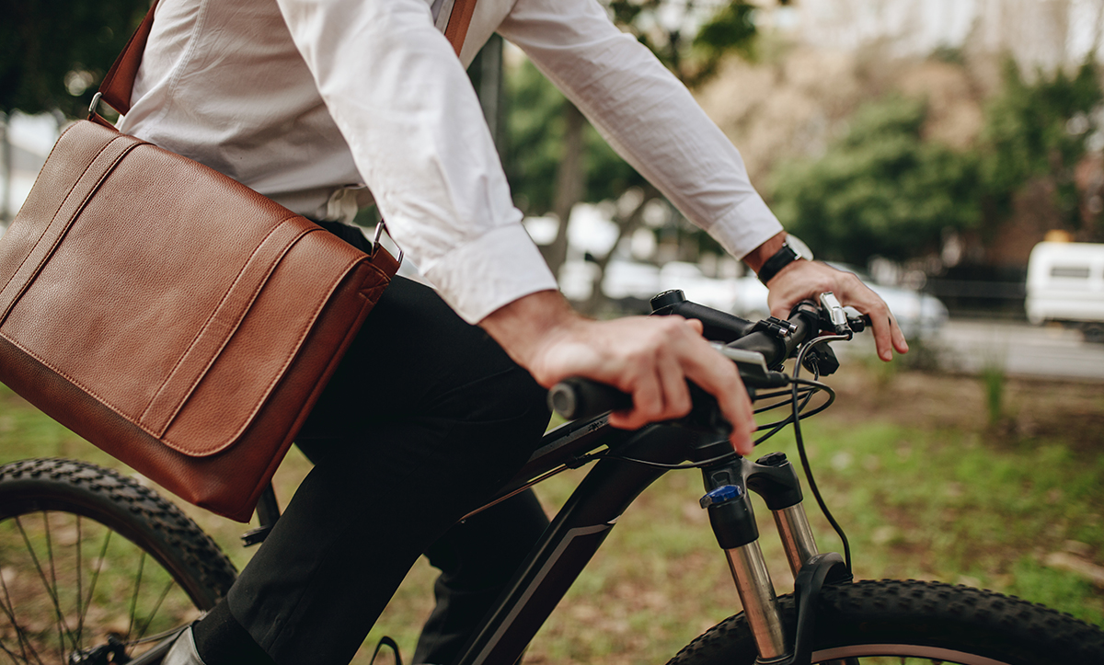
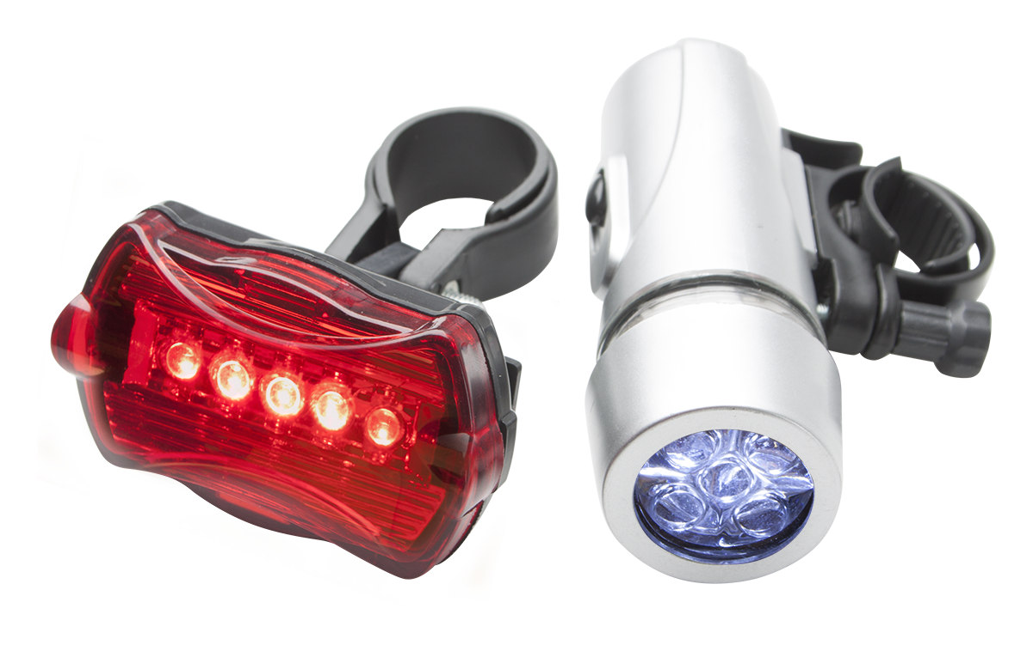
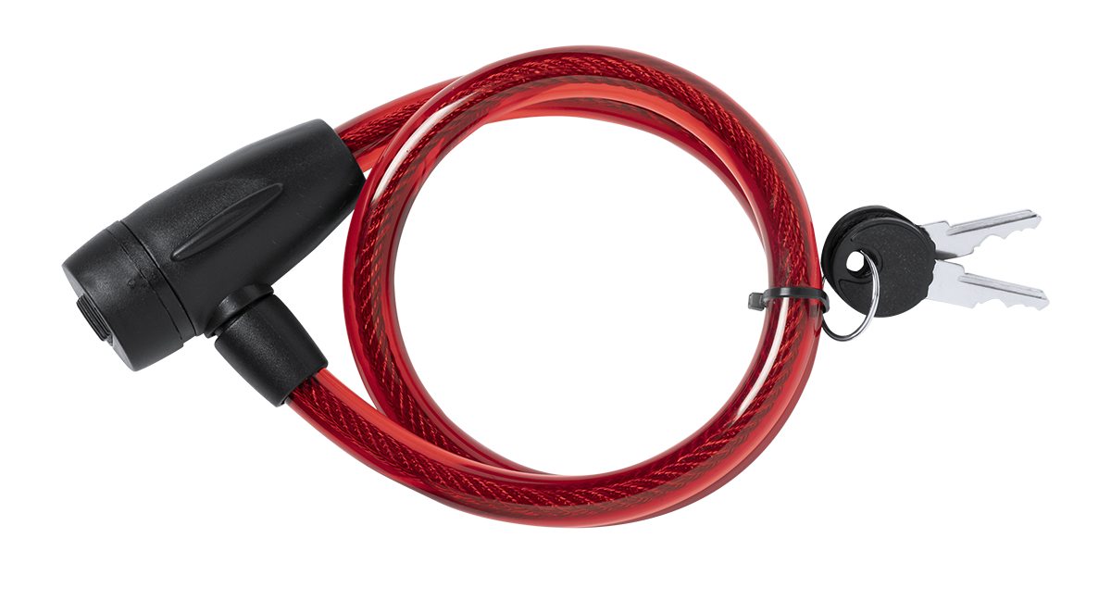
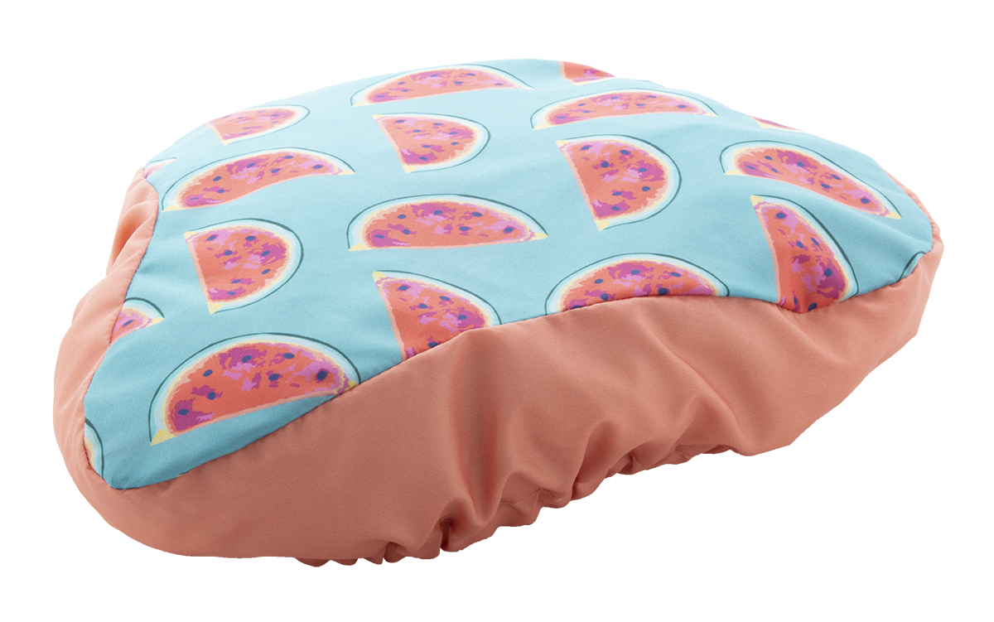
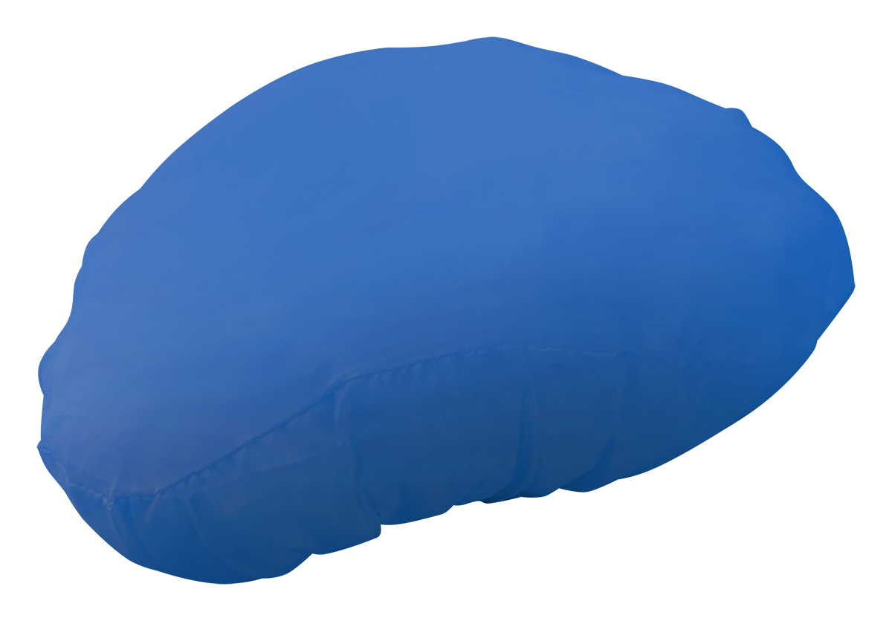
Place your contact details here!
TRAVEL WITH CONFIDENCE
Enjoy your time and discover the world with your bicycle! We provide the proper tools to make your journey more comfortable! Check out our collection and start arranging your next destination.
WIGGINSAP809467
Plastic bicycle light set with handlebar and seatpost mounts. With 5 LED front light and 5 LED rear blinker. Operates with 6 AAA batteries, delivered without batteries.
.0,000 EUR
TRIYOAP721480
Bicycle lock with PVC-coated steel wire and 2 keys.
0,000 EUR
CREARIDEAP718369
Custom made, full colour printed bicycle seat cover with elastic band, 190T polyester. Price includes sublimation printing. MOQ: 100 pcs.
0,000 EUR
TRAXAP810375
Bicycle seat cover with elastic band, 190T polyester.
0,000 EUR
Place your promotional conditions here!
.......
.......
.......
.......
www.yourwebsite.com

