Slide 1
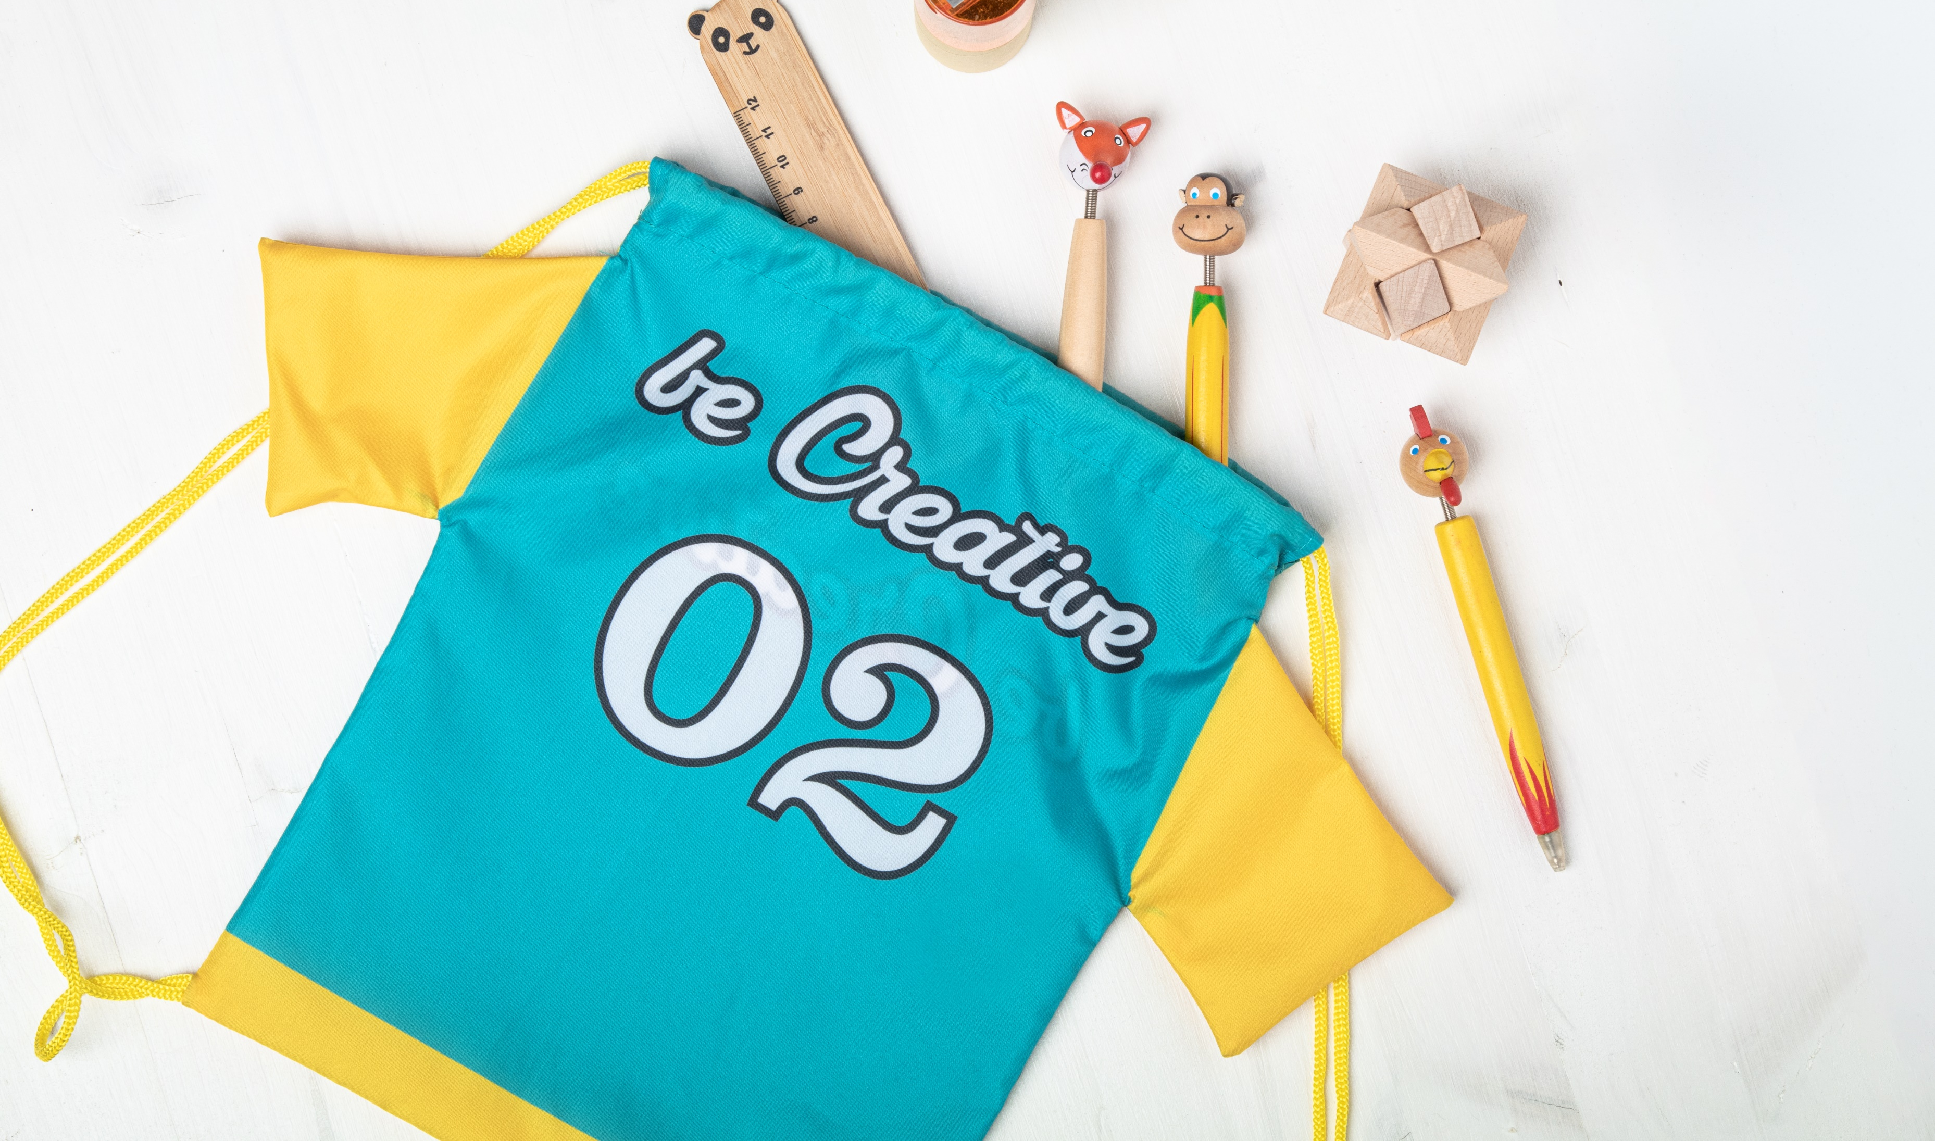
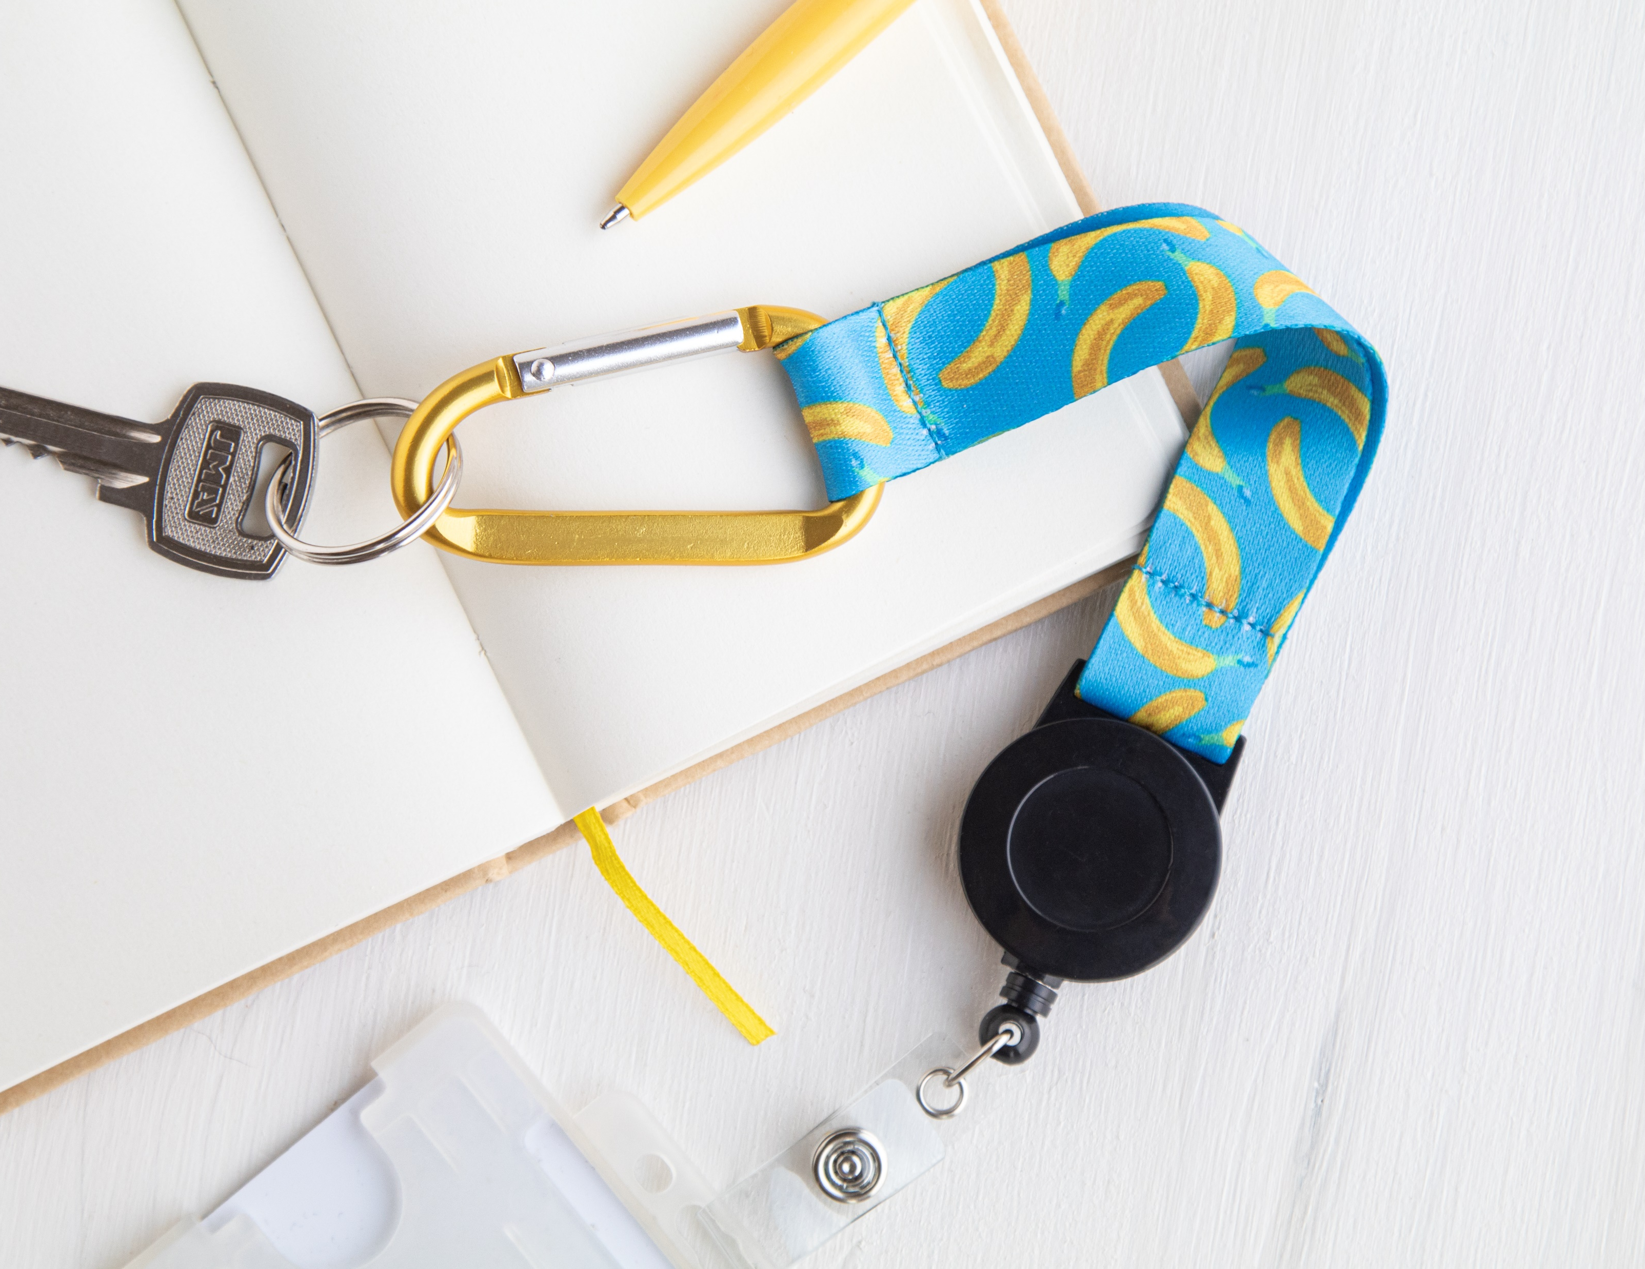
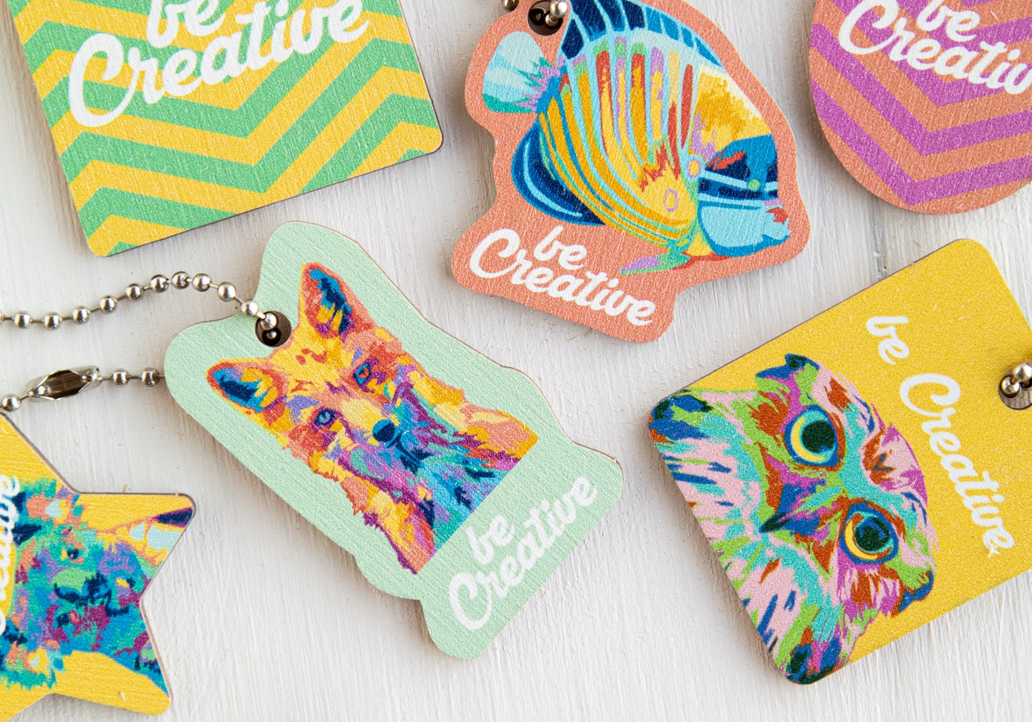
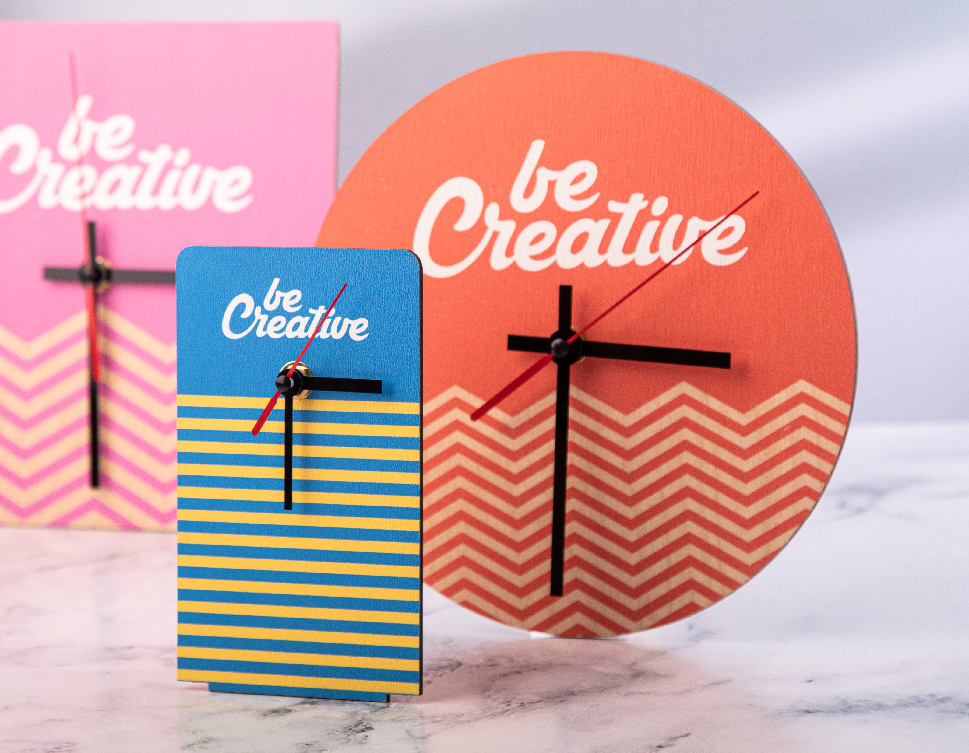
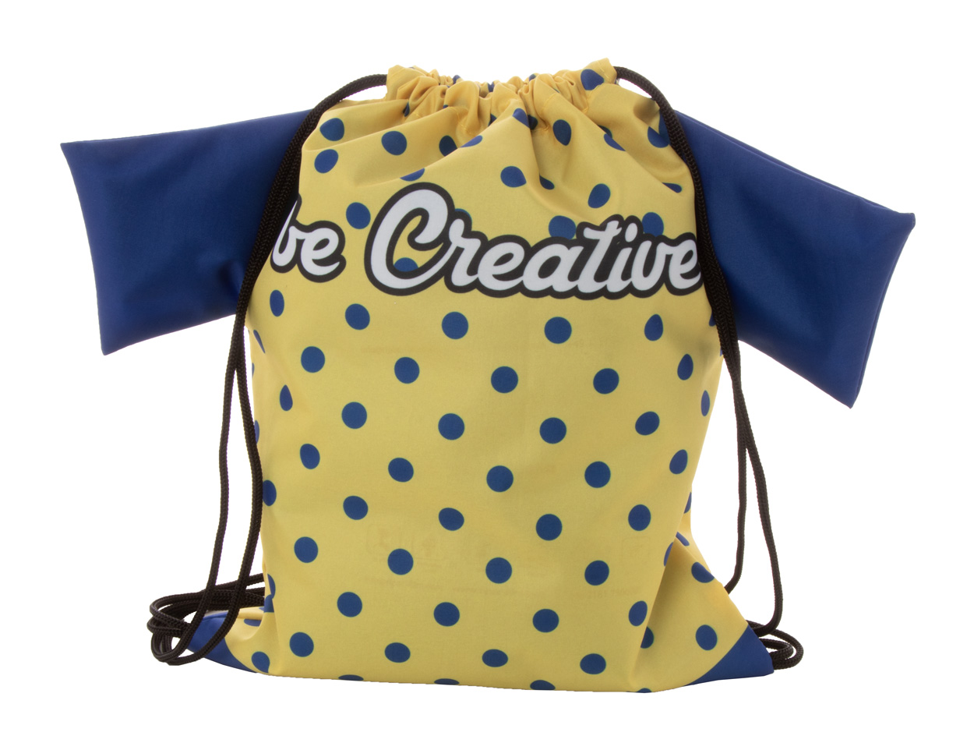
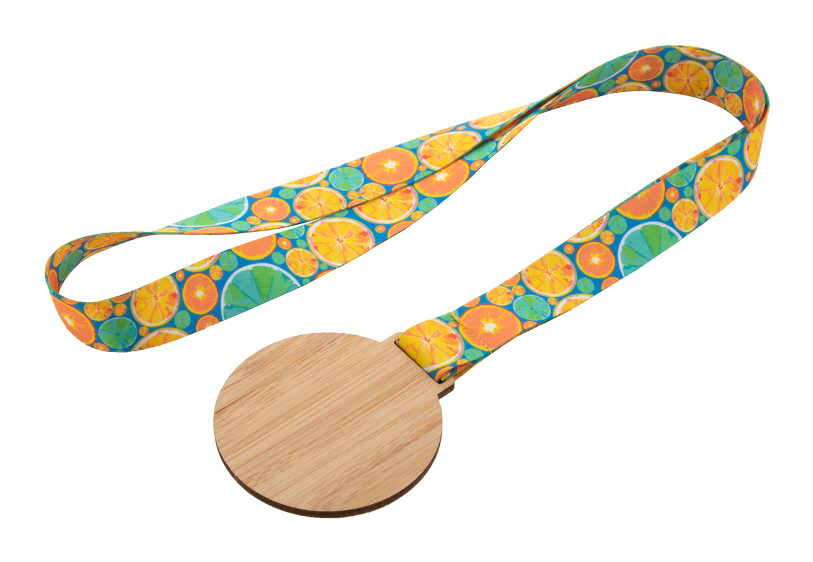
Place your contact details here!
Explore your creativity!
Let your imagination fly and design the perfect look for your promotional gifts. Showcase your brand in the most unique way possible with our BE CREATIVE collection.
Subiner YoYo RPET AP716567
Custom made RPET polyester keyring with sublimation printed graphics on both sides. With inside RPET label, telescopic pass holder, aluminium carabiner and metal keyring.
00,00 EUR
CreaFob Wood AP716564
Custom made, birch plywood keyring with full-colour printing and metal chain.
00,00 EUR
BeTime Wood D AP716613
Custom made, square shaped birch plywood wall clock with custom graphic. 00,00 EUR
CreaScrape
AP716569
Custom made plastic ice scraper with 600D RPET polyester glove. 00,00 EUR
CreaDraw T Kids
AP716552
Custom made, T-shirt shaped drawstring bag for children with coloured strings, 190T polyester.
00,00 EUR
Pavesave AP716580
Custom made, 600D RPET polyester dog waste bag dispenser with metal carabiner. 00,00 EUR
Subdal Eco AP716633
Custom made, bamboo medal on sublimation printed RPET lanyard. 00,00 EUR
Place your promotional conditions here!
.......
.......
.......
www.WriteYourWebsiteHere.com

