Slide 1
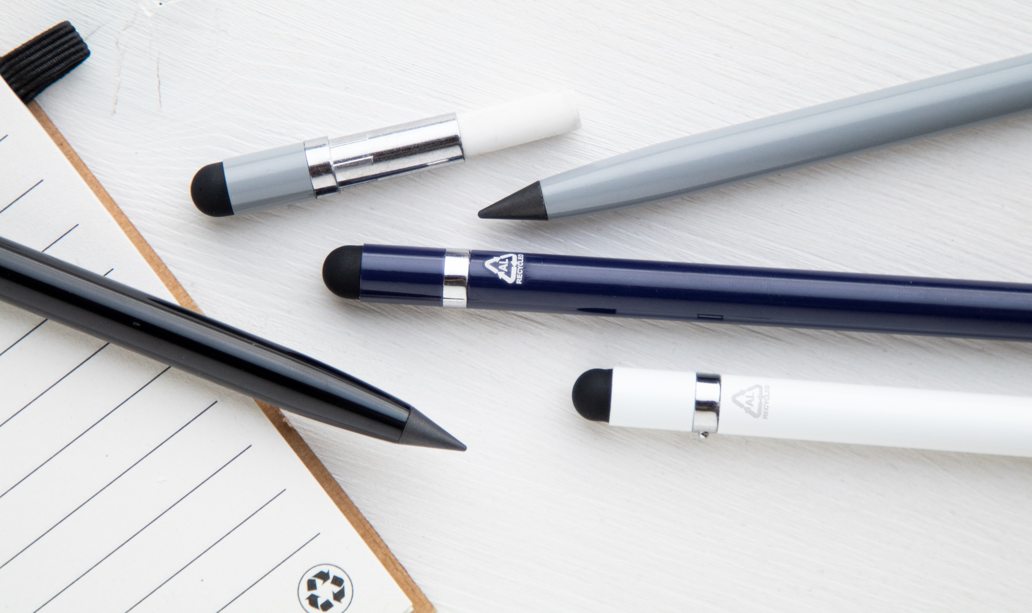
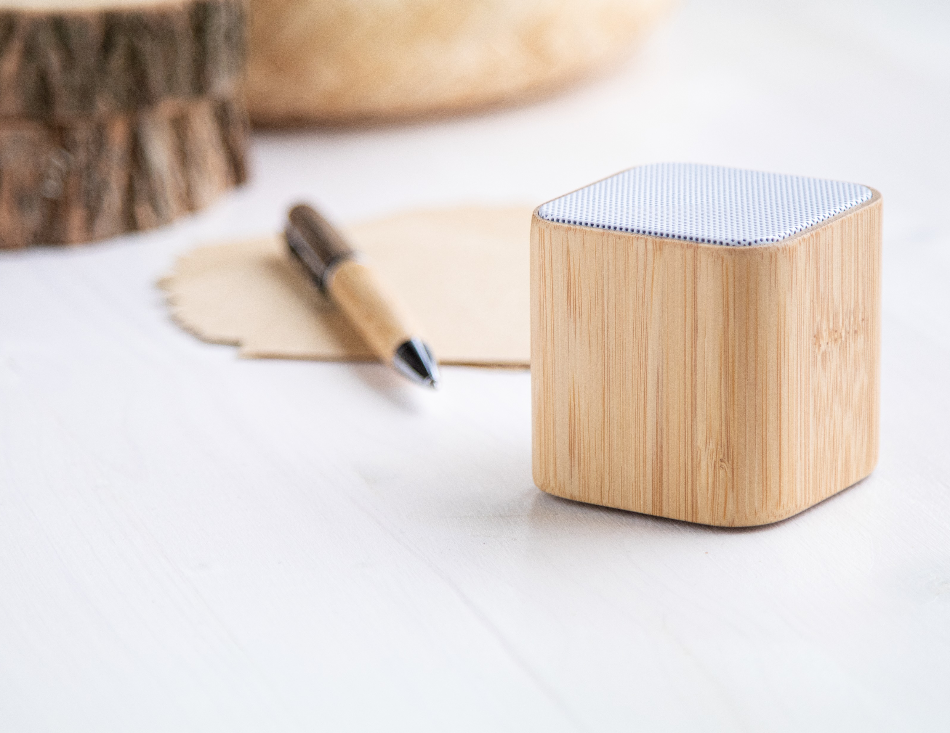
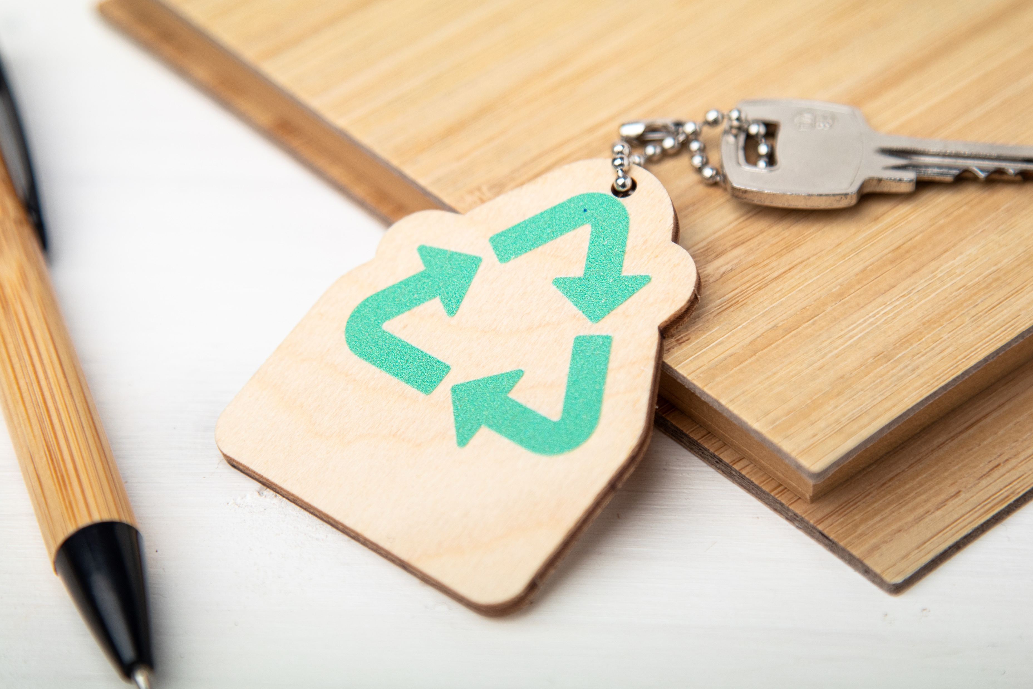
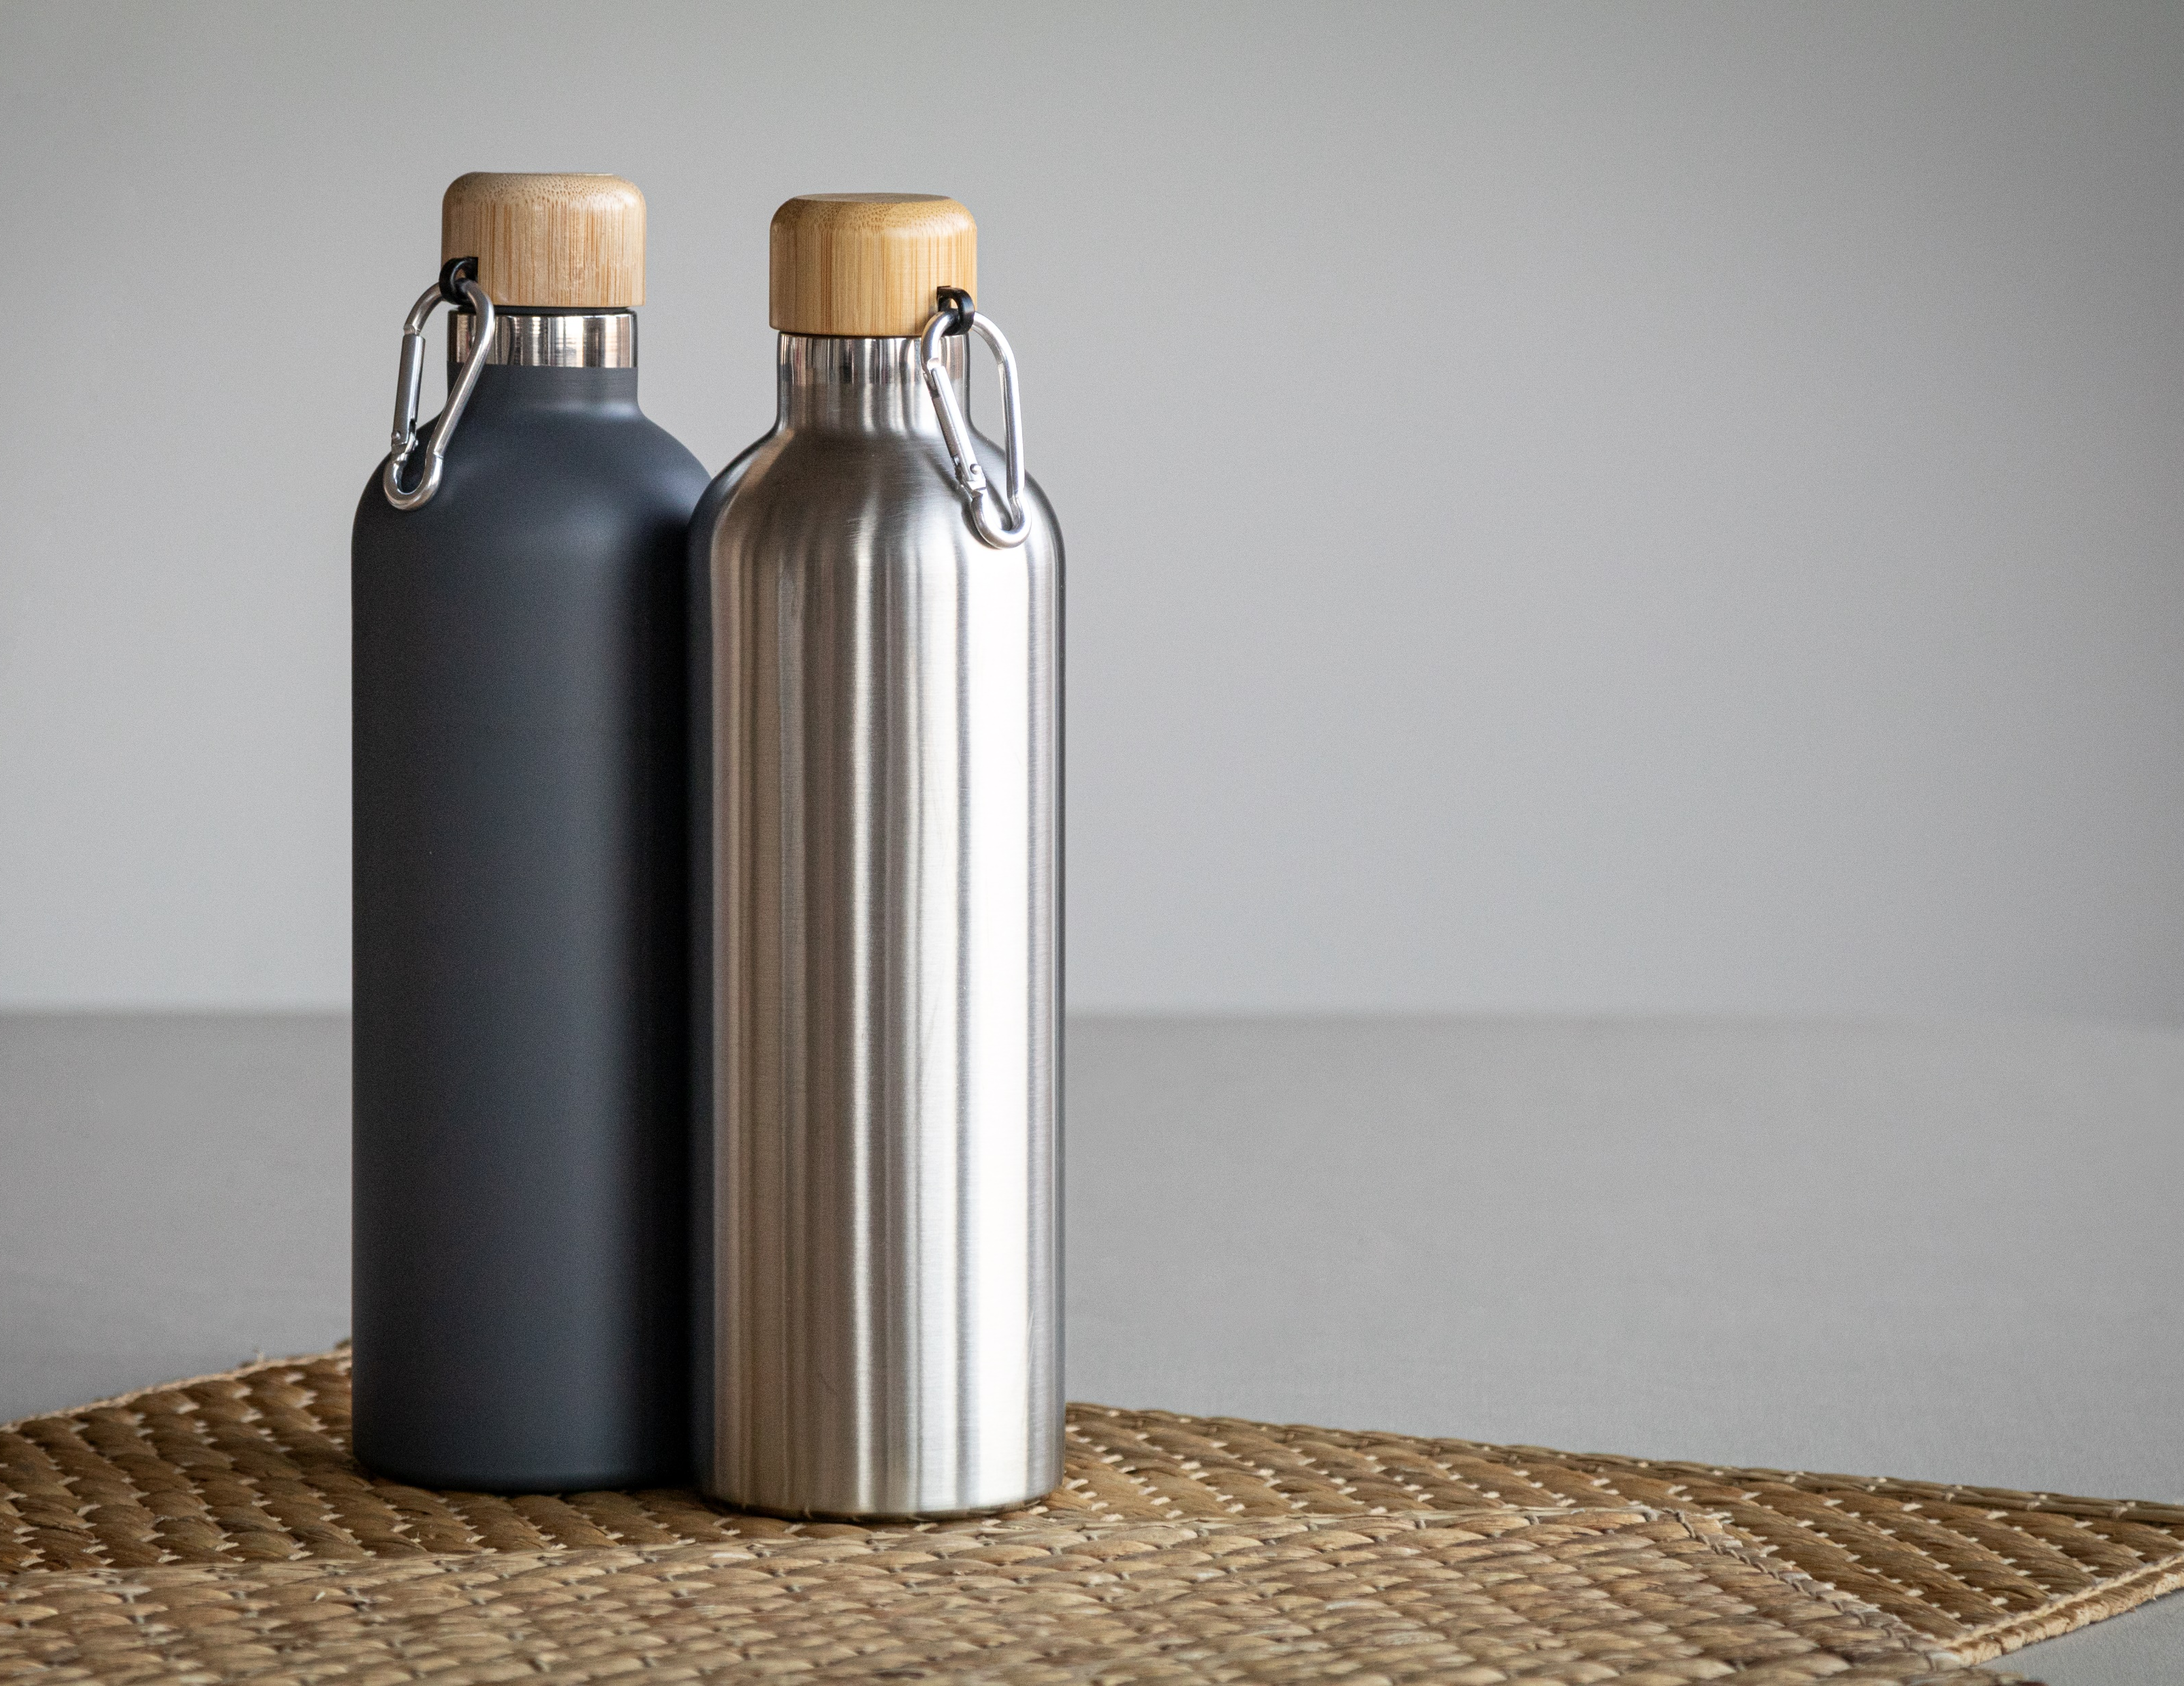
Place your contact details here!
Make the greener choice!
Our GO GREEN collection has expanded with a wide range of new natural, reusable and sustainable promotional gifts. Choose greener alternatives to traditional items and create an eco-friendly image for your company.
Cuboo AP800532
Bluetooth speaker in bamboo housing with hands-free call function and built-in rechargeable battery. Including USB charger cable.
00,00 EUR
EcoRing AP716563
Birch plywood keyring with metal chain and environment protection themed design. 00,00 EUR
Vacobo AP808051
Double wall stainless steel insulated vacuum flask with bamboo lid and carabiner, 500 ml.
00,00 EUR
Donson
AP800530-21
Wireless fast charger (15W) in recycled aluminium and bamboo housing. Including USB charger cable.
00,00 EUR
Eravoid
AP800502
Recycled aluminium, long-lasting inkless pen with touch screen stylus and metal alloy tip, which oxidizes the paper.
00,00 EUR
Rebento AP808052
Recycled PP plastic lunch box with bamboo lid, cutlery set (knife and fork) and elastic strap. 500 ml.
00,00 EUR
CreaFelt Money AP716630
Custom made, RPET felt purse with full colour printed flap and back side. With distinctive RPET label.
00,00 EUR
Place your promotional conditions here!
.......
.......
.......
www.WriteYourWebsiteHere.com

