Slide 1
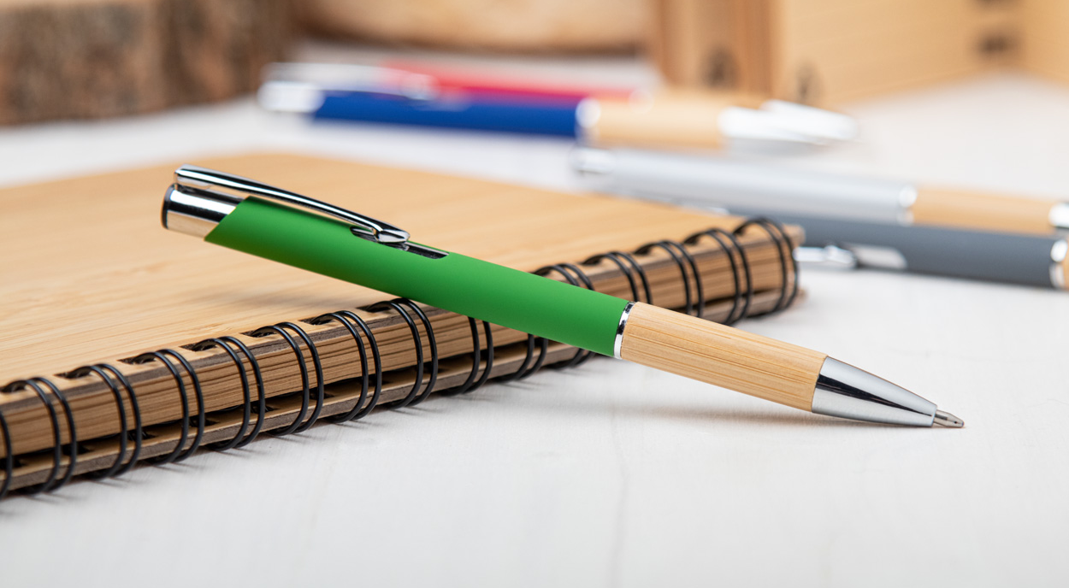
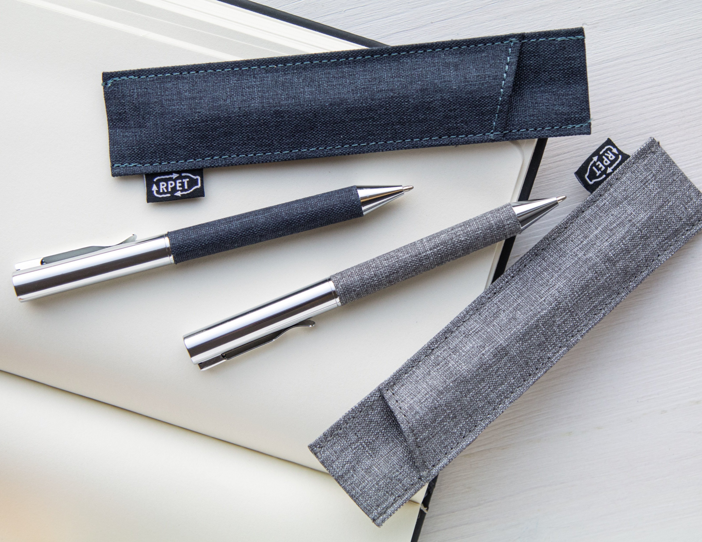

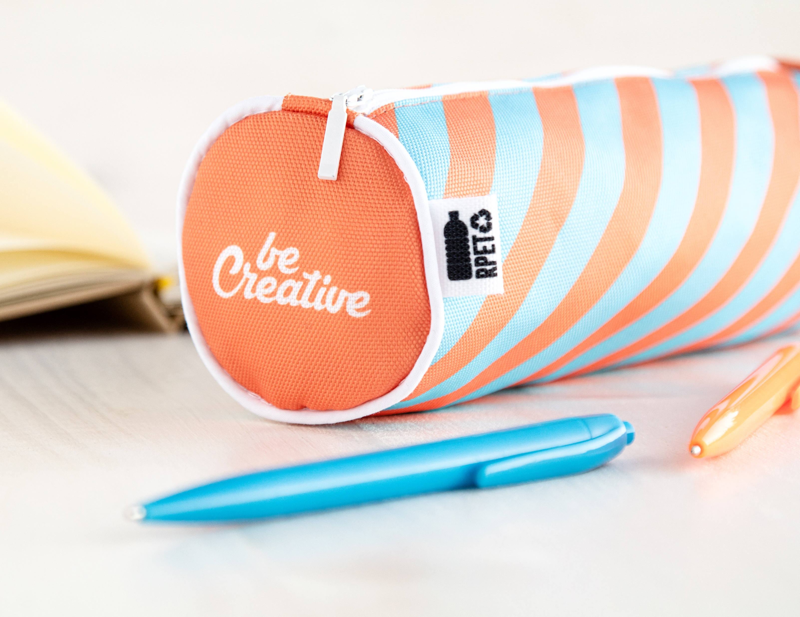
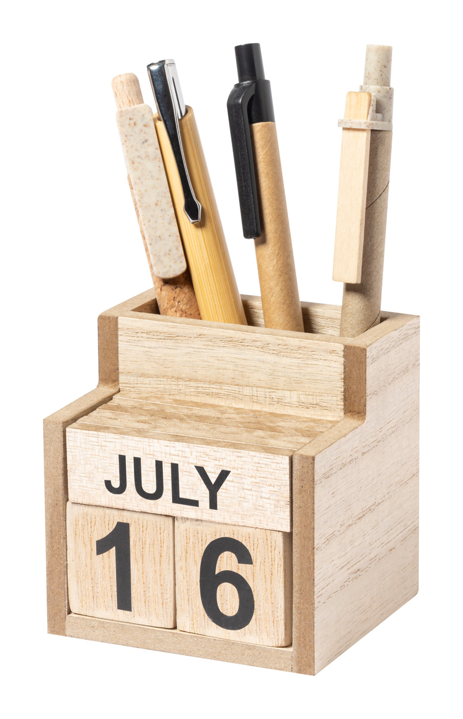
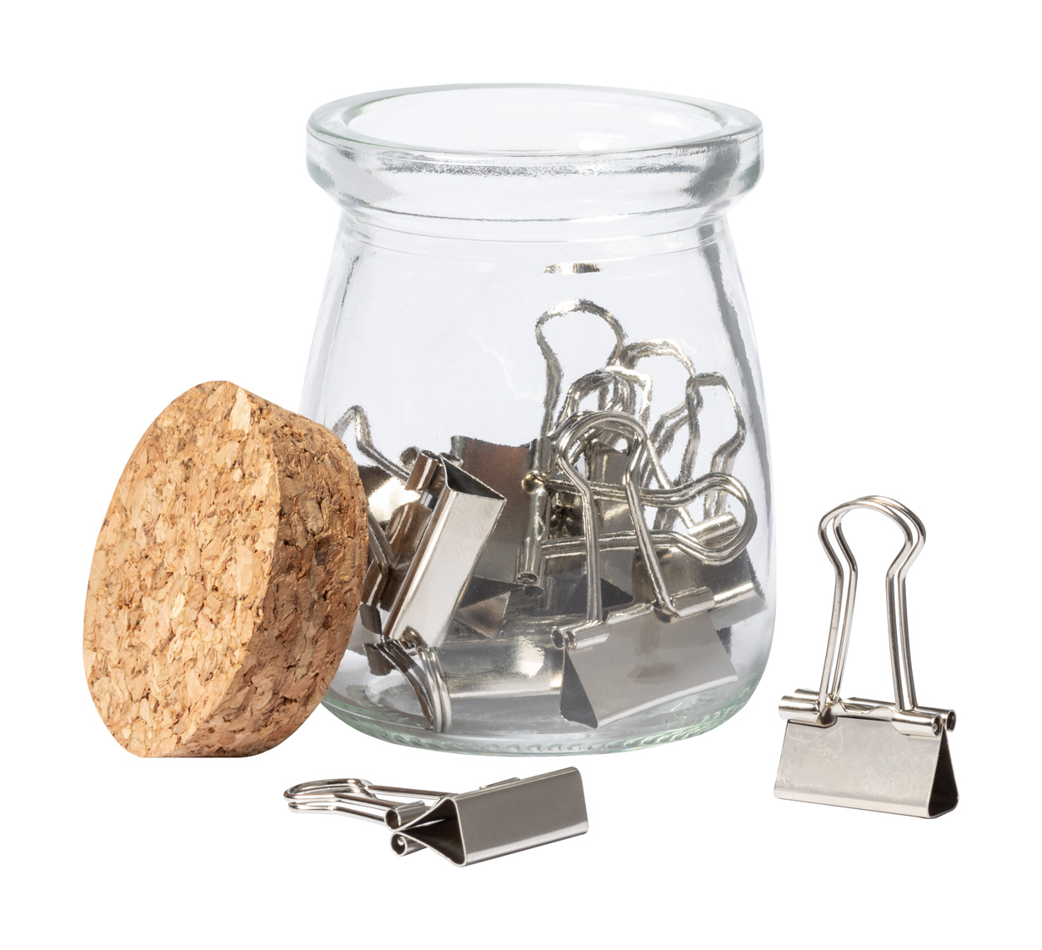
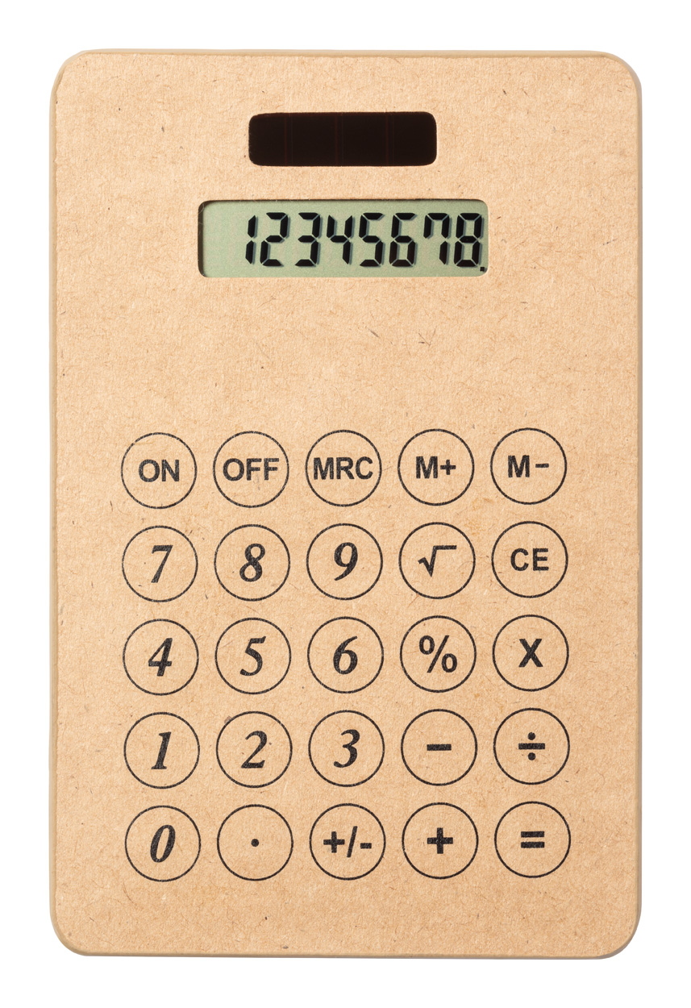
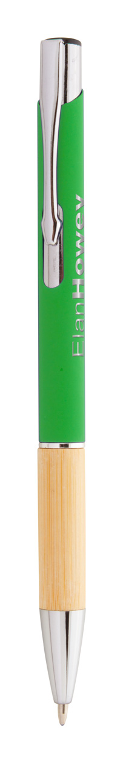
Place your contact details here!
Get down to business!
Aid your customers in personalizing their workstation and in surrounding themselves with colourful, natural or elegant office accessories. Find the ideal items and make your brand a part of everyday working activities.
Teppet AP800498 Metal twist ballpoint pen with RPET polyester covered barrel. In matching RPET polyester case. With blue refill. 00,00 EUR
Drawy 15 AP716610 15 cm flexible plastic ruler with custom graphics.
00,00 EUR
Roppy RPET AP716576 Custom made, round shaped zipped pen case in 600D RPET polyester.
00,00 EUR
Laorek
AP722703
Wooden pen holder with perpetual calendar.
00,00 EUR
Forsen
AP722724
15 pcs metal note clips in glass jar, with natural cork lid.
00,00 EUR
Vulcano
AP722702
8-digit solar powered calculator in recycled paper housing. Including button cell battery. 00,00 EUR
Roonel AP800505
Aluminium ballpoint pen with bamboo grip, rubberized finish and blue refill. 00,00 EUR
Place your promotional conditions here!
.......
.......
.......
www.WriteYourWebsiteHere.com

