Slide 1
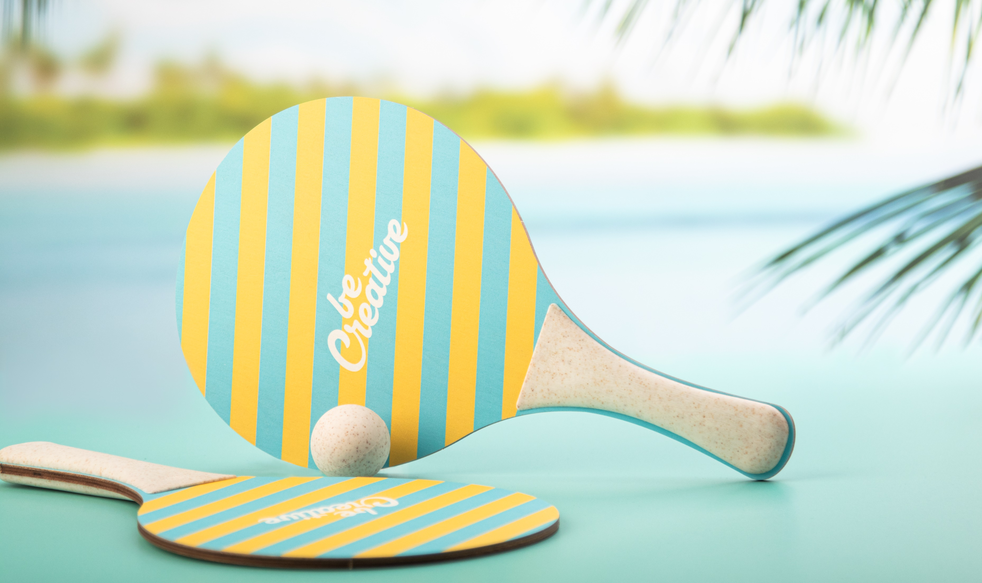
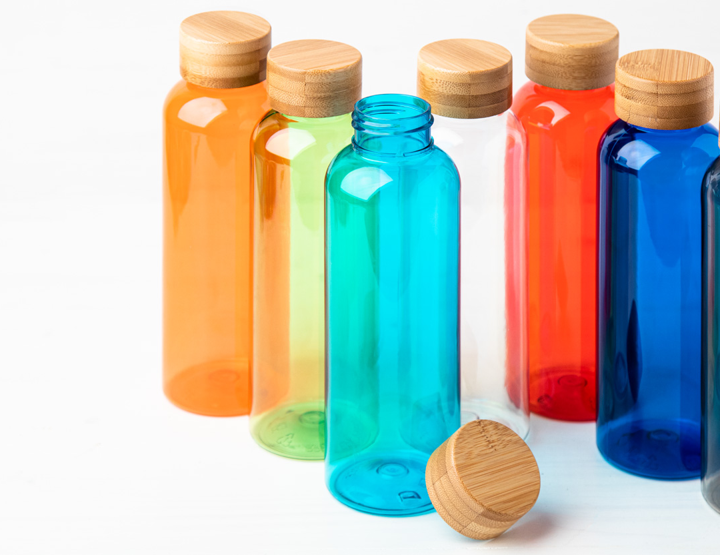
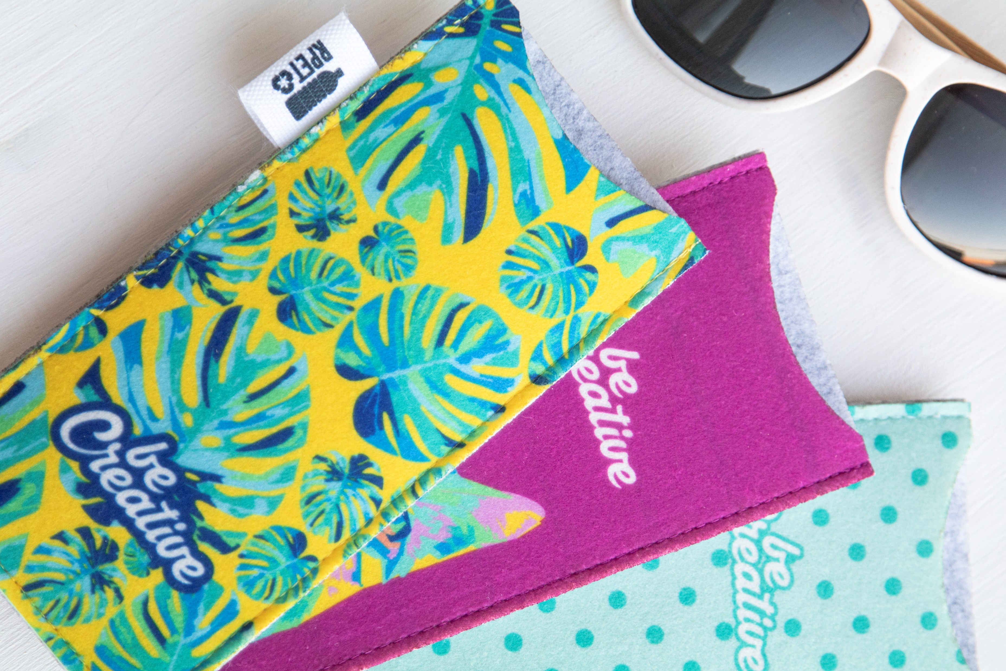
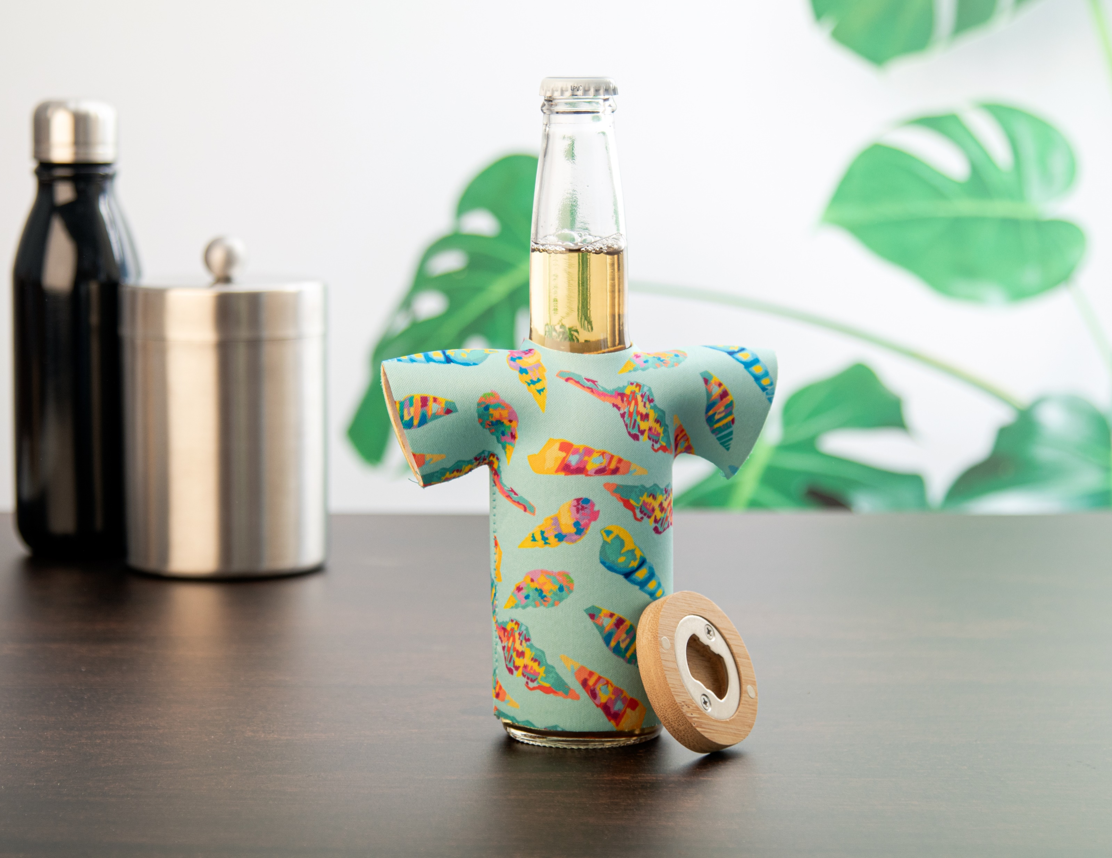
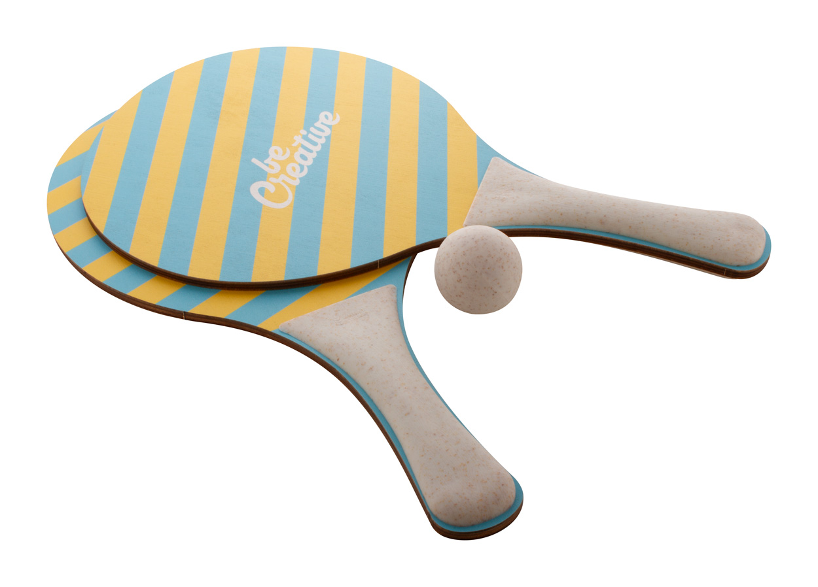
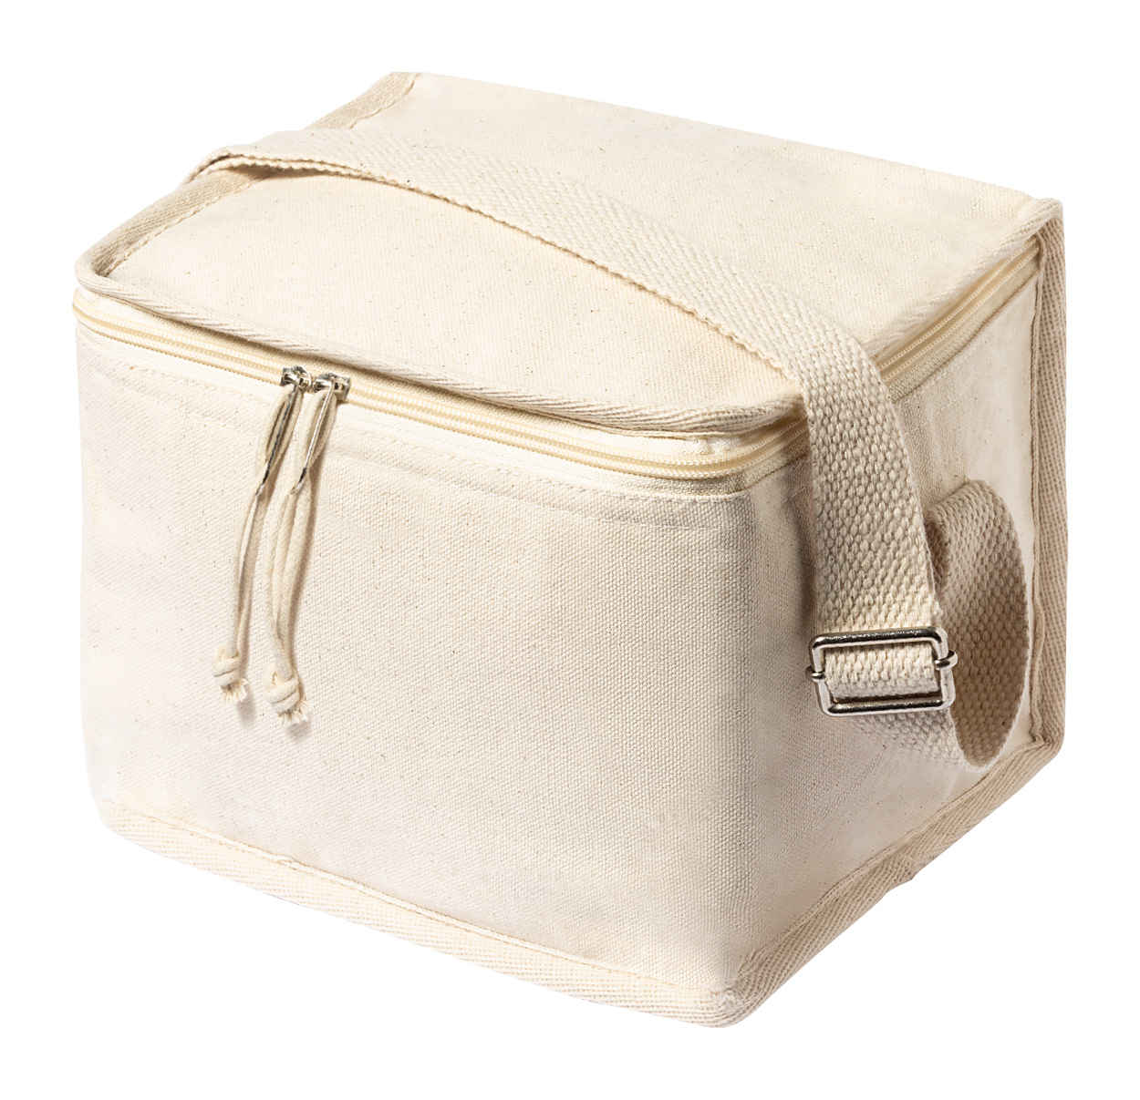
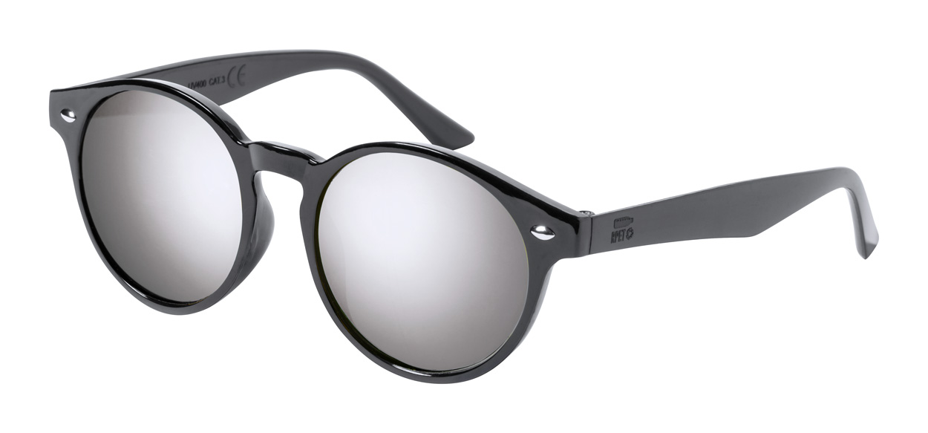
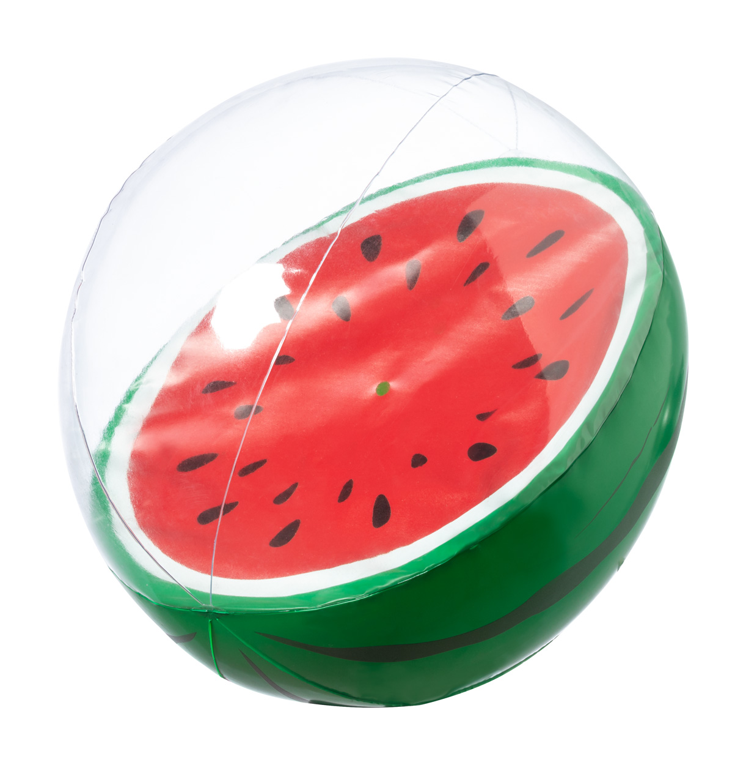
Place your contact details here!
Kick off the summer with style!
Bring the fun to your customers and promote summer adventures with the ideal accessories. The best promotional gifts guarantee that your brand becomes the most memorable part of the beach.
Pemboo AP800492 Sport bottle in BPA-free RPET plastic with bamboo lid, 500 ml.
00,00 EUR
CreaFelt Sun AP716579 Custom RPET felt sunglasses case with full colour printed front side. With distinctive RPET label.
00,00 EUR
PrintBeer AP716616 Custom made neoprene cooler cover for beer bottle.
00,00 EUR
CreaShot
AP716639
Custom made beach tennis with 2 rackets and one ball. Made of birch plywood and ecological wheat straw plastic.
00,00 EUR
Parum
AP722566-00
Zipped cooler bag in cotton with aluminium padding. Including a PP plastic lunch box with bamboo lid and elastic strap, with cutlery set.
00,00 EUR
Poren
AP722834
RPET sunglasses with metallic lenses and UV
400 protection. 00,00 EUR
Darmon
AP722839 PVC beach ball with fruit decoration. Deflated size: 370 mm
00,00 EUR
Place your promotional conditions here!
.......
.......
.......
www.WriteYourWebsiteHere.com

