Slide 1

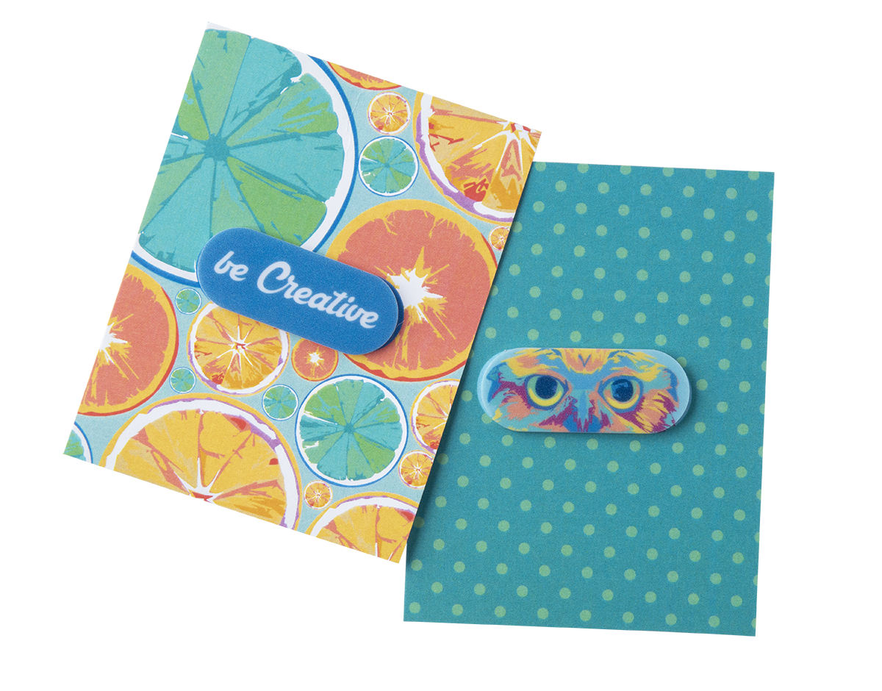
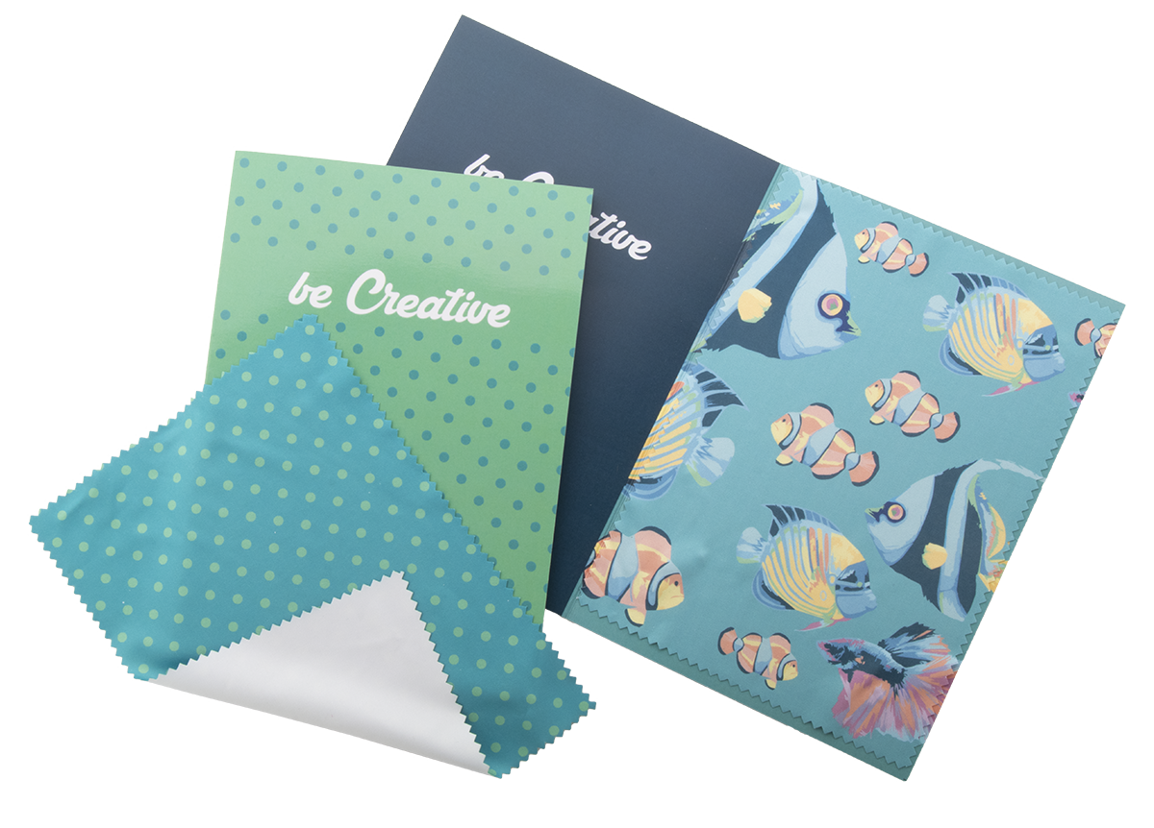
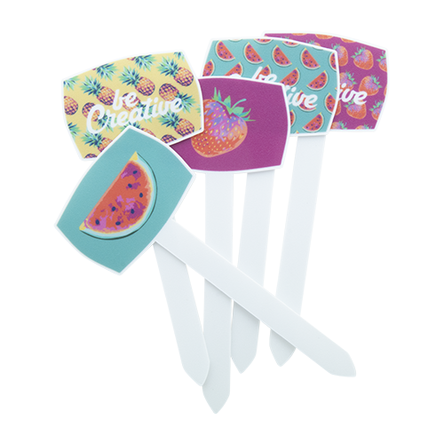
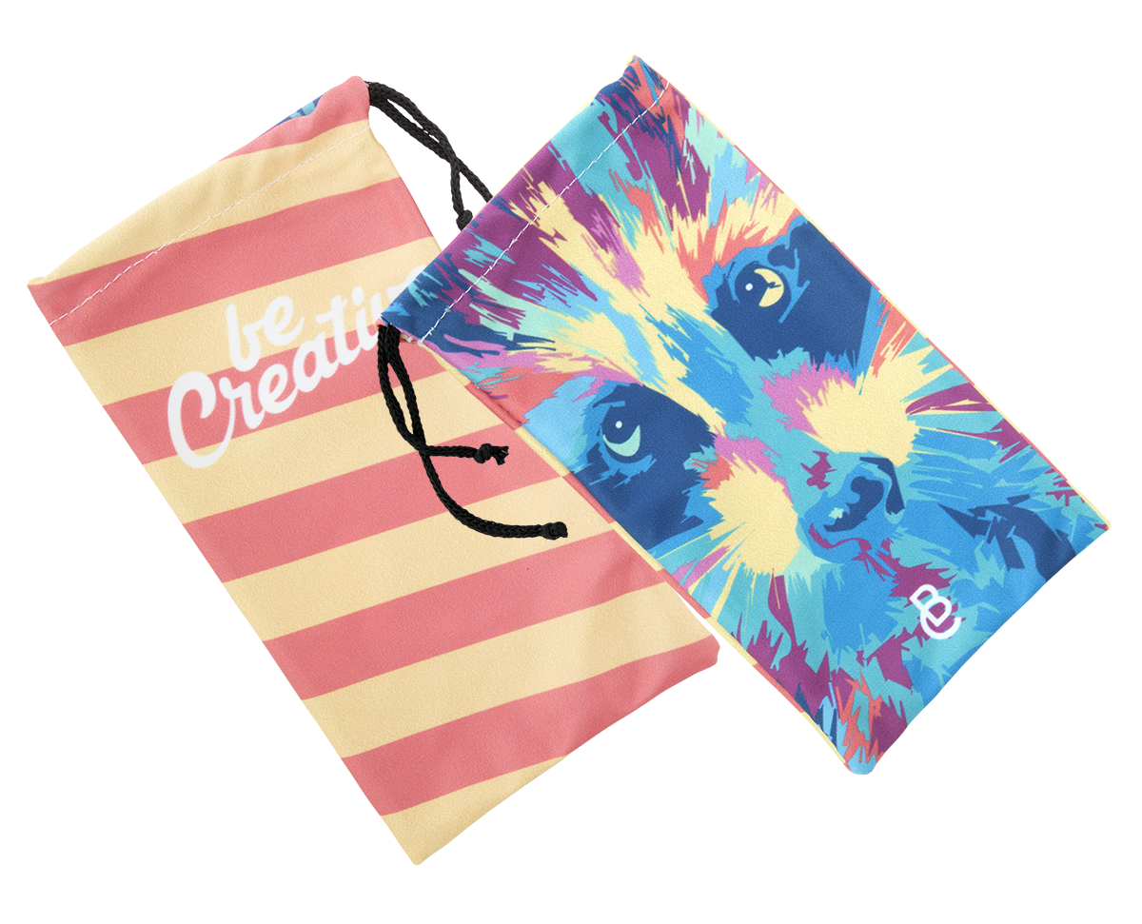
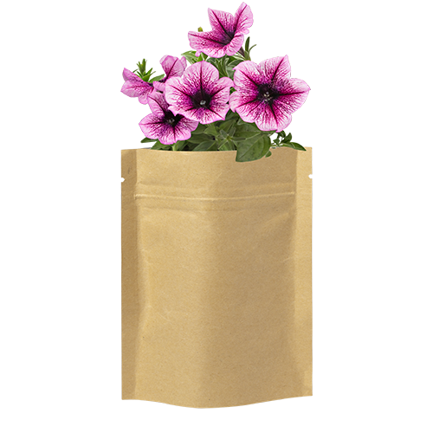
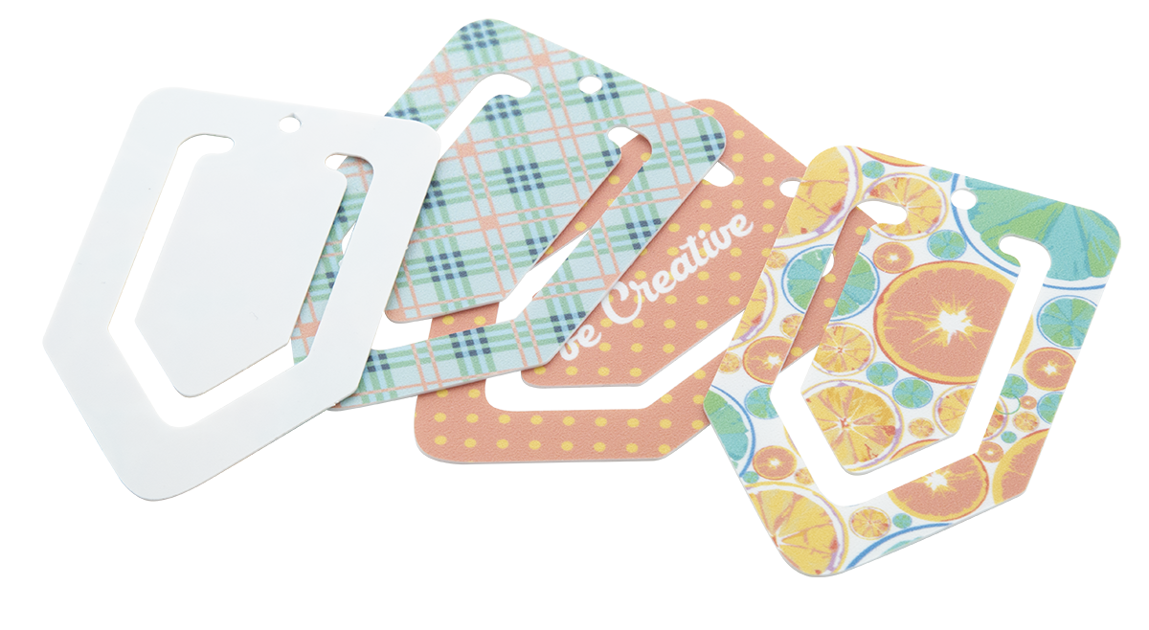
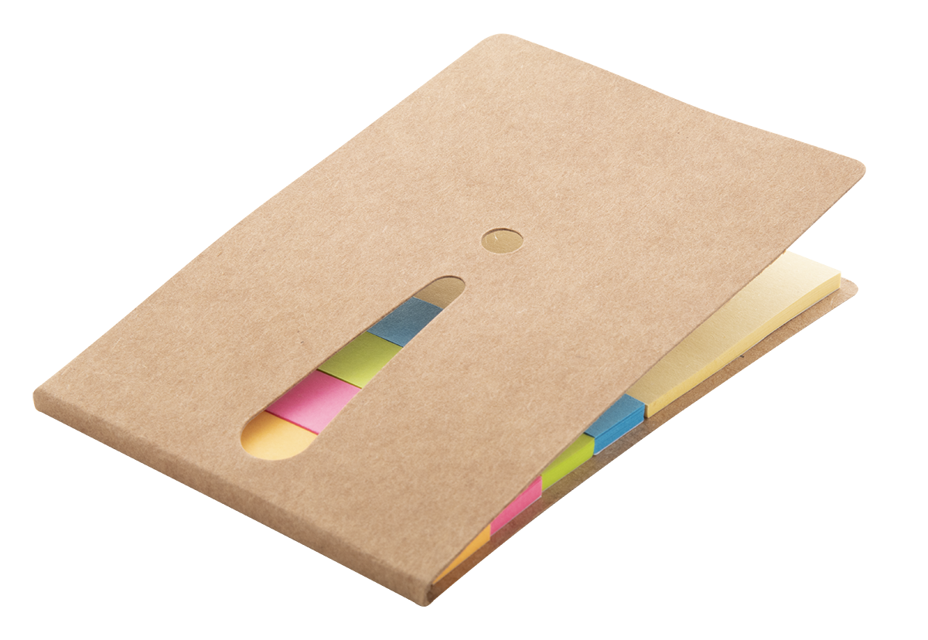
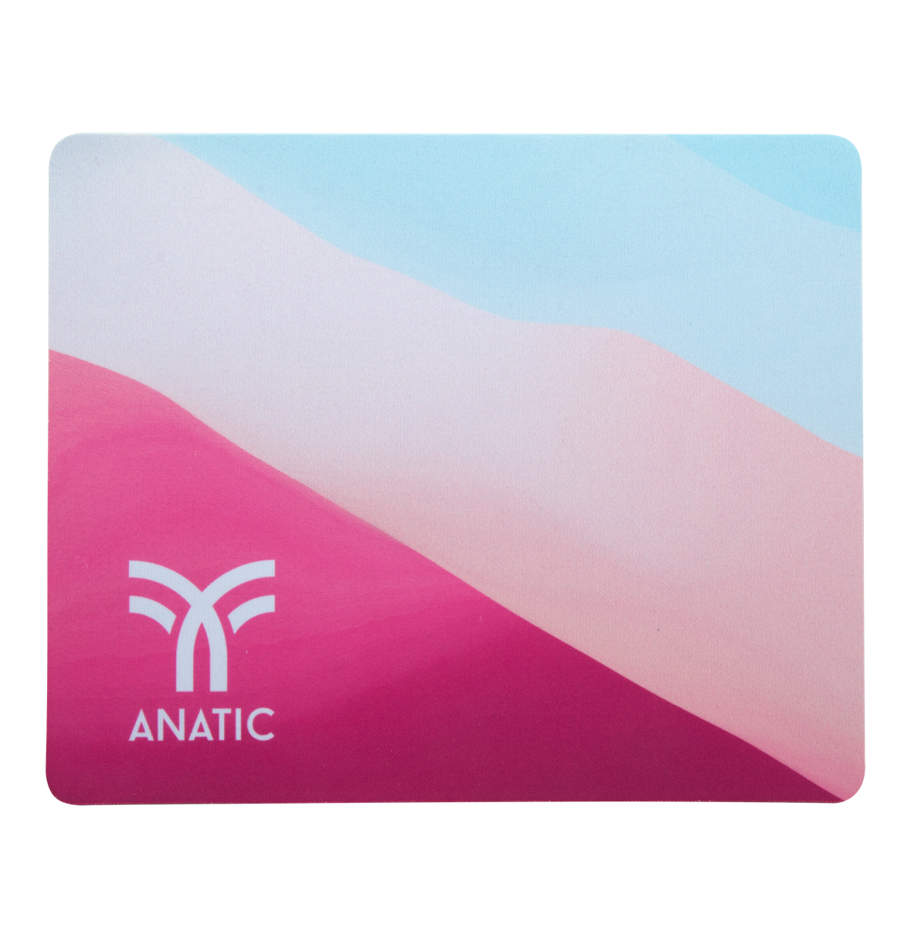
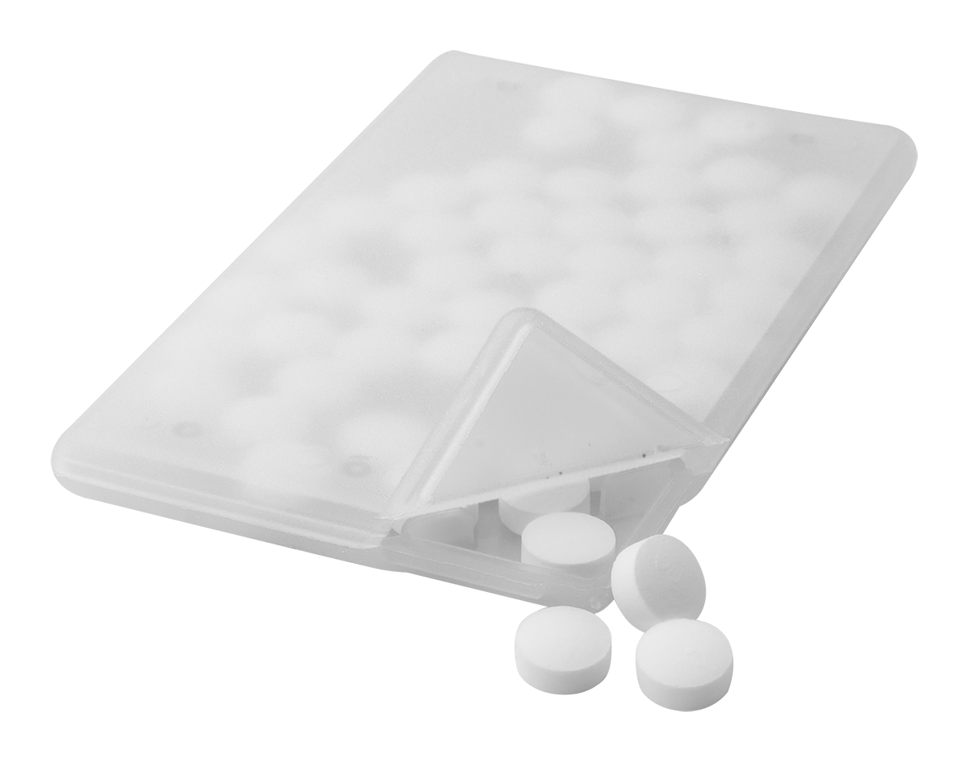
Place your contact details here!
SMALL GIFTS THAT
FIT IN AN ENVELOPE
Do you want your letter to be opened or to organize a promotion?
Are you looking for gifts that can be posted easily? Here is the best selection for you!
CREACAM AP718784
Custom, full colour printed plastic, anti spy webcam blocker with sliding cover and adhesive back. With digital printed paper card. Price includes digital and UV LED printing. MOQ: 100 pcs.
0,000 EUR
DIOPTRY MAIL AP718197
Custom made paper postcard with custom graphic on both sides. Including a sublimation printed microfibre (180 g/m²) cleaning cloth for glasses. MOQ: 100 pcs.
0,000 EUR
PLANTIT AP718368
Full colour printed plastic T-type plant label. Ideal for seed trays or pots. Price includes UV-LED printing on one side. MOQ: 250 pcs.
0,000 EUR
MARXY AP718347
Plastic paper clip bookmark with custom graphics. Price includes UV LED printing on one side. MOQ: 250 pcs.
0,000 EUR
SUBOCALL AP718064
Custom made, polyester mobile phone case with sublimation printed graphics. MOQ: 200 pcs.
0,000 EUR
SOBER AP721479-00
Flower planting kit in laminated paper bag. Including 5-8 petunia seeds in assorted colours.
0,000 EUR
EXCLAM AP800424
Adhesive notepad with 25 large and 100 small notes (in 4 different colours). With die-cut exclamation mark on the cover.
0,000 EUR
SUBOMAT AP812410
Mouse pad for sublimation printing. Price includes sublimation printing. MOQ: 50 pcs. Material: rubber and polyester.
0,000 EUR
CARD AP896000
Card shaped, transparent plastic mint box with cca. 50 menthol candies.
0,000 EUR
Place your promotional conditions here!
.......
.......
.......
.......
www.writeyourwebsitehere.com

