Slide 1

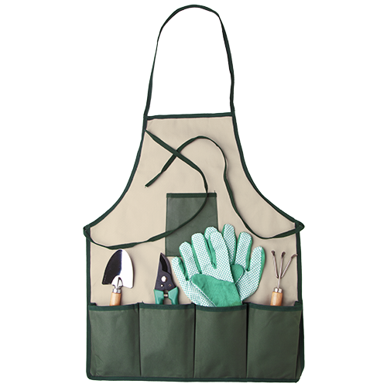
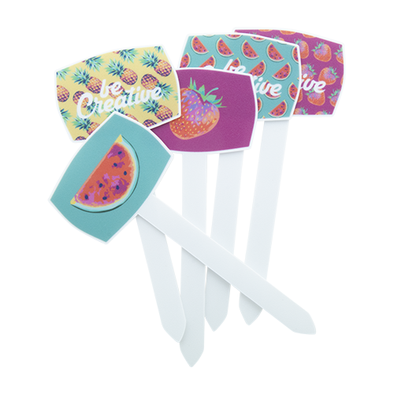
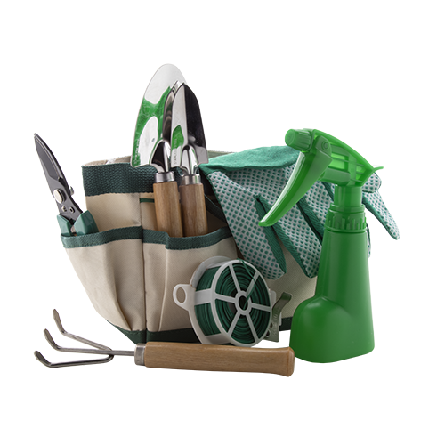
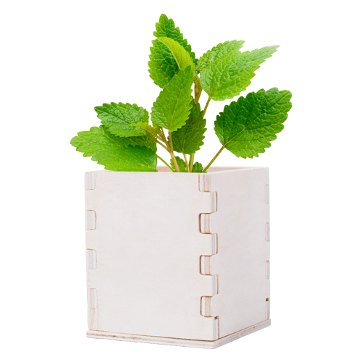
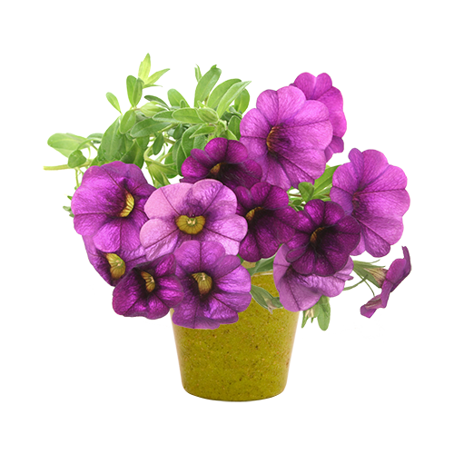
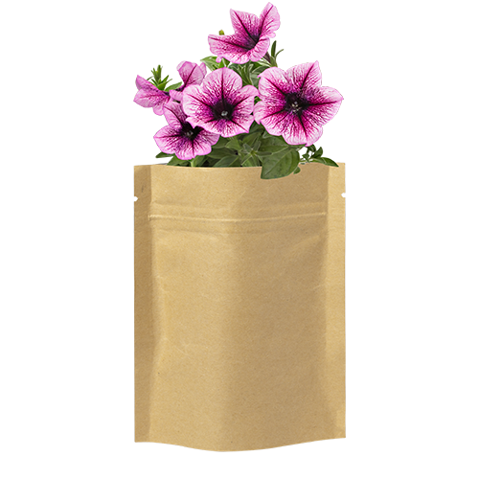
Place your contact details here!
GARDENING
ACCESSORIES
Make your garden and house more colourful and homely! Choose from our collection and create a floral environment.
PLANTIT AP718368
Full colour printed plastic T-type plant label. Ideal for seed trays or pots. Price includes UV-LED printing on one side. MOQ: 250 pcs.
0,000 EUR
BOTANIC AP892009
Garden tools set in nylon organizer bag. Including pruning scissors, hand fork, 2 trowels, binding wire with cutter, sprayer and a pair of gloves.
0,000 EUR
JARDIN AP892010
Garden tools set in nylon apron. Including pruning scissors, hand fork, trowel and a pair of gloves.
0,000 EUR
MERIN AP721179
Mint growing kit in wooden box with biodegradable plastic pot, 6-8 mint seeds and growing substrate.
0,000 EUR
PETUNIA AP731428
Flower pot with 5-8 petunia seeds in different colours, the pot is made of biodegradable material.
0,000 EUR
SOBER AP721479-00
Flower pot with 5-8 petunia seeds in different colours, the pot is made of biodegradable material.
0,000 EUR
Place your promotional conditions here!
.......
.......
.......
.......
www.WriteYourWebsiteHere.com

