Slide 1
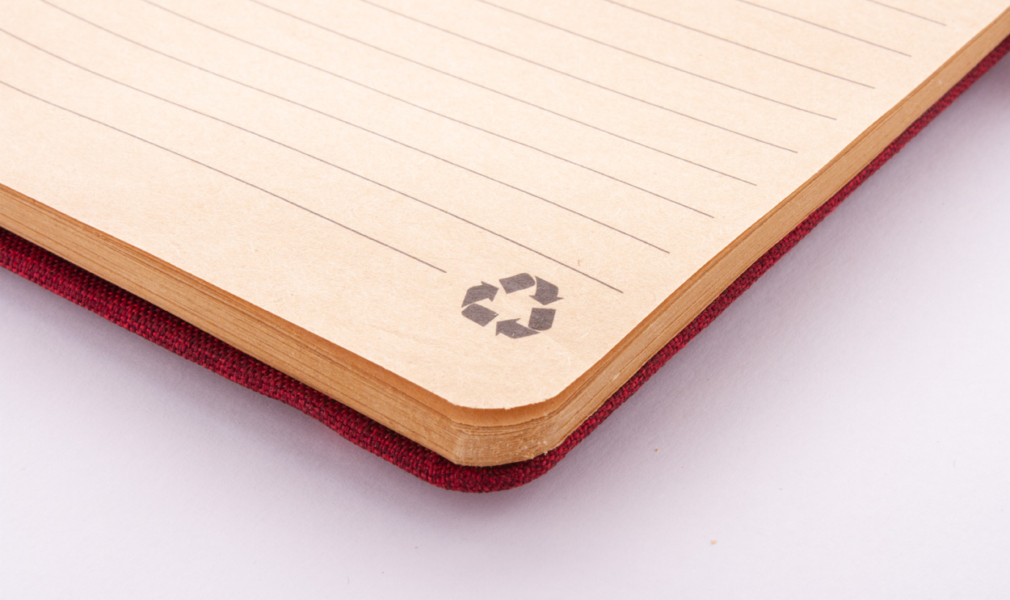
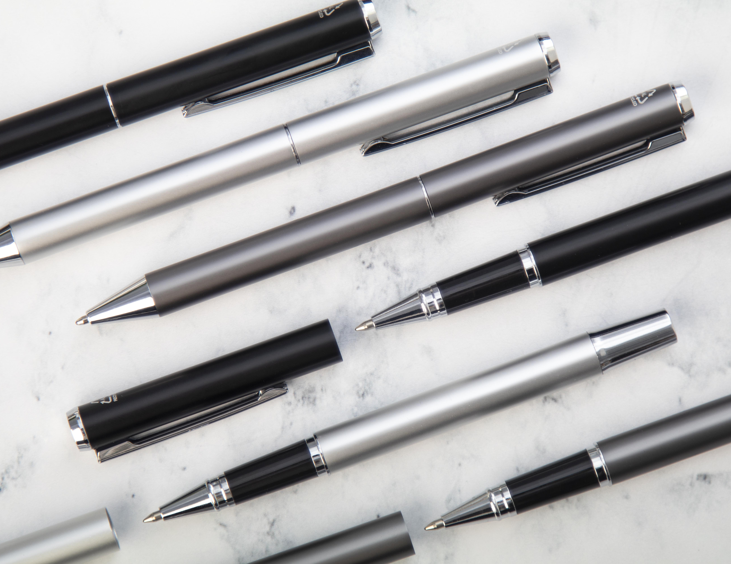
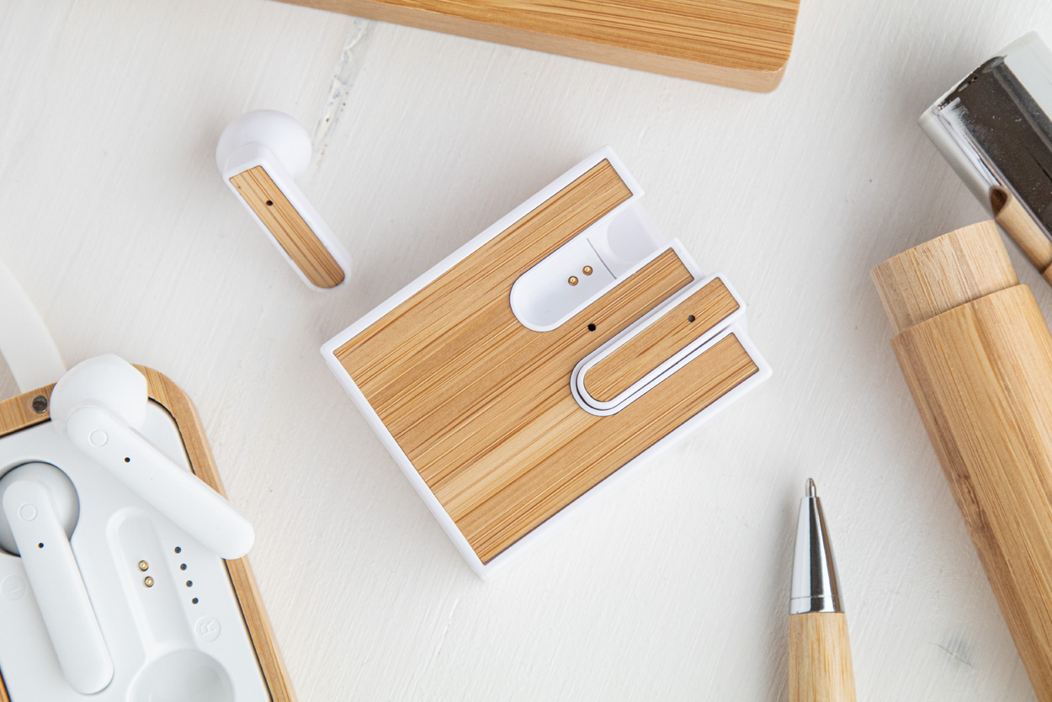
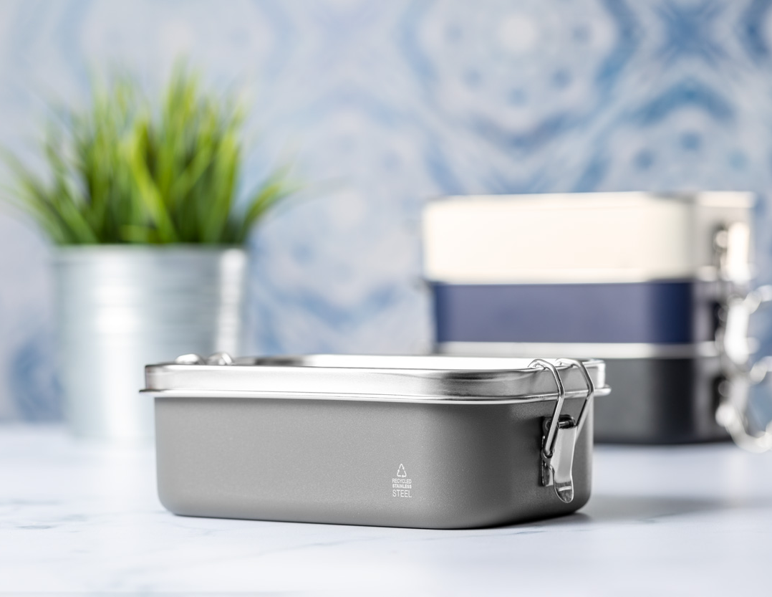
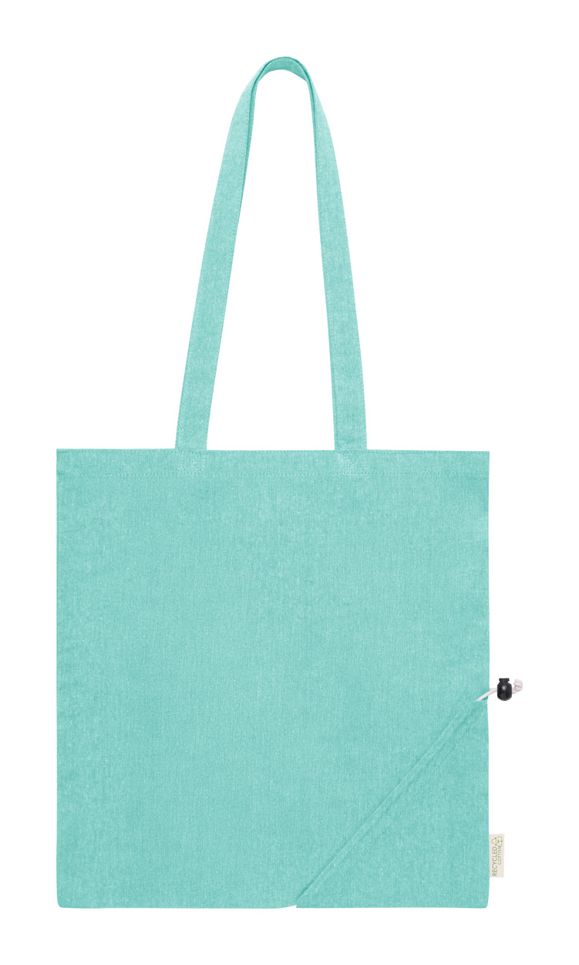
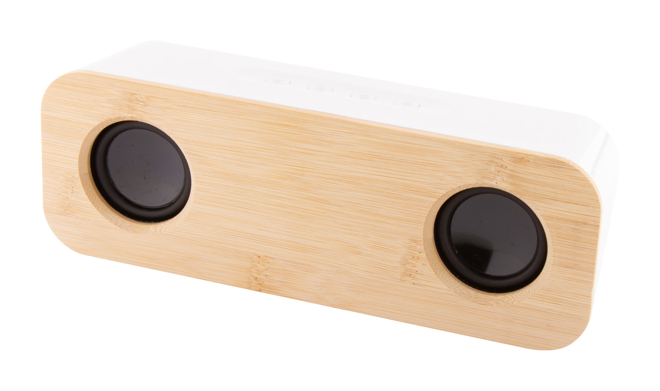
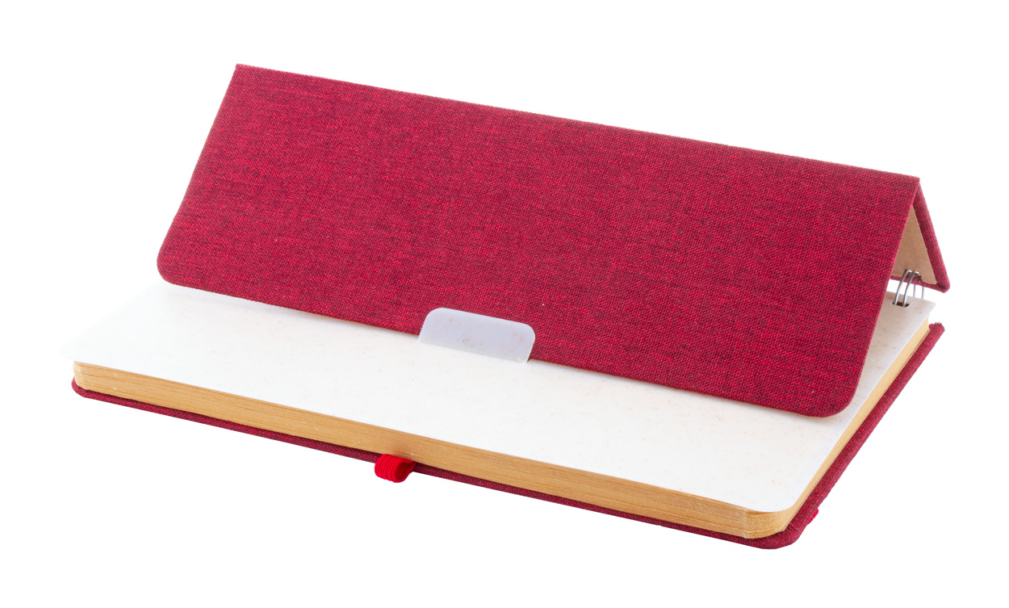
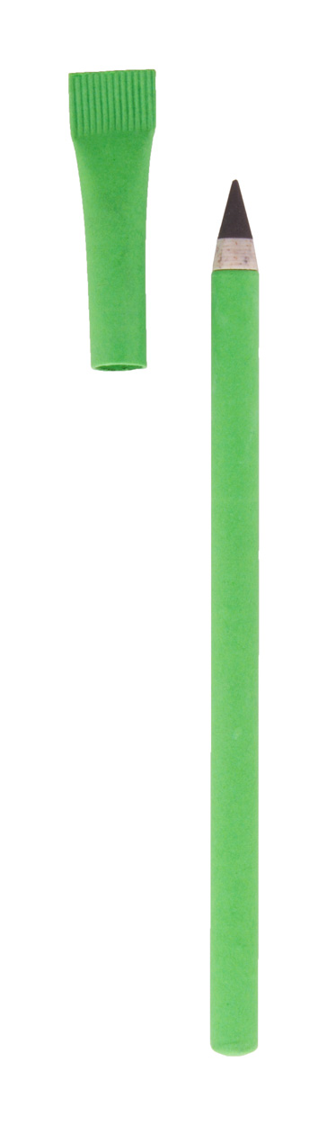
Place your contact details here!
Stay in the cycle and use it again!
Choose products that are made from recycled or recyclable materials. These were or can be transformed into new products, reducing the use of fresh raw materials and the amount of waste.
Ralum AP800499
Recycled aluminium pen set with roller and ballpoint pen in black paper gift box. With blue refill.
00,00 EUR
Rabsody AP800526-01
Wireless bluetooth earphones with bamboo inlay and hands-free call function. In recycled ABS plastic charger case with bamboo inlay. 00,00 EUR
Shonka AP722828
Recycled stainless steel lunch box with coloured body, contrasting lid and secure buckle closure, 750 ml.
00,00 EUR
Biyon
AP722765
Foldable recycled cotton shopping bag with long handles and distinctive recycled cotton label.
00,00 EUR
Herkool
AP800536
Bluetooth speaker in recycled ABS and bamboo housing with 2 speaker drivers and built-in rechargeable battery.
00,00 EUR
Holbook AP800515
RPET polyester covered spiral notebook with wheat straw plastic mobile and tablet holder insert.
00,00 EUR
Nopyrus
AP800495
Recycled paper long lasting inkless pen with matching colour cap. With wheat straw plastic and metal alloy tip, which oxidizes the paper.
00,00 EUR
Place your promotional conditions here!
.......
.......
.......
www.WriteYourWebsiteHere.com

