Slide 1

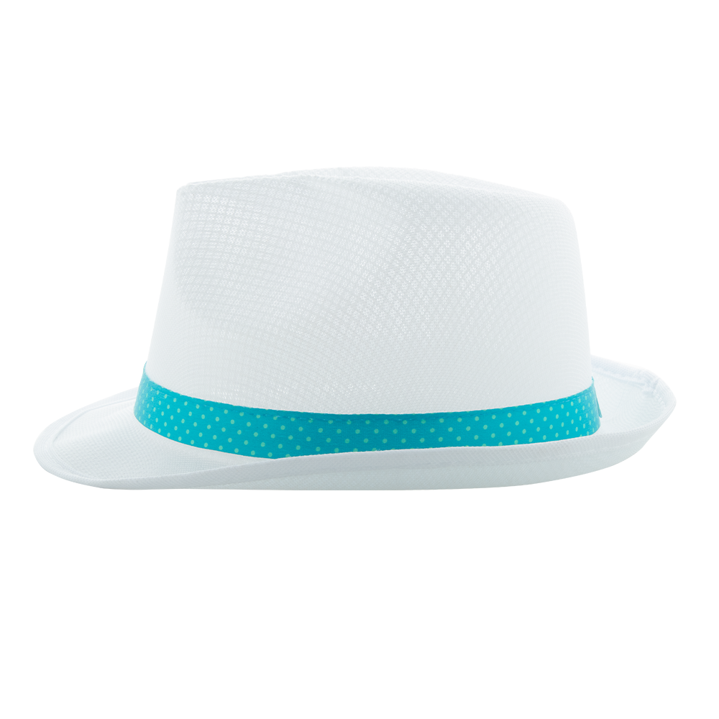
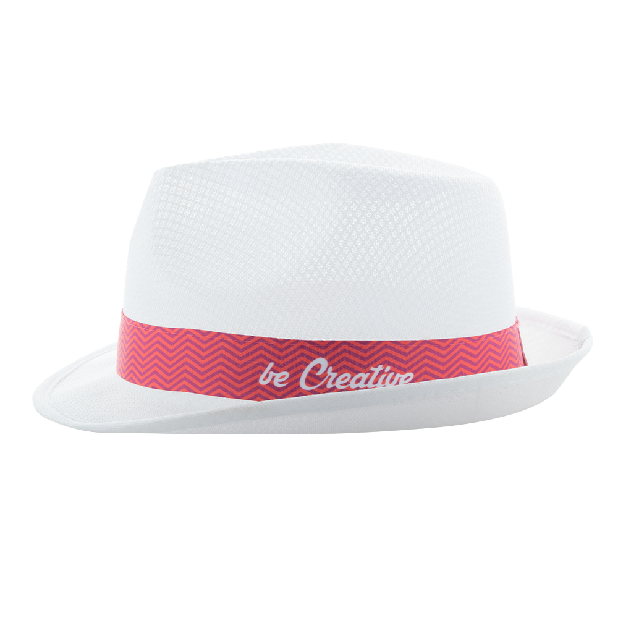
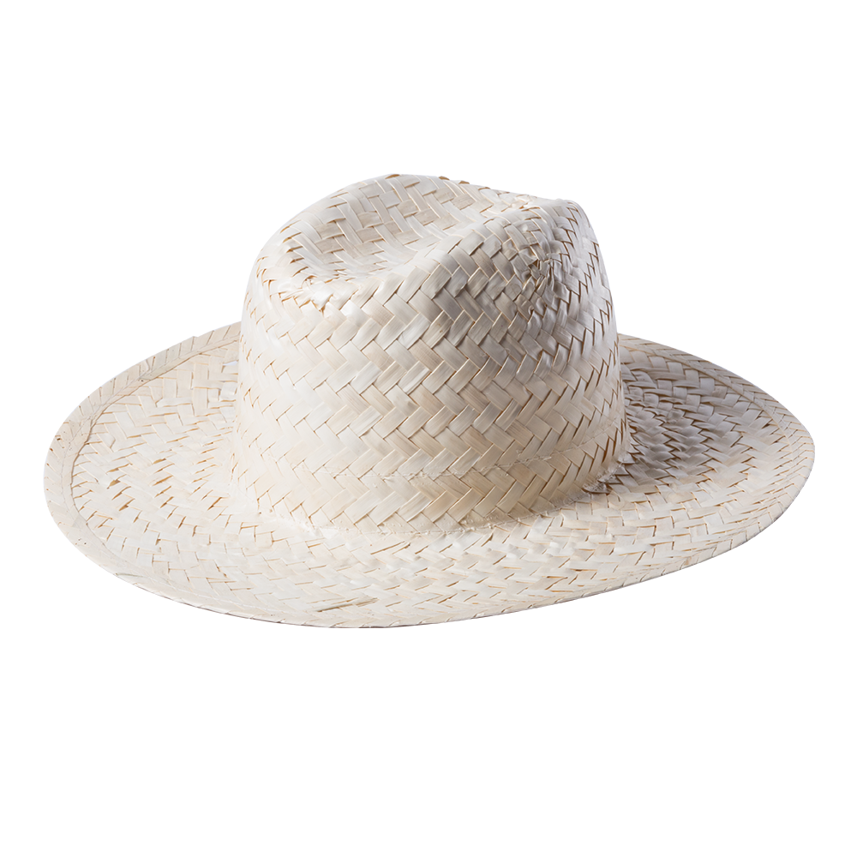
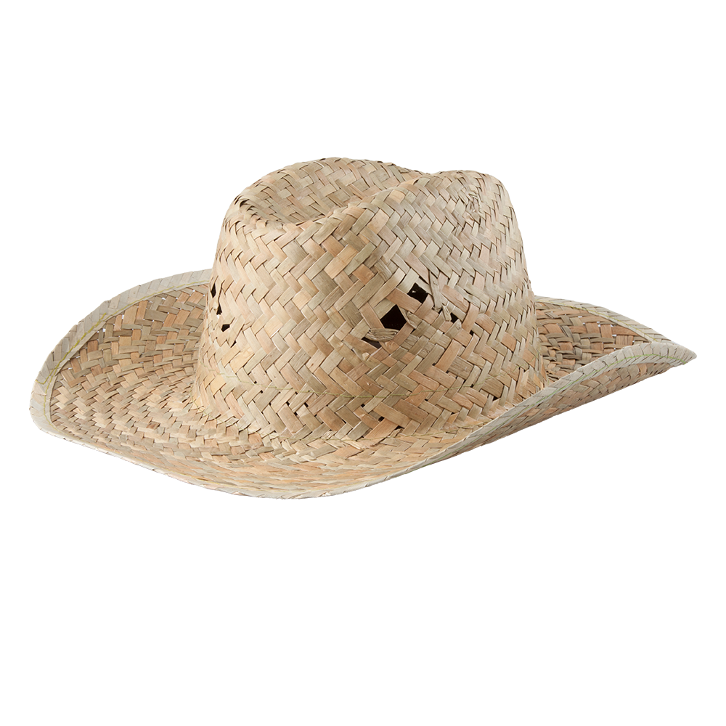
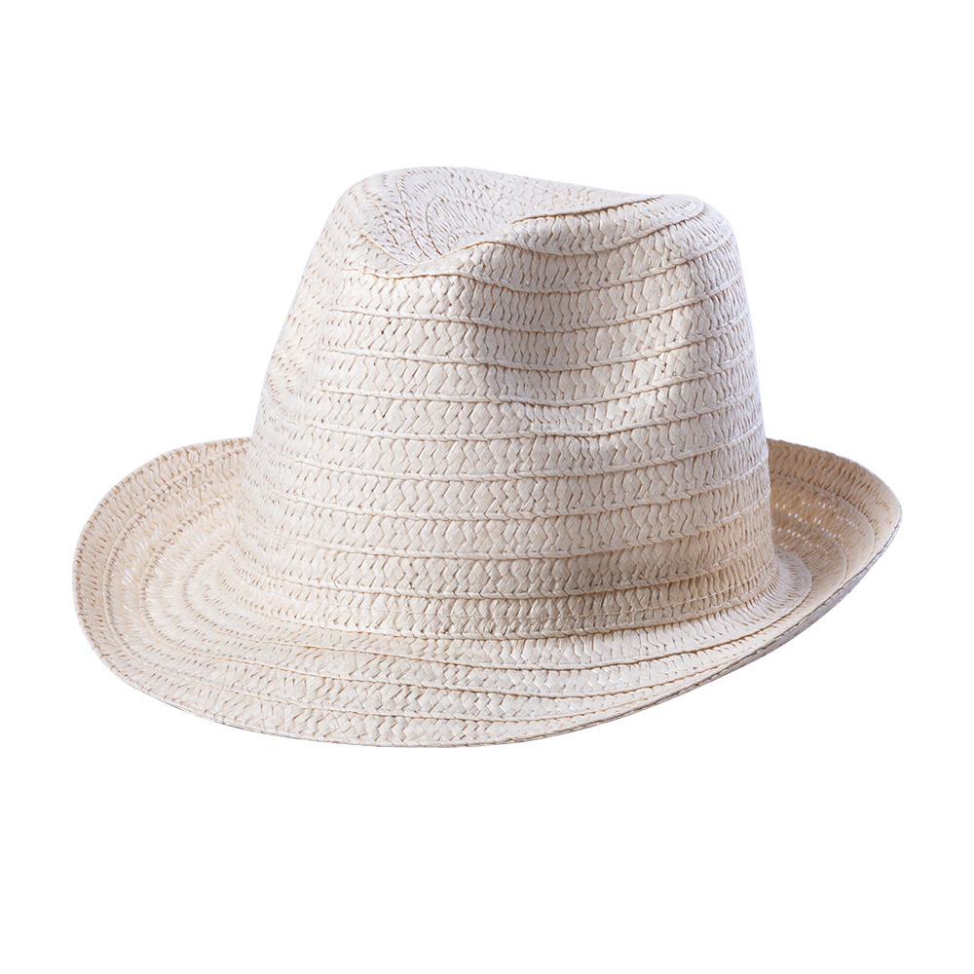
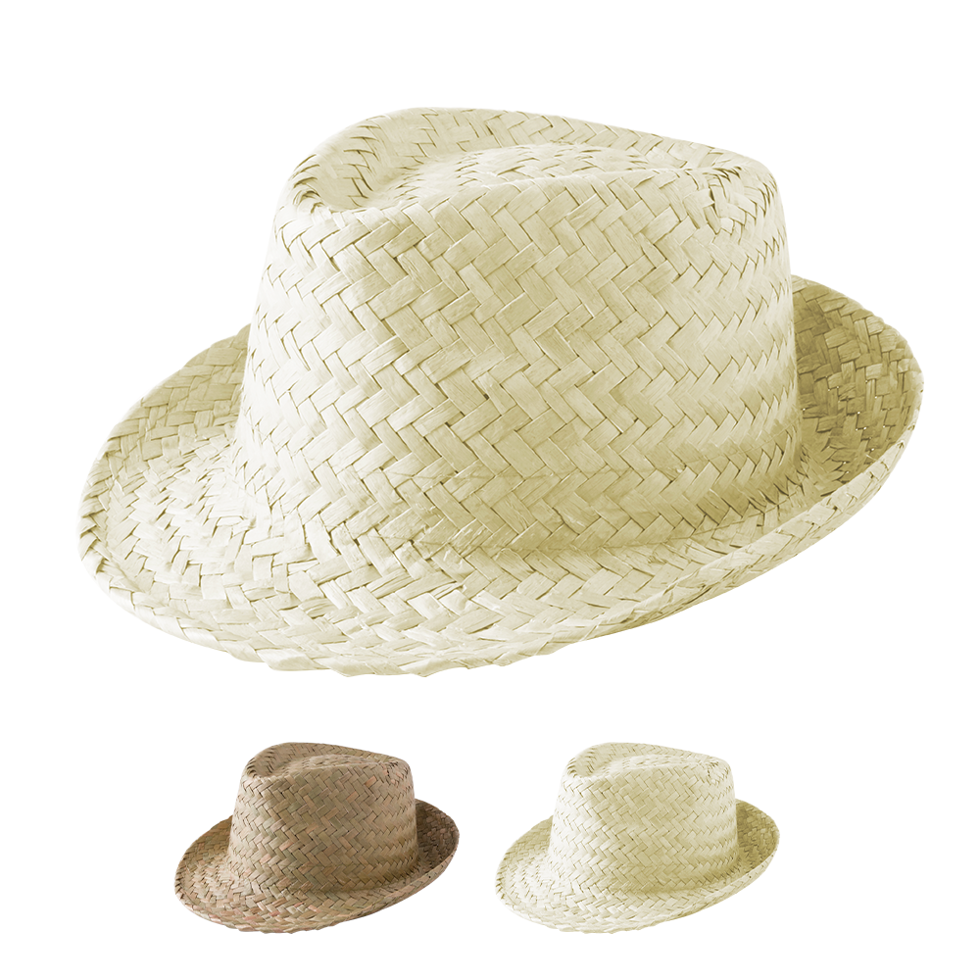
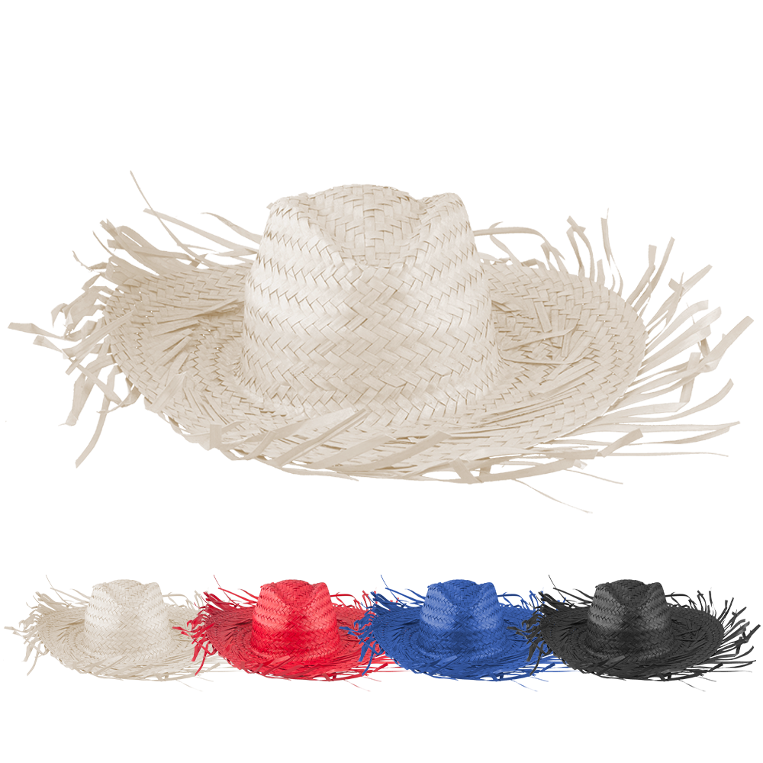
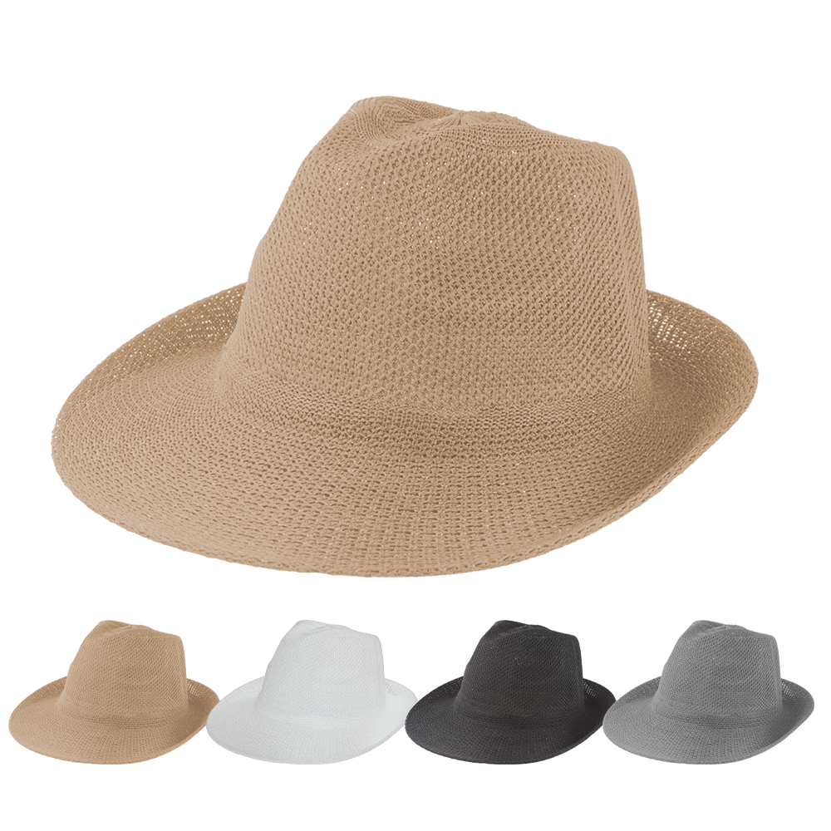
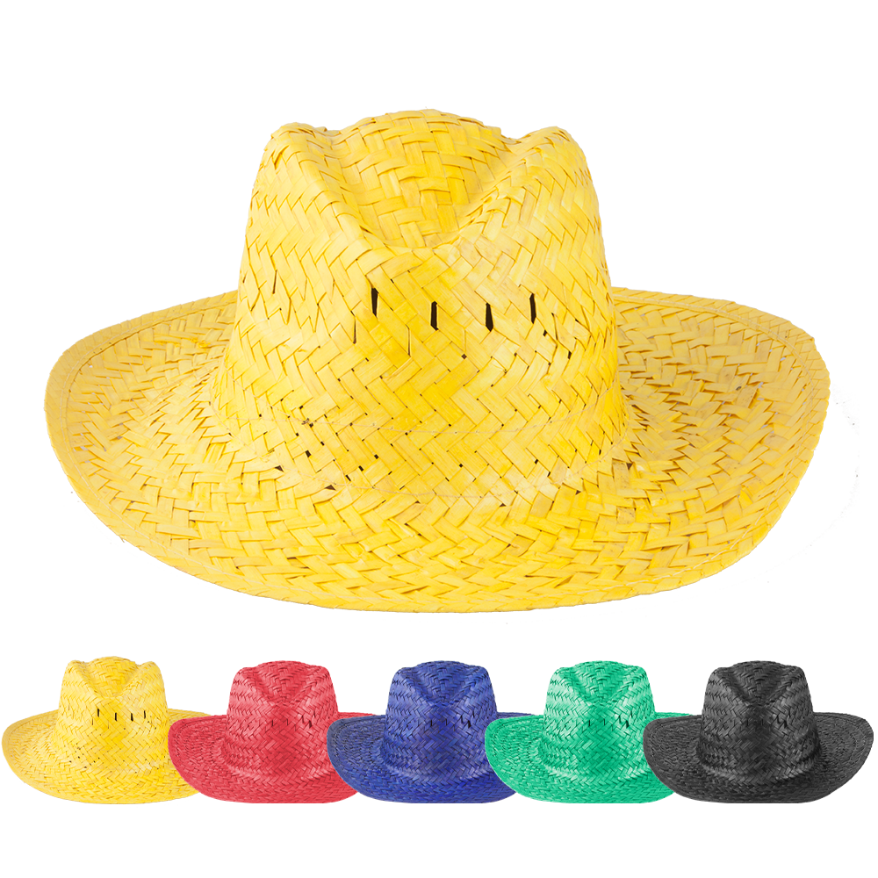
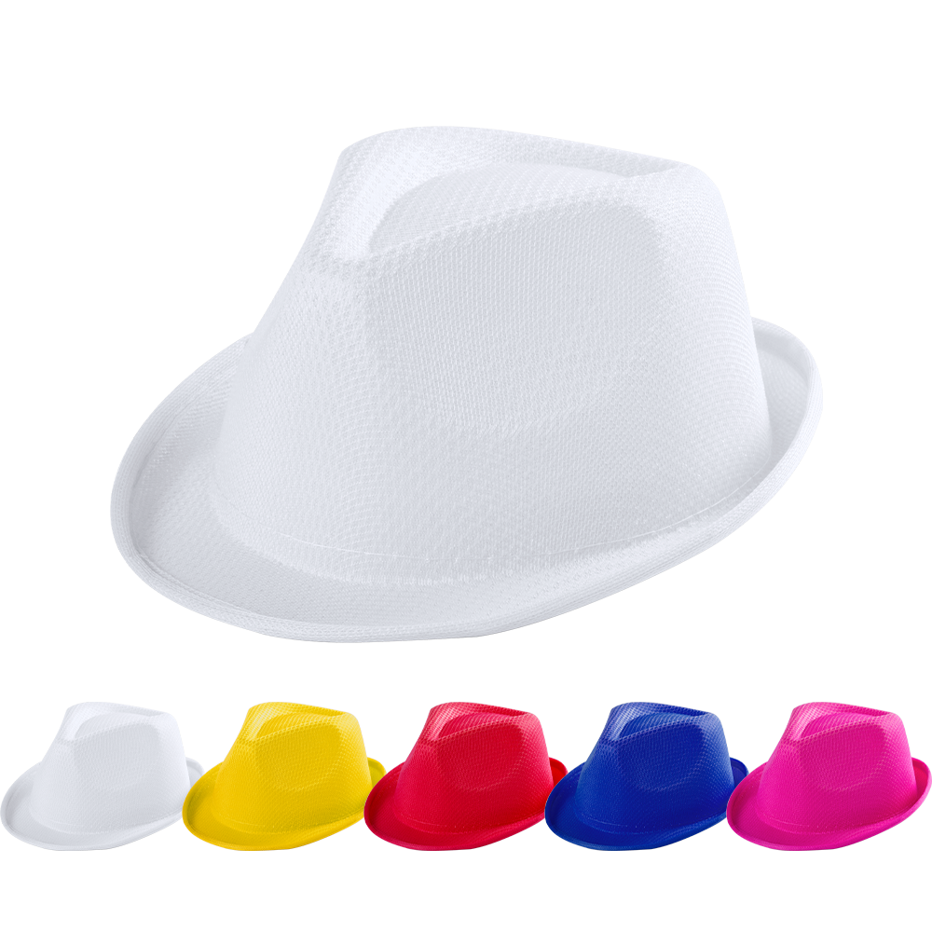
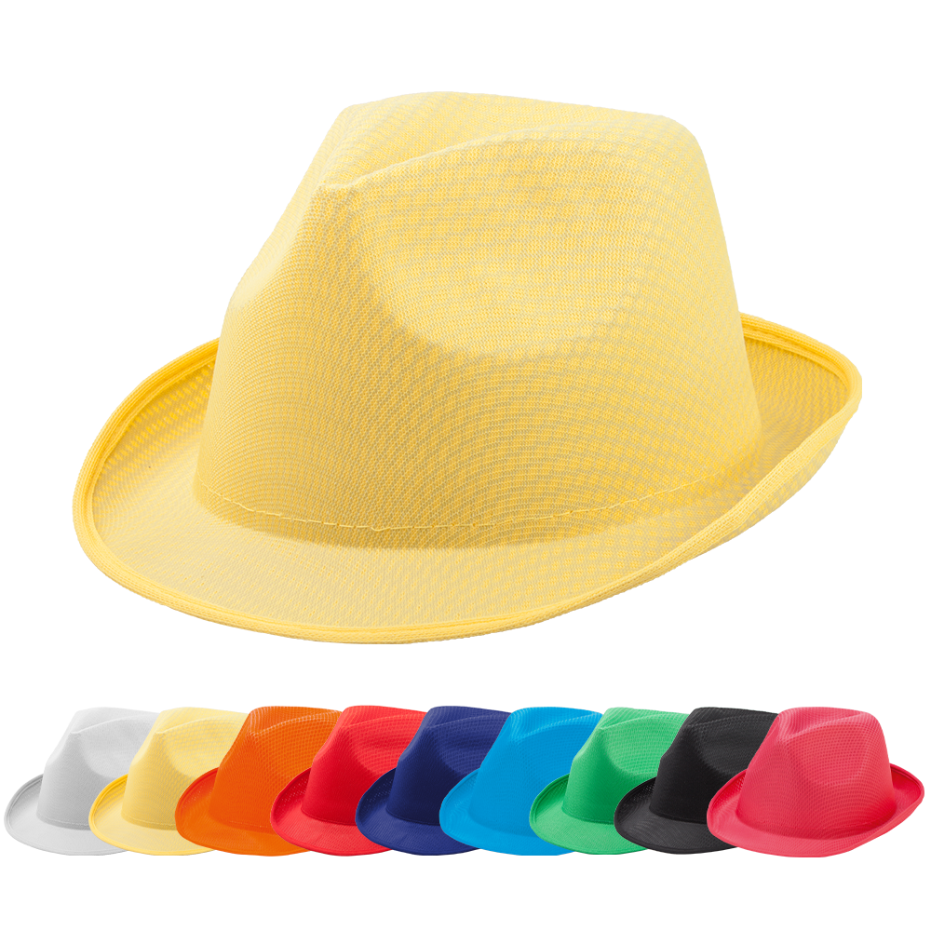
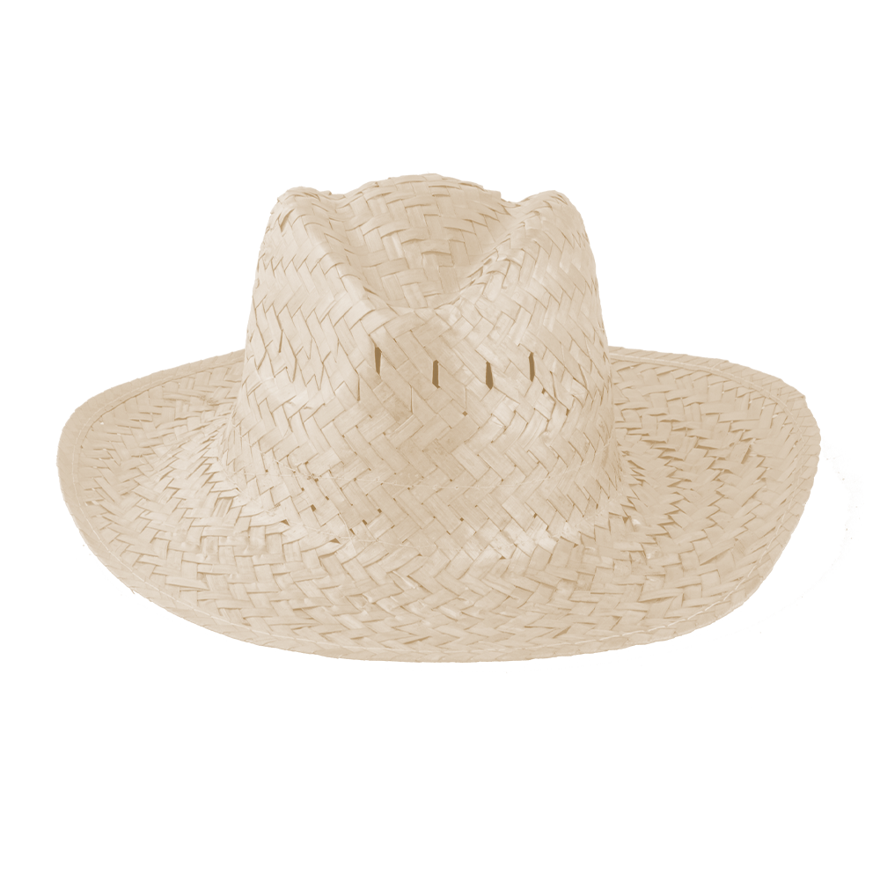
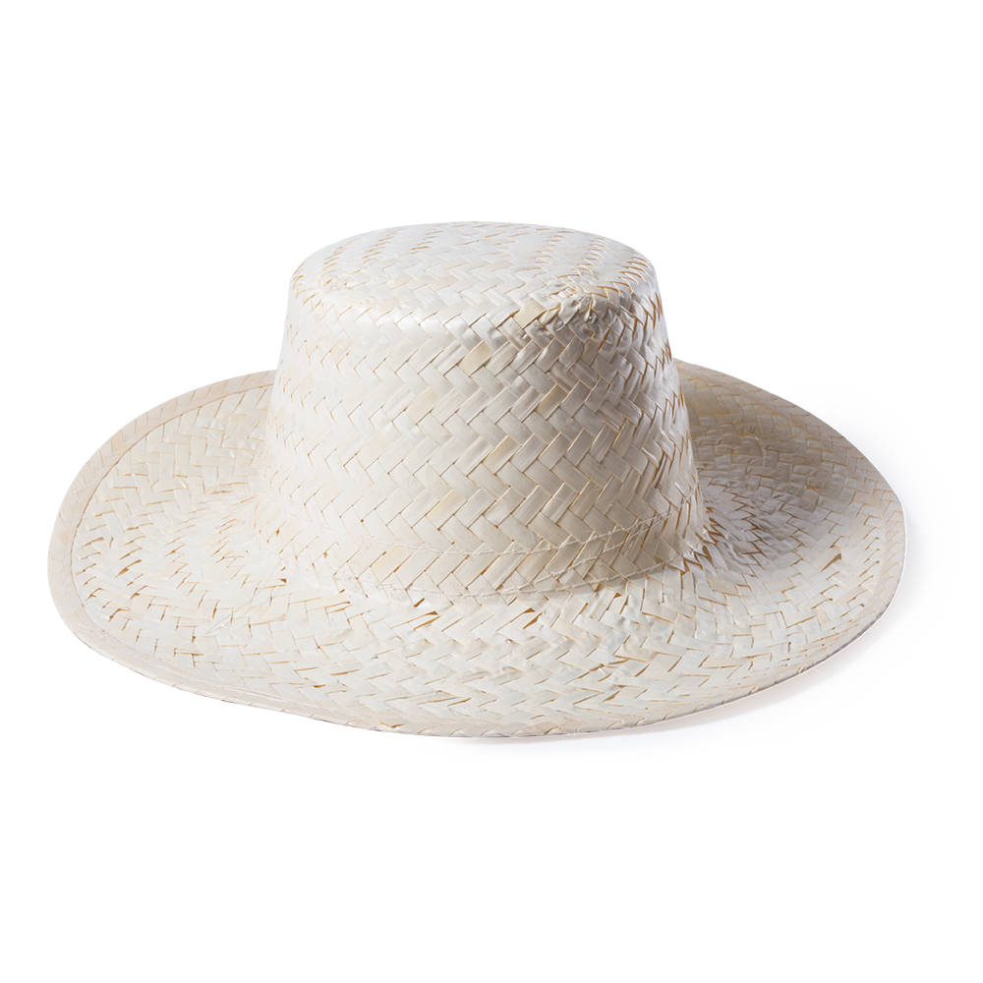
Place your contact details here!
Enjoy the sunshine and protect yourself!
A fashionable hat will turn the heads wherever you go. A unique hat band will make it more extraordinary and memorable. We offer our sublimation hat band at a special sale price for a limited time.
Subrero
AP718139
Subrero XL
AP718367
Dimsa
AP781818
Bull
AP741009
Licem
AP721194-00
Zelio
AP741918
Filagarchado
AP761984
Timbu
AP791197
Splash
AP761017
Tolvex
AP741828
Braz
AP791198
Lua
AP761986
Dabur
AP781821
Place your promotional conditions here!
.......
.......
……
www.WriteYourWebsiteHere.com

