Slide 1

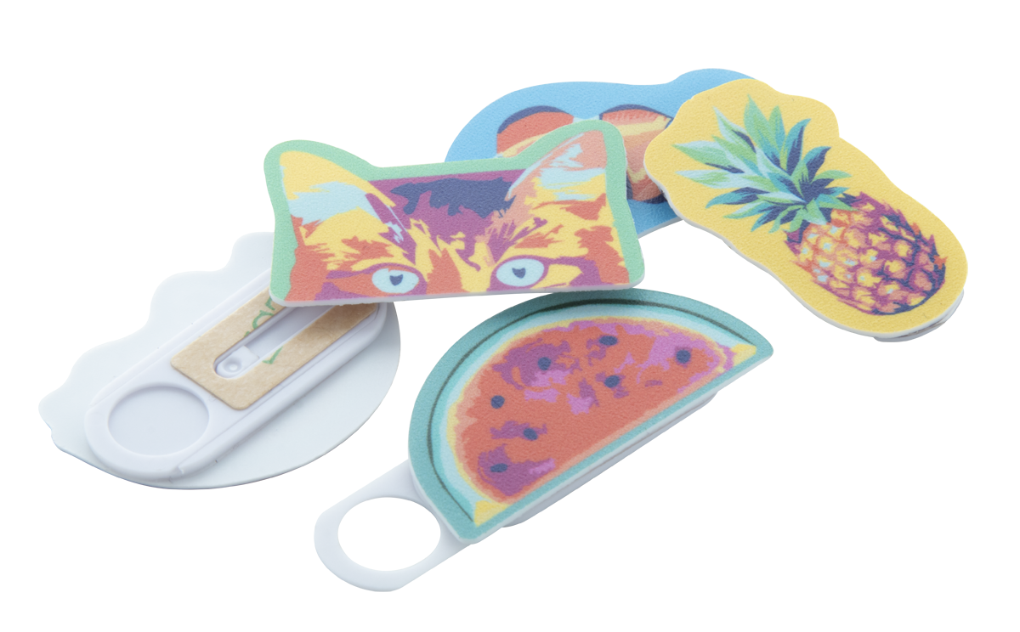
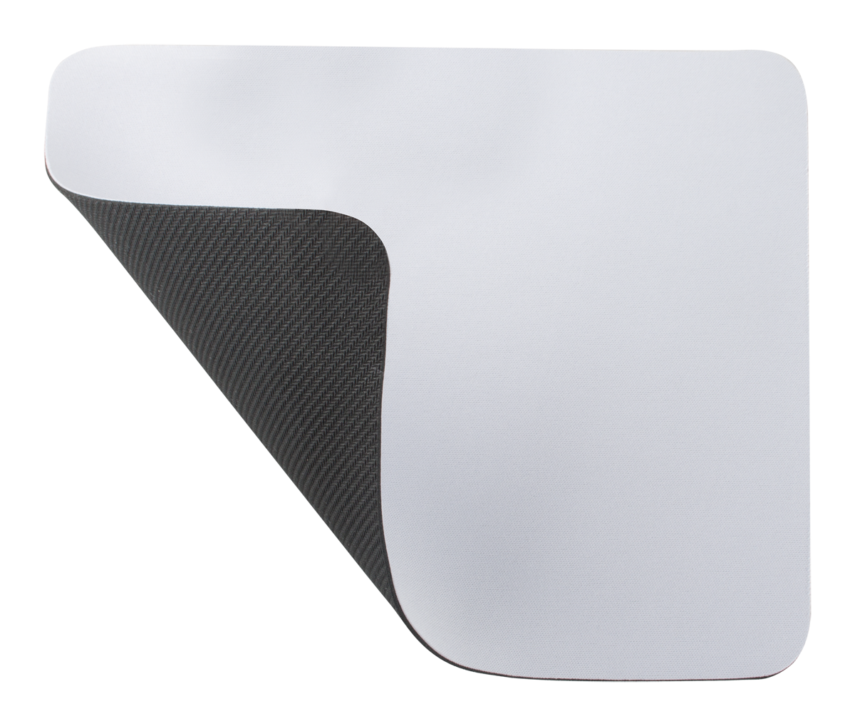
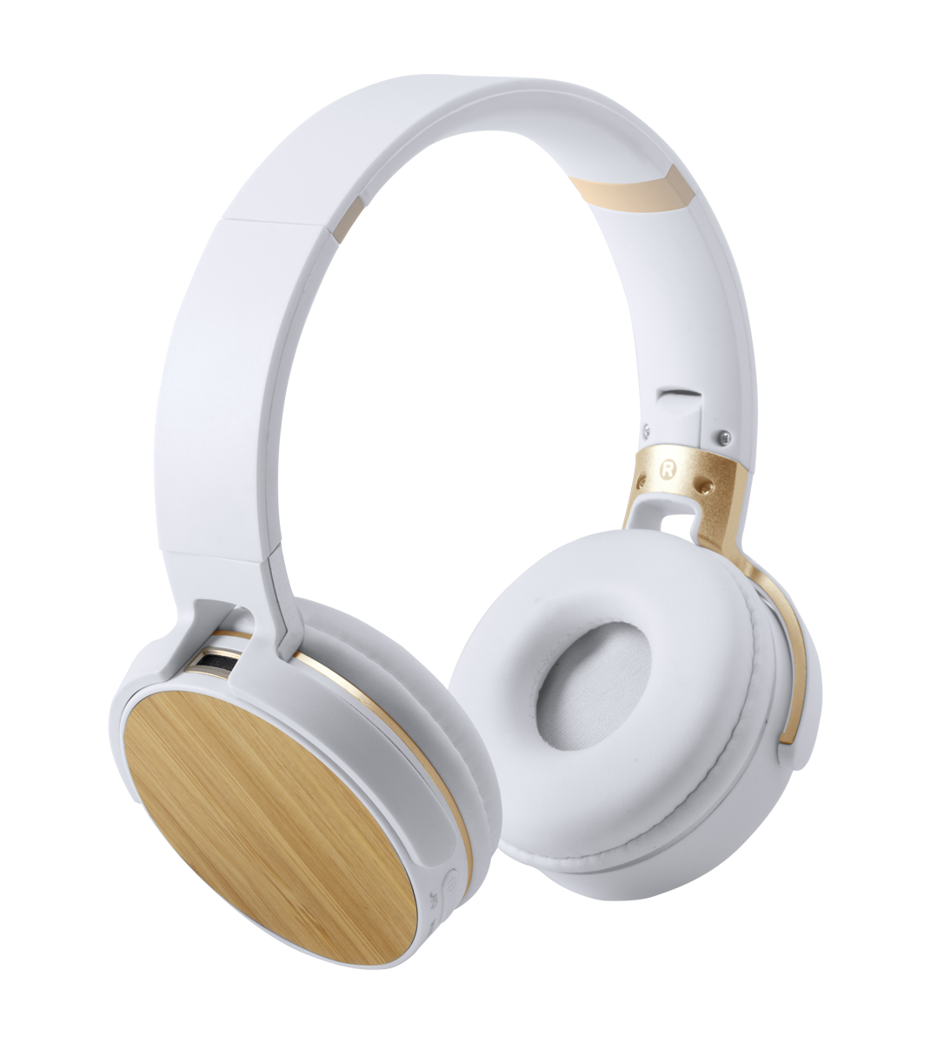

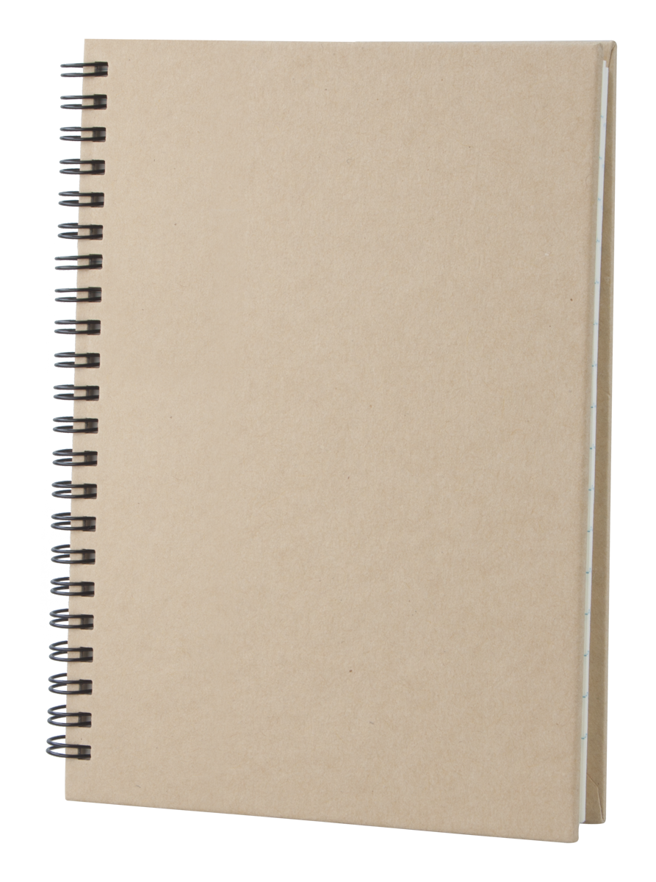
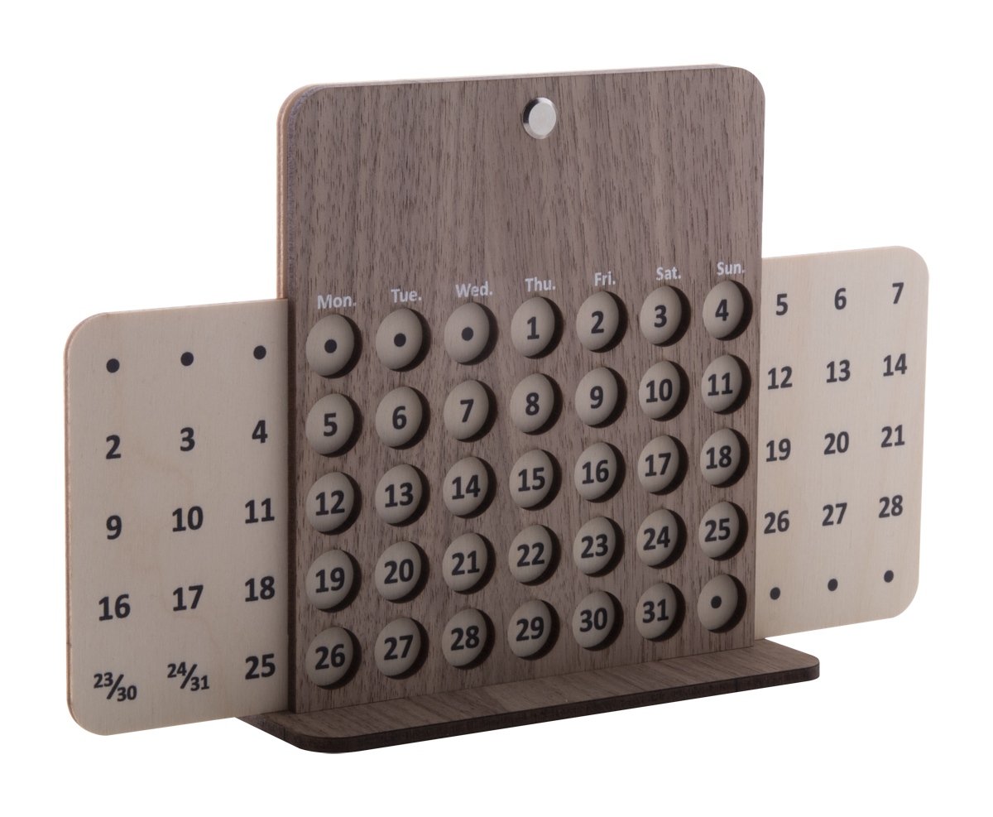

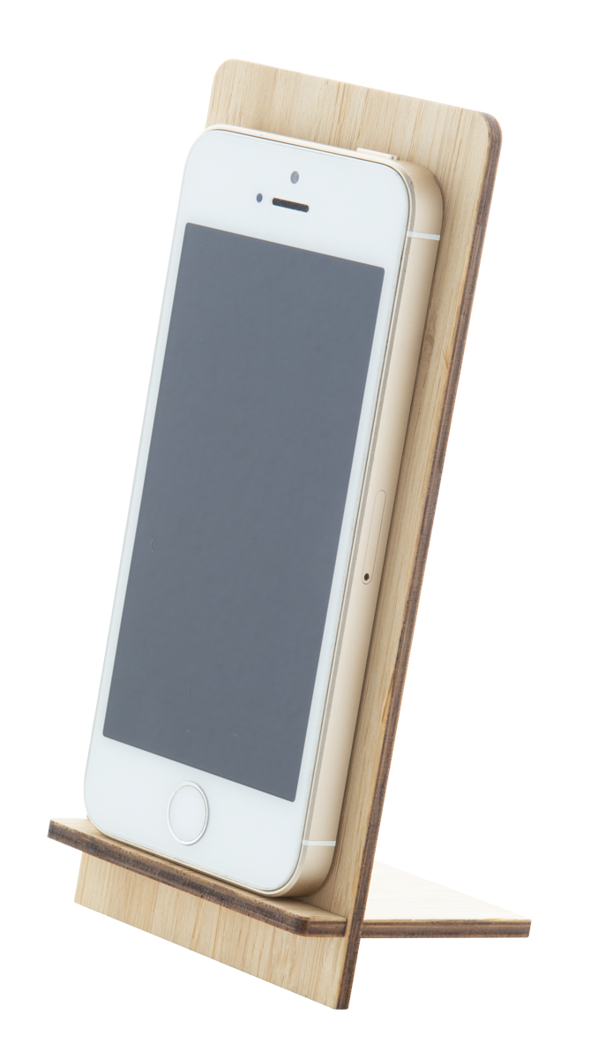
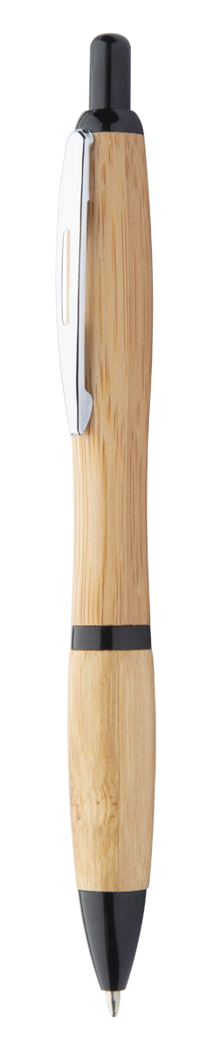
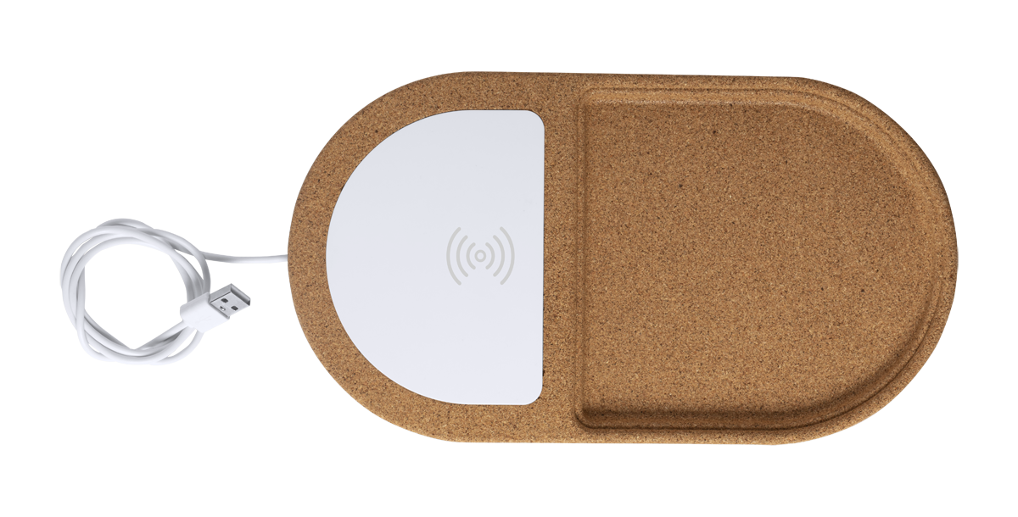
Place your contact details here!
HOME OFFICE
GIFTS FOR YOUR PET!
Create a practical and comfortable working space at home so that you can stay productive and inspired even when you’re working remotely. Browse our wide collection and find all the necessary technology items, writing and office supplies for your own home office.
SHAPECAM AP718377
Plastic anti spy webcam blocker with custom shaped, full colour printed overlay (maximum size: 50×25 mm). With sliding cover and adhesive back. With digital printed paper card. Price includes digital and UV LED printing. MOQ: 100 pcs.
00,00 EUR
SUBOMAT AP812410
Mouse pad for sublimation printing. Price includes sublimation printing. MOQ: 50 pcs. Material: rubber and polyester.
00,00 EUR
TREIKO AP721523-01
Bluetooth headphones with bamboo decoration and built-in rechargeable battery. With hands-free call and micro SD MP3 playback functions. Including 3,5 mm audio Jack and USB charger cables.
00,00 EUR
GULLIVER AP791047
Recycled paper spiral notebook with 80 lined sheets, A5.
00,00 EUR
FOREVER AP718644
Perpetual desk calendar in birch and walnut plywood. Delivered flat-packed. 00,00 EUR
HESTIA AP803415-01
High quality porcelain mug in white colour with bamboo coaster, 320 ml. In gift box.
00,00 EUR
FARGESIA AP718375
Desk mobile phone holder in bamboo plywood. Delivered flat-packed.
00,00 EUR
COLDERY AP810441
Bamboo ballpoint pen with coloured plastic parts and metal clip. With blue refill.
00,00 EUR
DILFOX AP721673
Natural cork desk organizer with built-in wireless charger. Max. output: 1000 mA. Including USB cable.
00,00 EUR
Place your promotional conditions here!
.......
.......
.......
.......
www.WriteYourWebsiteHere.com

