Slide 1

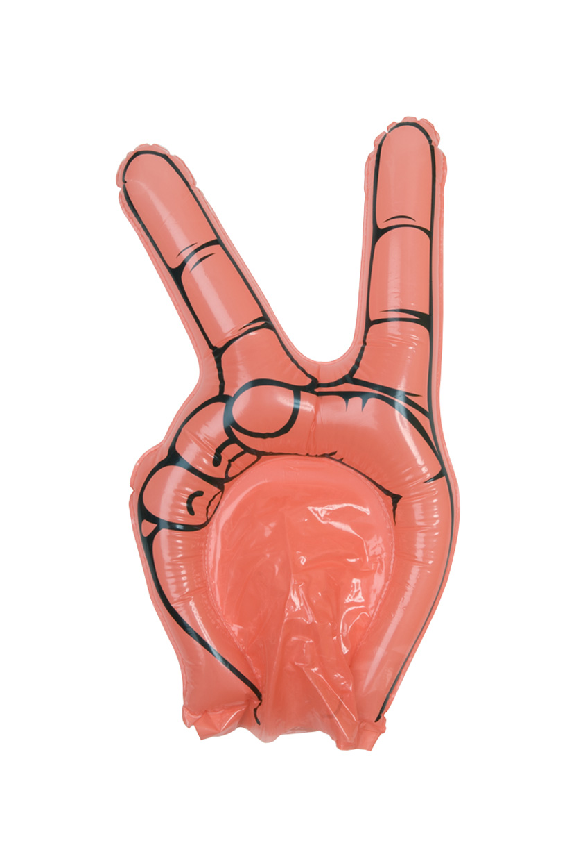
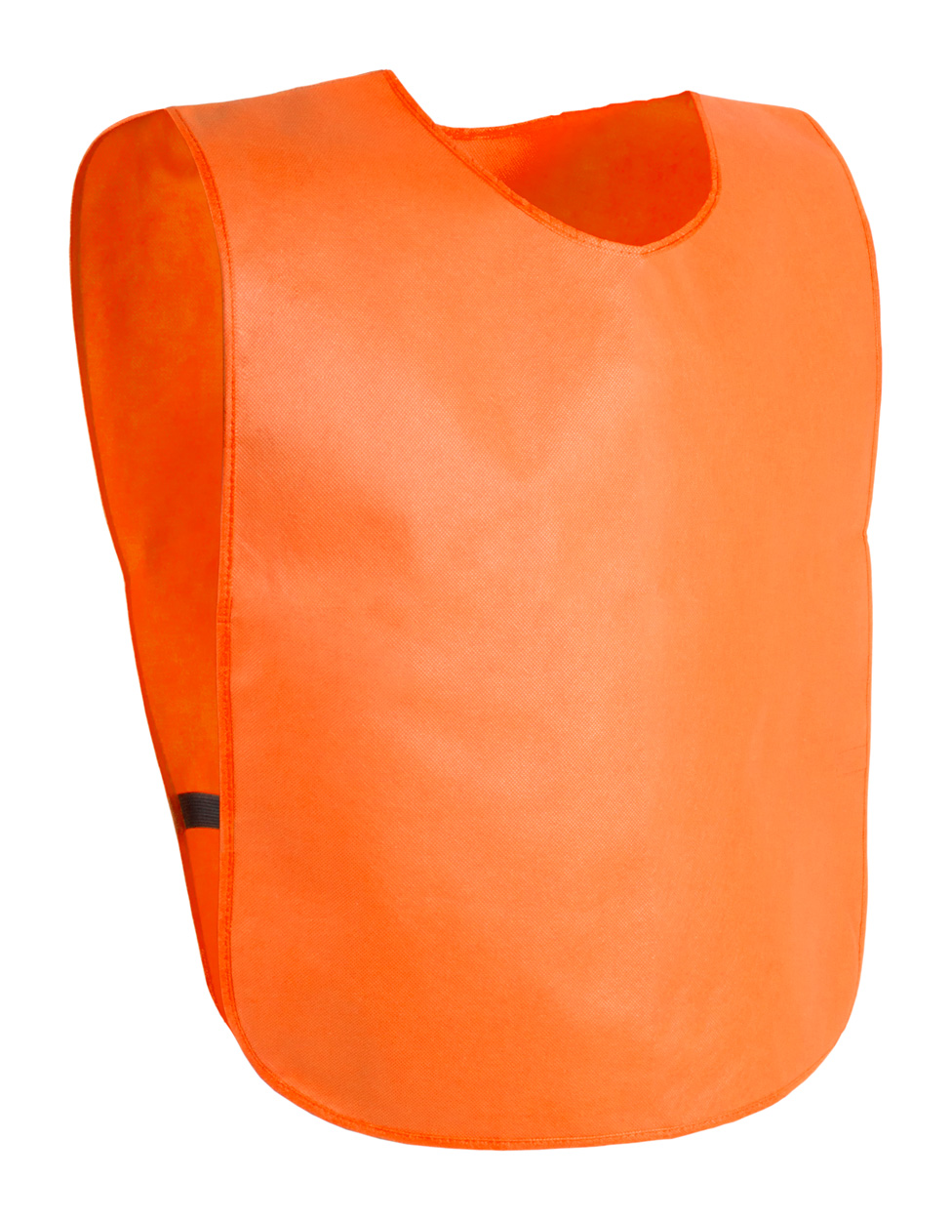



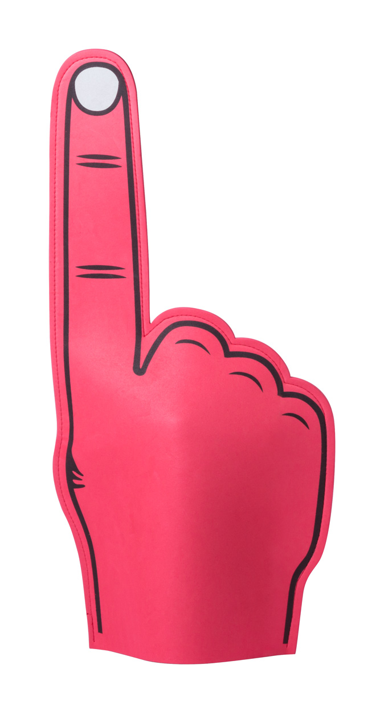
Place your contact details here!
SPORTS AND CHEERING
Have you ever participated in an unforgettable sport event that made you feel thrilled? Either being on the sports fields or cheering on the stands our collection helps you to live that moment!
HOGAN AP761898
Inflatable hand for fans.
0,000 EUR
CLAXO AP810376
Plastic whistle with matching colour lanyard.
0,000 EUR
CAMBEX AP741555
Non-woven sport vest for adults.
0,000 EUR
DELKO AP791920
PU leather and PVC football, size 5. Delivered deflated.
0,000 EUR
TORRES AP761201
Inflatable cheering sticks, disposable, 2pcs. Delivered deflated, mouthpiece for inflating is included, made of LDPE. 0,000 EUR
ZACKY AP721192
EVA foam cheering hand for fans.
0,000 EUR
Place your promotional conditions here!
.......
.......
.......
.......
www.WriteYourWebsiteHere.com

