Slide 1

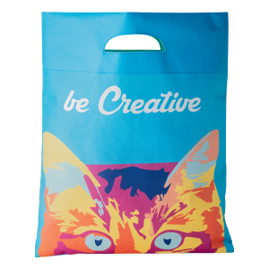
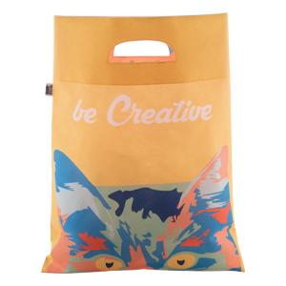
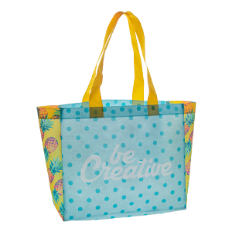
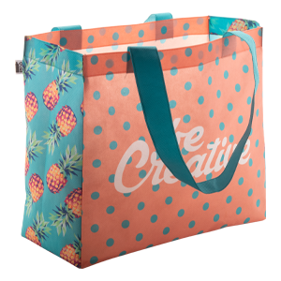
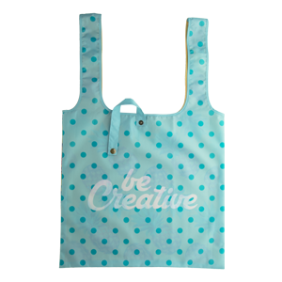
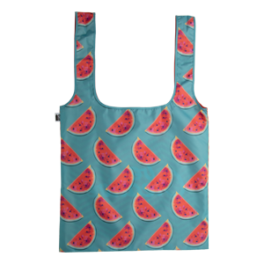
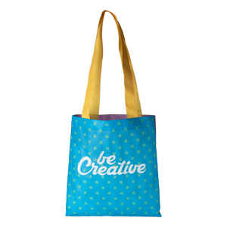
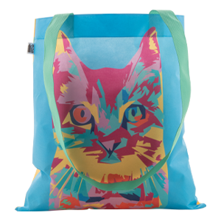
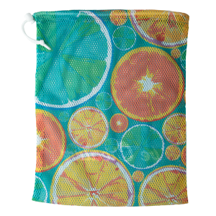
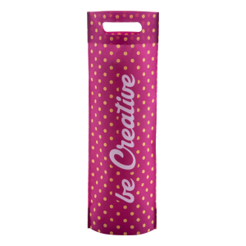
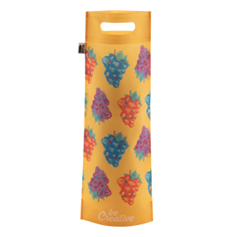
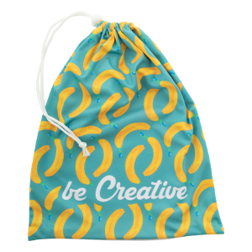
Place your contact details here!
CUSTOM SHOPPING BAGS FROM 50 PCS
Order custom made shopping bags and produce bags with sublimation printed graphics from 50 pcs. All of these products are made in Europe, ensuring short production time and constant availability.
SuboShop shopping bags come in a variety of styles and sizes. Find your favourite and create your own design.
SuboProduce produce bags are great to pack fruits and vegetables and can be printed with eye catching custom designs.
SuboShop Zero
AP718213
SuboShop Zero RPET AP718901
SuboShop B
AP718776
SuboShop B RPET
AP718902
SuboShop Fold
AP718665
SuboShop Fold RPET
AP718699
SuboShop A
AP718212
SuboShop A RPET
AP718900
SuboProduce Mesh
AP718551
SuboShop Wine
AP718666
SuboShop Wine RPET
AP718903
SuboProduce
AP718550
Place your promotional conditions here!
.......
.......
……
www.WriteYourWebsiteHere.com

