Slide 1

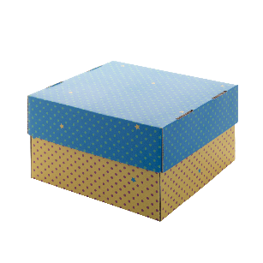
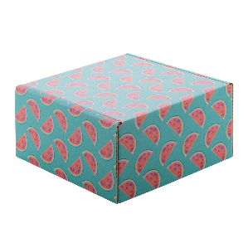
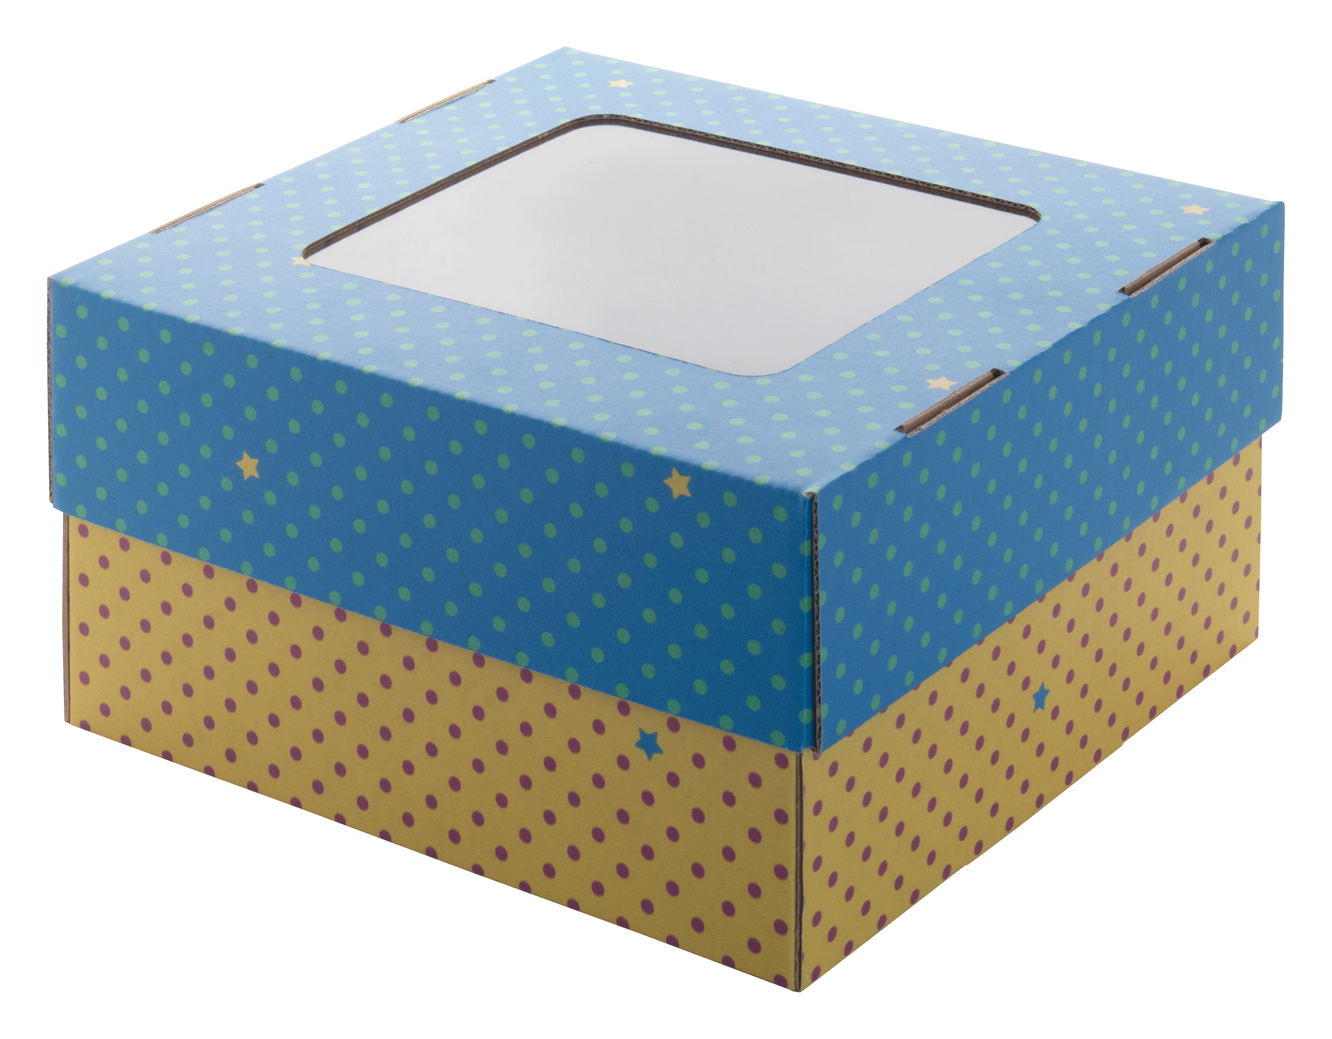
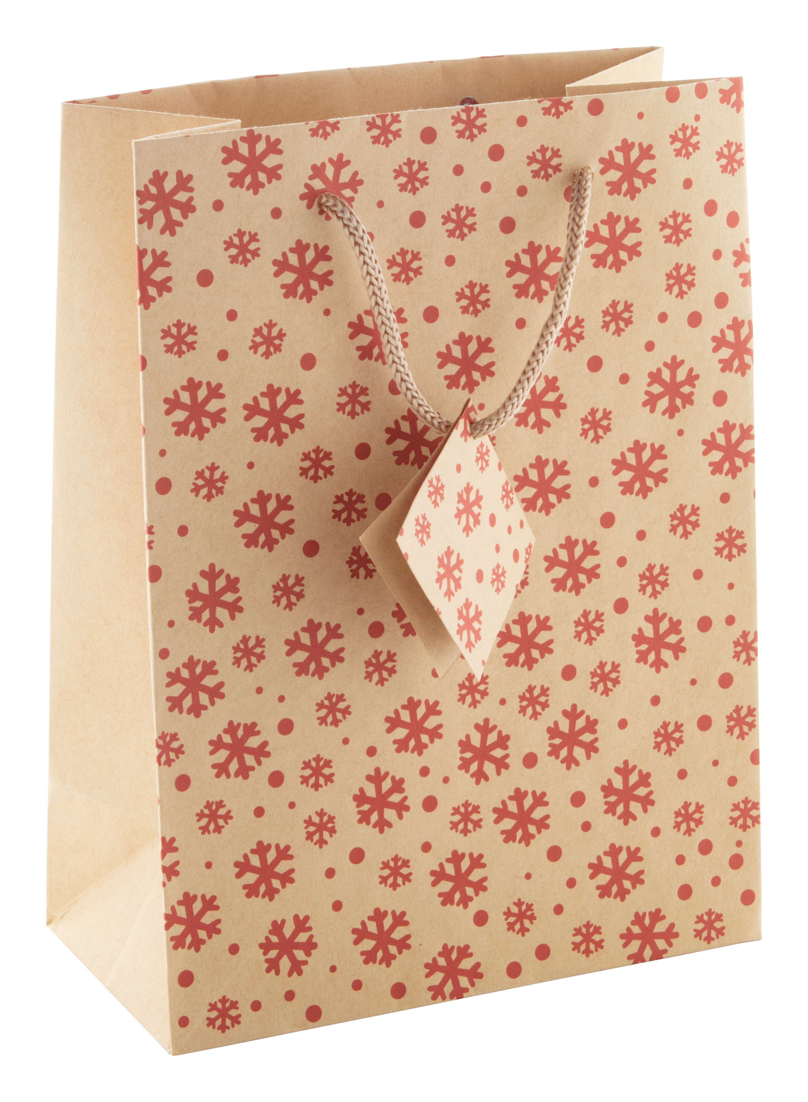
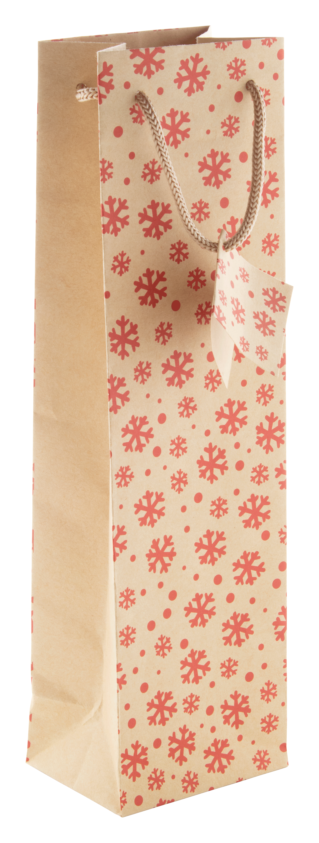
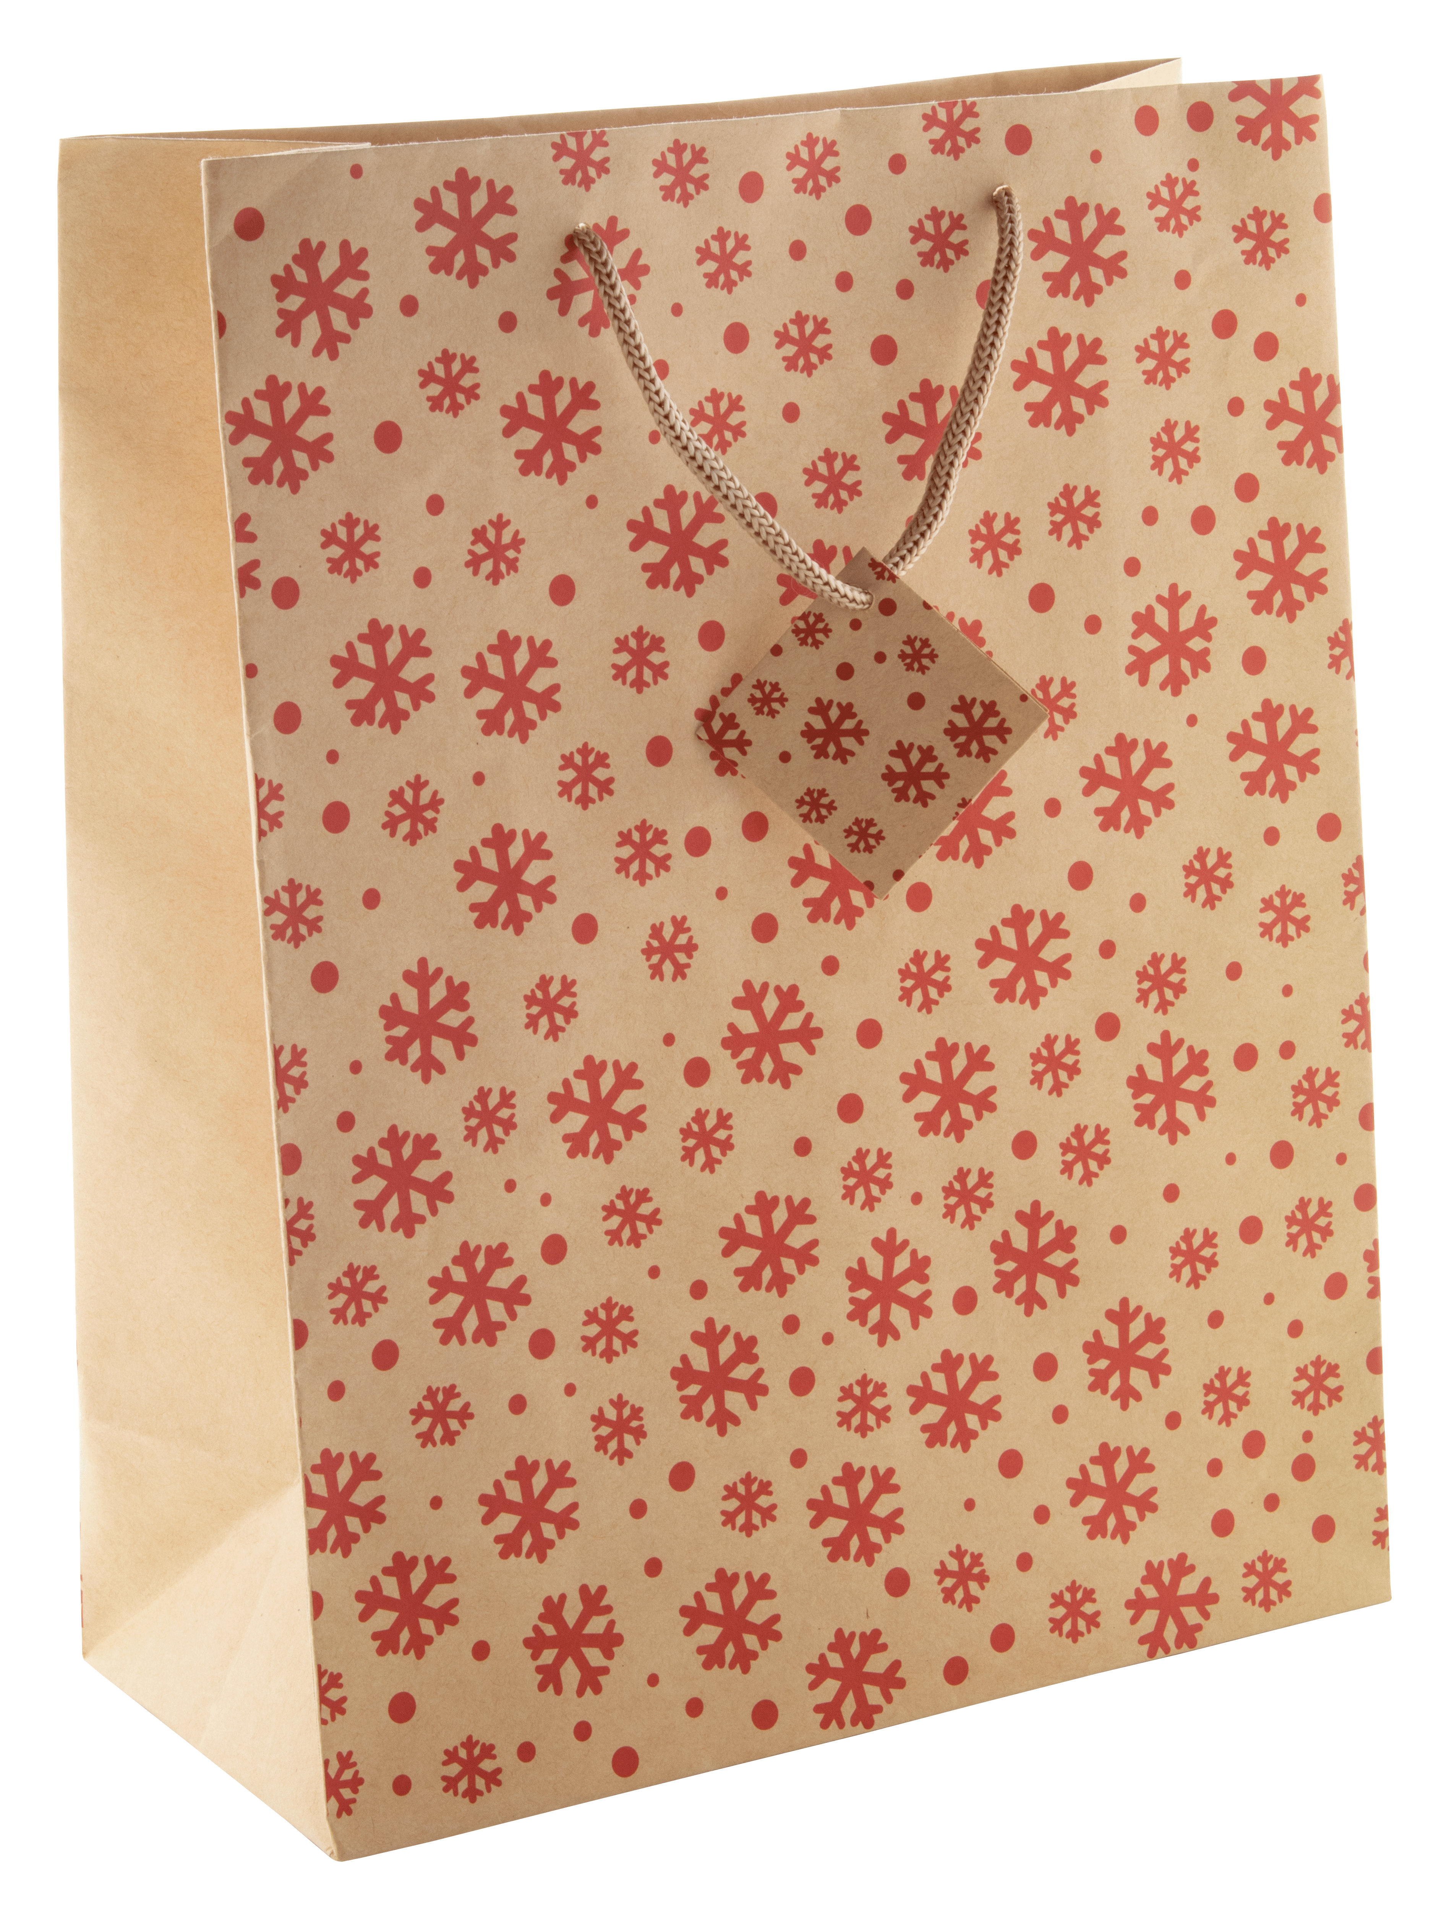
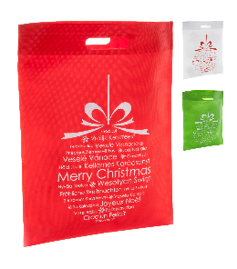
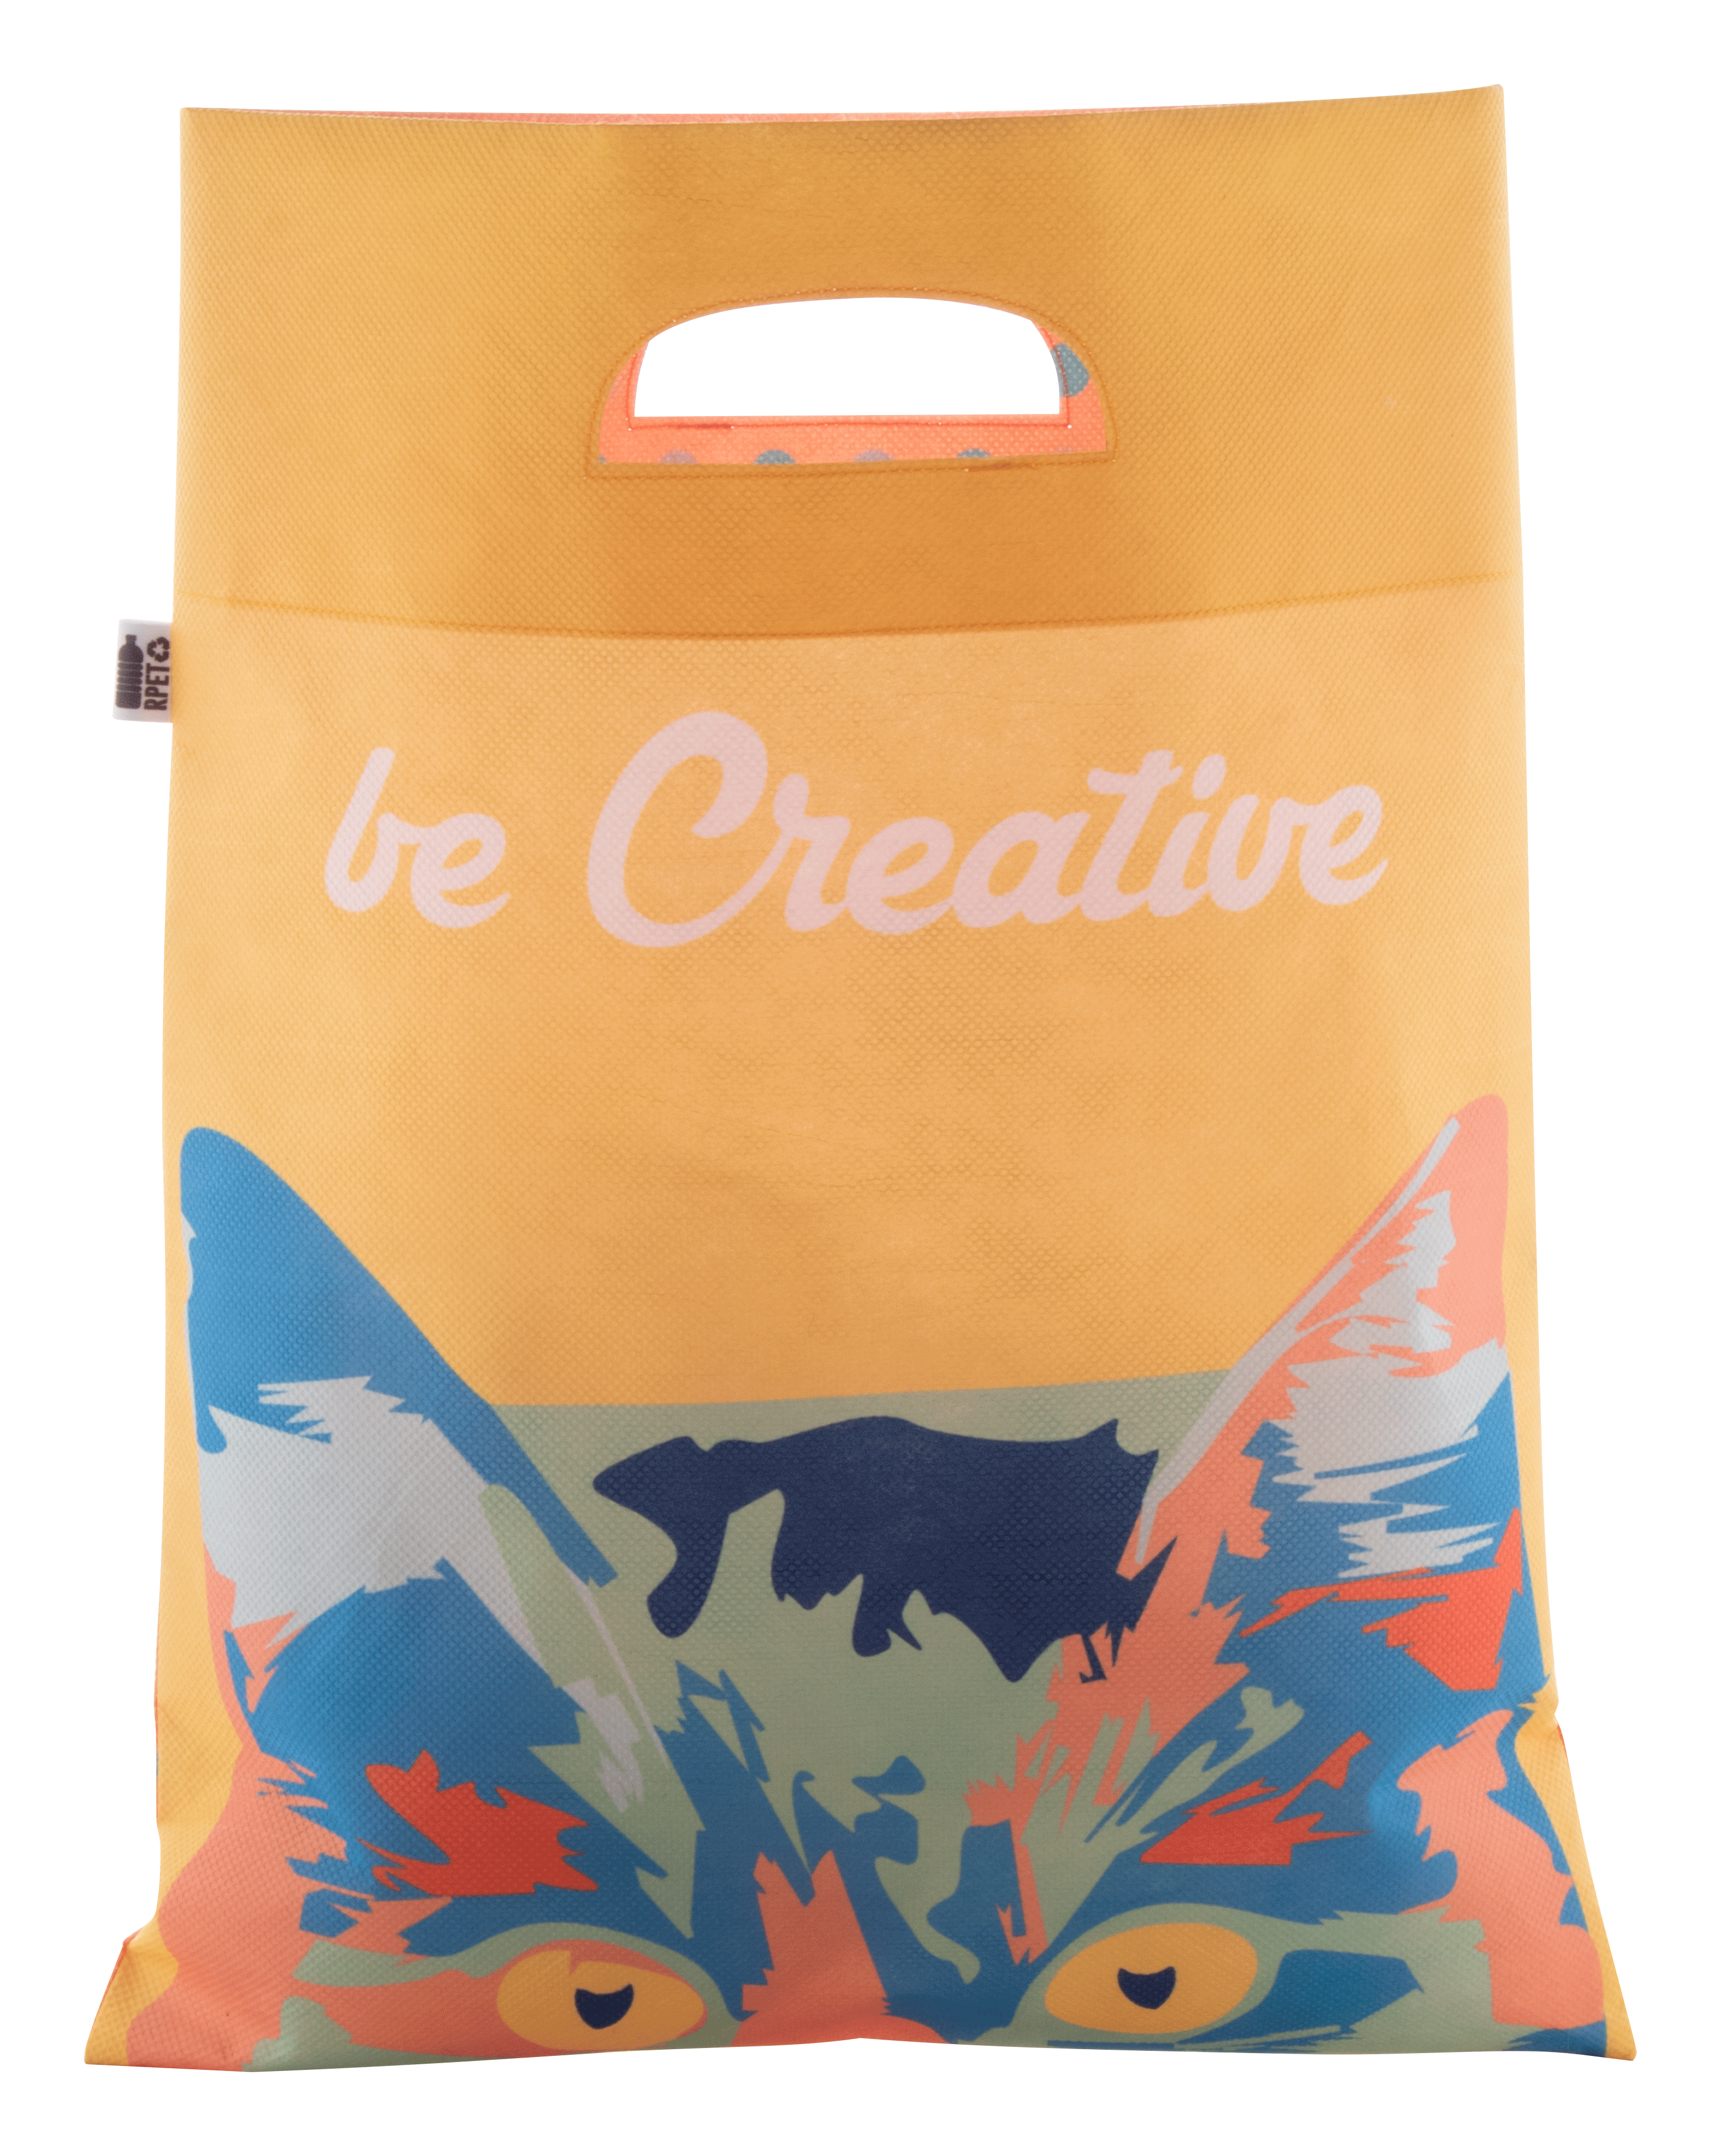
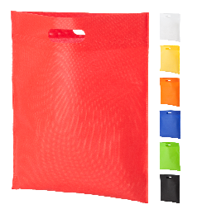
Place your contact details here!
CHRISTMAS PACKAGING
Elegant packaging adds value! Check out some of our ideas for your Christmas promotional presents! Order custom packaging to your brand which takes your packaging to the next level!
CreaBox Gift Box Plus S AP716126-01
Custom made, full colour printed corrugated cardboard lid-bottom box. Delivered flat-packed. MOQ: 50 pcs.
00,00 EUR
CreaBox Post Square S
AP716129-01
Custom made, full colour printed corrugated cardboard, square based postal gift box with self sealing strip. Delivered flat-packed. MOQ: 50 pcs.
00,00 EUR
CreaBox Gift Box Window S
AP716143-01
Custom made, full colour printed corrugated cardboard lid-bottom box with window. Delivered flat-packed. MOQ: 50 pcs.
00,00 EUR
Majamaki S
AP808767
Kraft paper gift bag with Christmas design and gift tag.
00,00 EUR
Majamaki W
AP808768
Kraft paper gift bag for wine bottle with Christmas design and gift tag.
00,00 EUR
Majamaki L
AP808766
Kraft paper gift bag with Christmas design and gift tag.
00,00 EUR
Xagi
AP809432
Christmas design shopping bag, non-woven 70 g/m².
00,00 EUR
SuboShop Zero RPET
AP718901
Custom made, RPET non-woven shopping bag with die-cut handles, 80 g/m². With sublimation printed graphics on both sides and distinctive RPET label. MOQ: 50 pcs.
00,00 EUR
Blaster
AP731631-05
Non-woven shopping bag, 70 g/m².
00,00 EUR
Place your promotional conditions here!
.......
.......
.......
.......
www.WriteYourWebsiteHere.com

