Slide 1
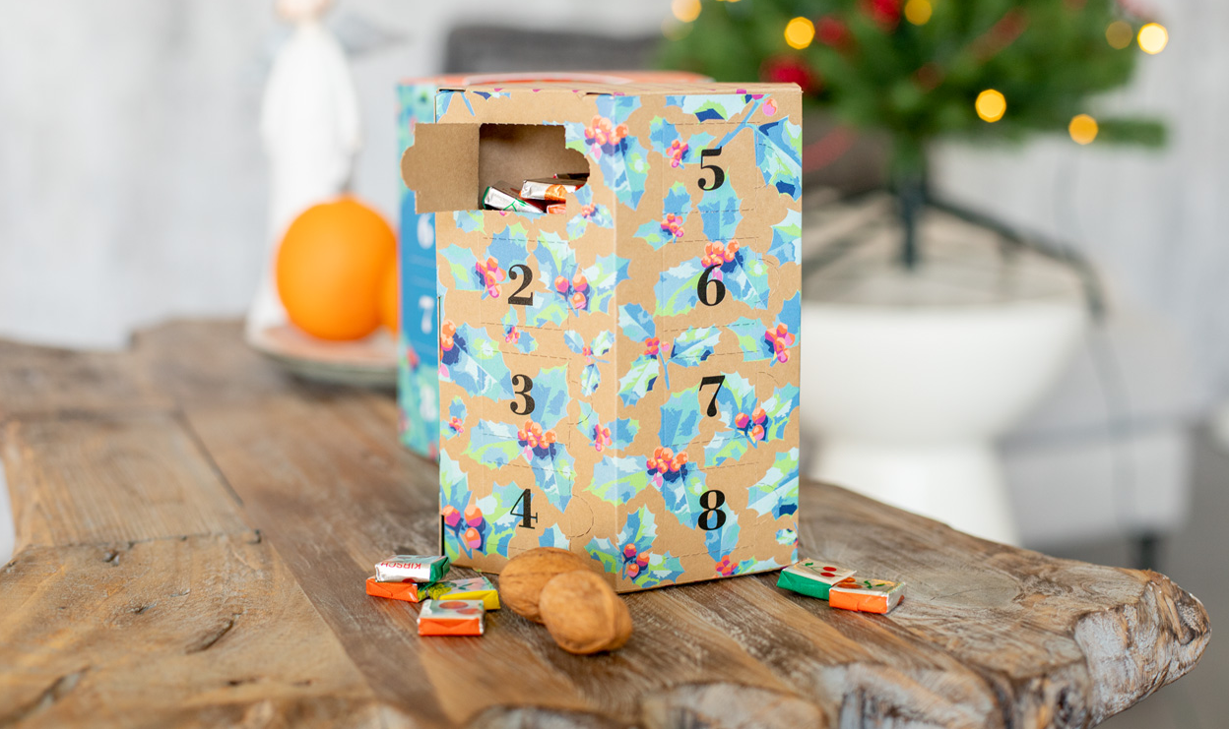
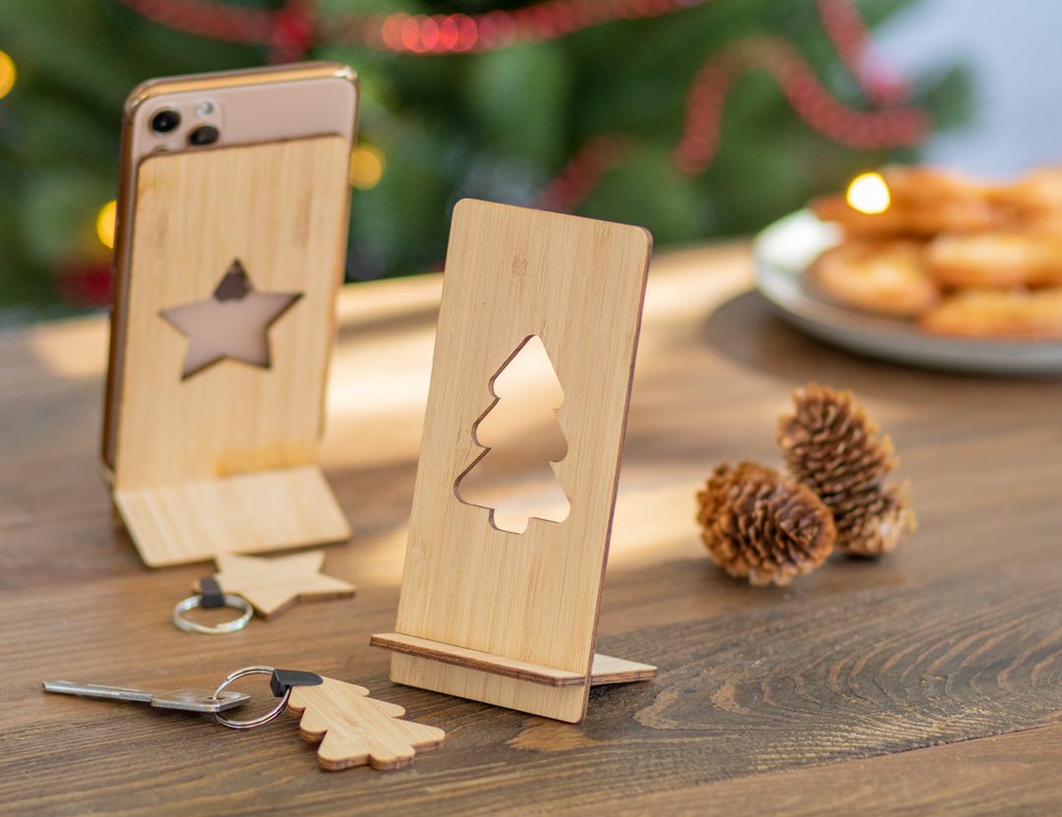
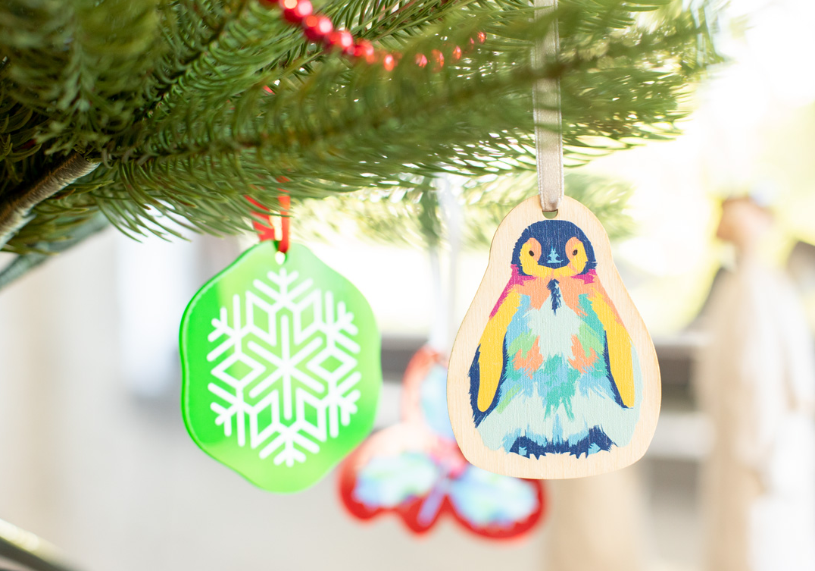
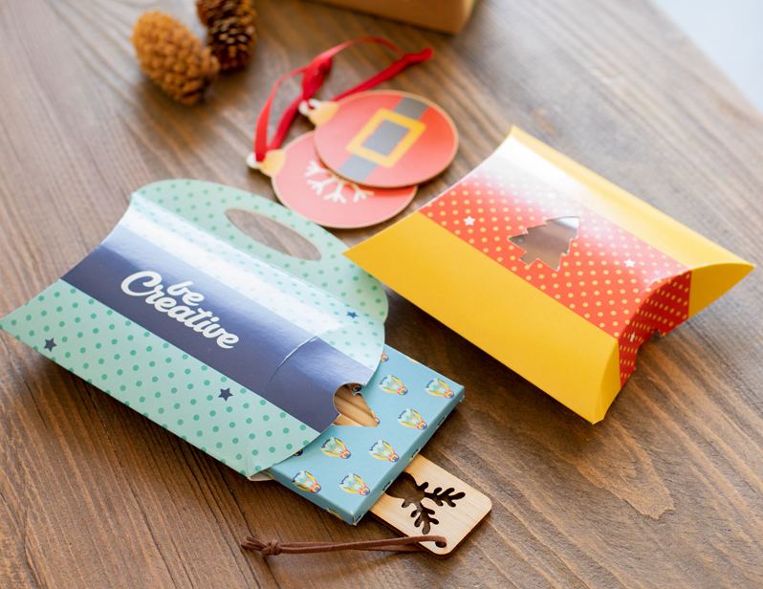
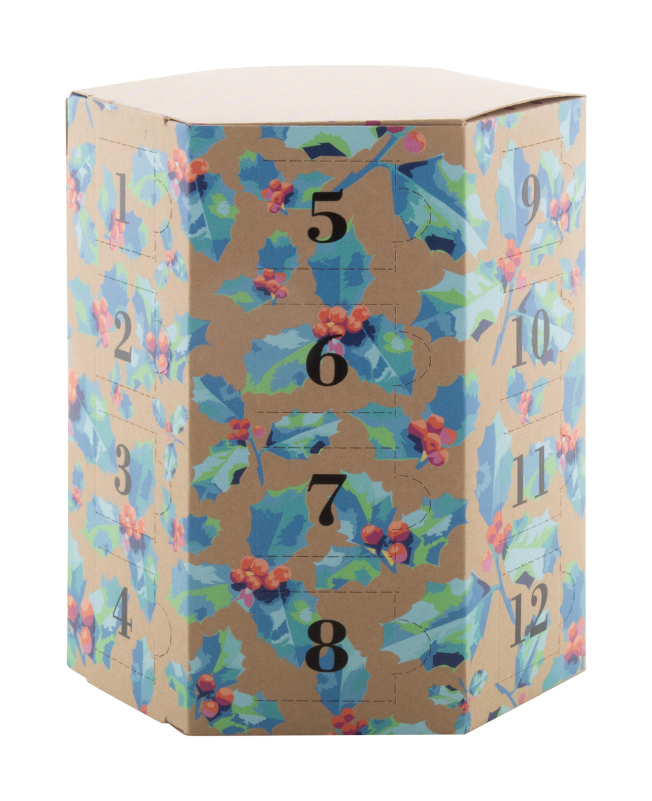
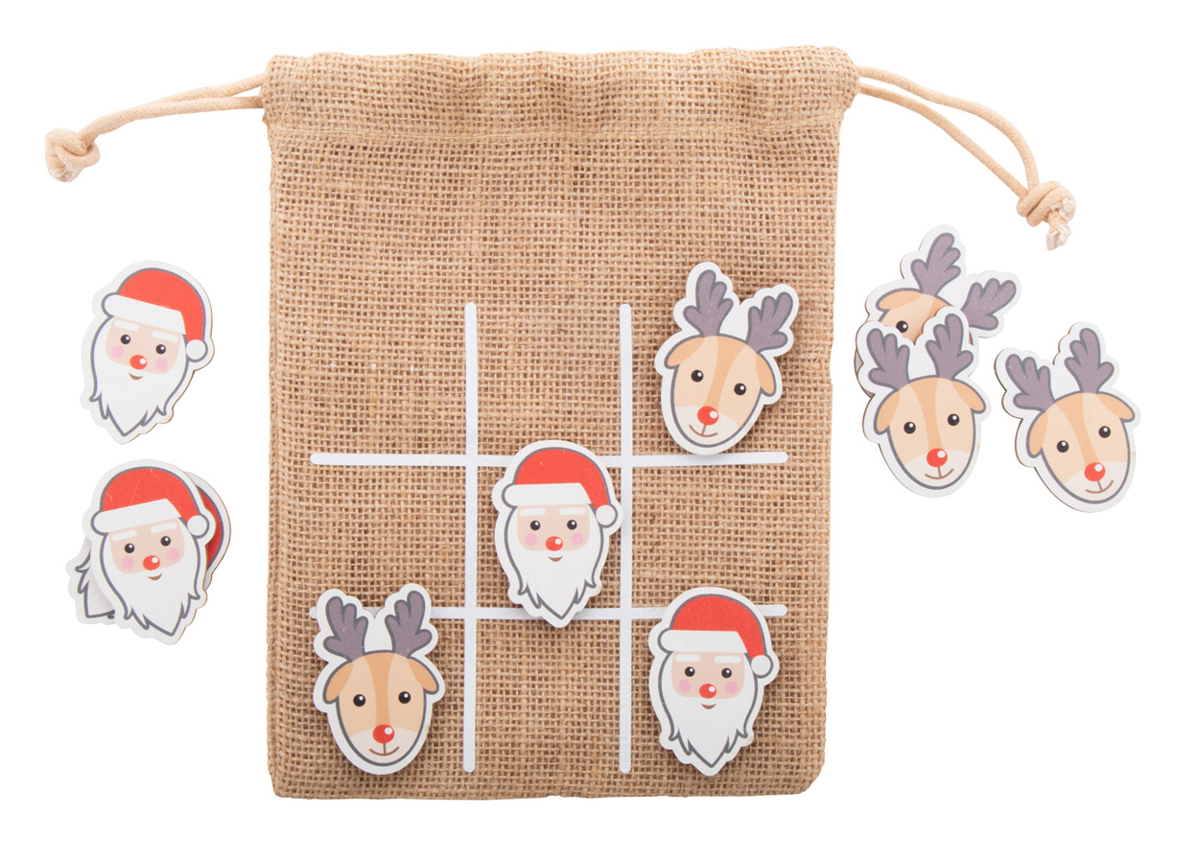
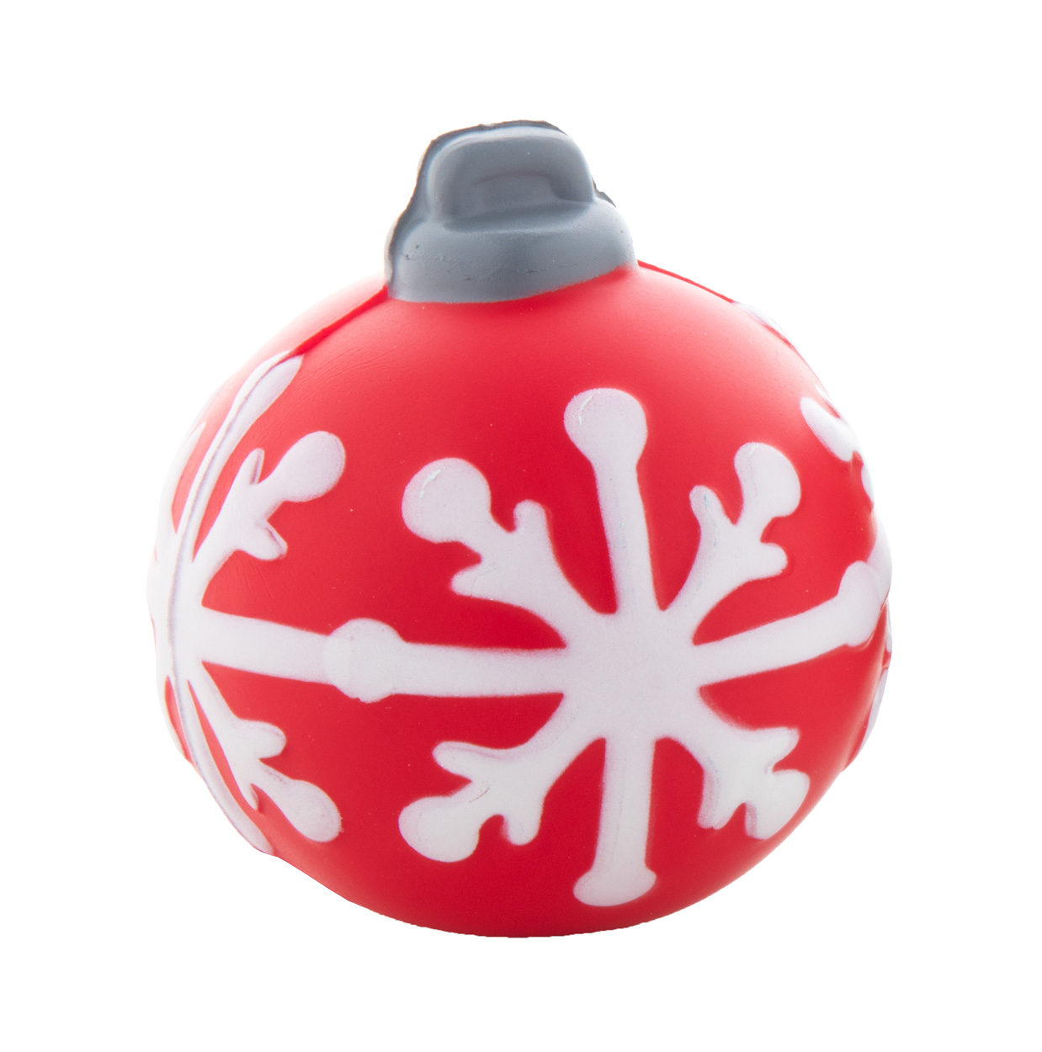
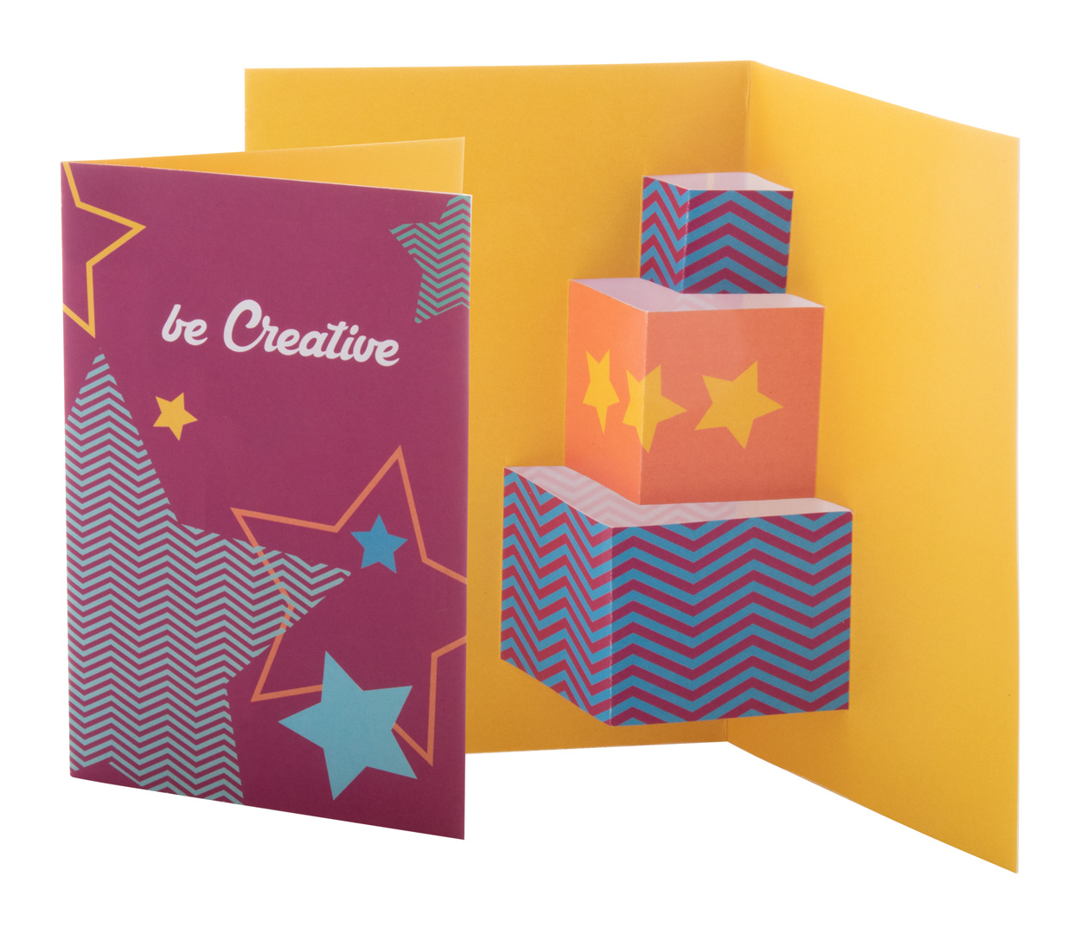
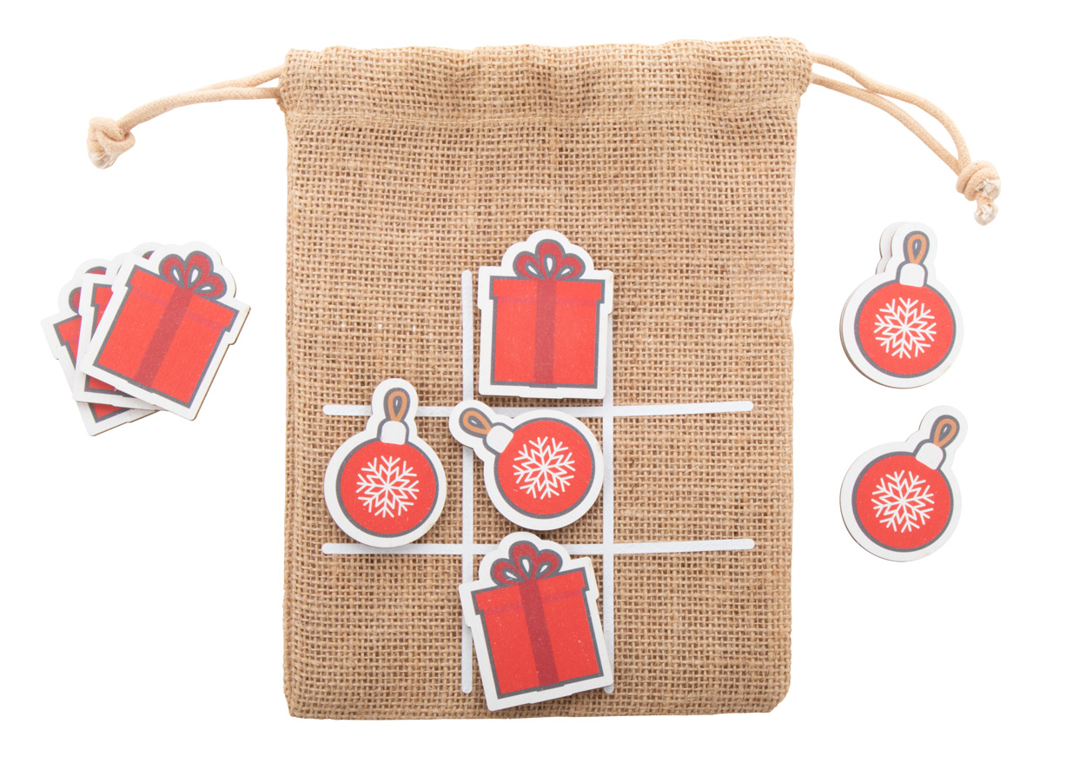
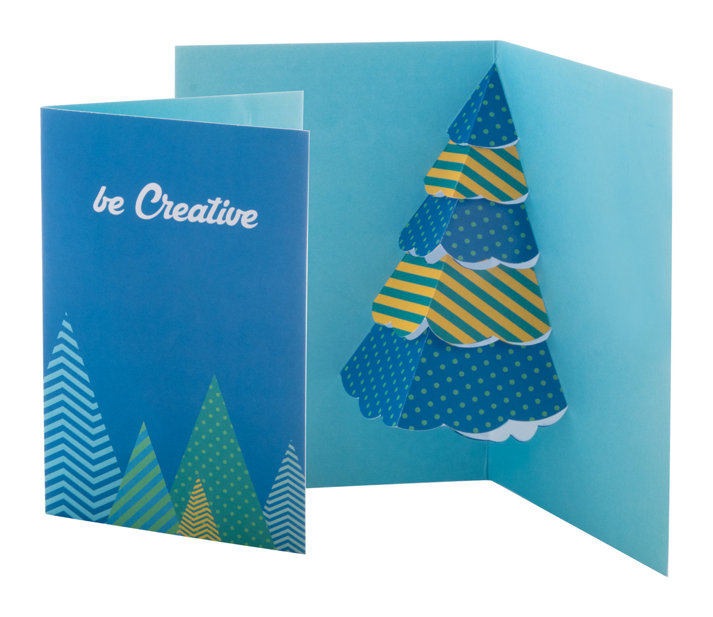
Place your contact details here!
Bring some magic into Christmas
Deliver the mood during the holiday season with the most charming promotional gifts. Promote your company with delightful Christmas-themed products or create your own graphics and spread the love along with your brand.
Kannykka AP716503
Desk mobile phone holder in bamboo plywood with die-cut Christmas motive.
00,00 EUR
Fjerny AP716504
Christmas keyring in bamboo plywood with metal ring.
00,00 EUR
CreaJul AP716492
Custom made Christmas tree ornament in acrylic, with custom shape and full colour graphics.
00,00 EUR
CreaJul Wood AP716491
Custom made Christmas tree ornament in birch plywood, with custom shape and full colour graphics.
00,00 EUR
CreaBox Pillow Xmas S AP716499
Custom made, full colour printed paperboard pillow box with Christmas tree shaped window.
00,00 EUR
CreaBox Pillow Carry S AP716501
Custom made, full colour printed paperboard pillow box with handle.
00,00 EUR
HeXmas Eco
AP716496
Custom made, full colour printed hexagonal Advent calendar in kraft paper with 24 compartments.
00,00 EUR
Juxo
AP716493
Christmas design tic-tac-toe game in birch plywood with 10 tokens and jute carry pouch.
00,00 EUR
Joulustress
AP808042
Christmas tree ornament shaped antistress ball.
00,00 EUR
Dimensions
AP716497
Custom made paper Christmas card with 3-dimensional pop-up shape. With custom graphic on both sides.
00,00 EUR
Find more gift ideas in our Christmas catalogue!
Place your promotional conditions here!
.......
.......
.......
www.WriteYourWebsiteHere.com

