Slide 1
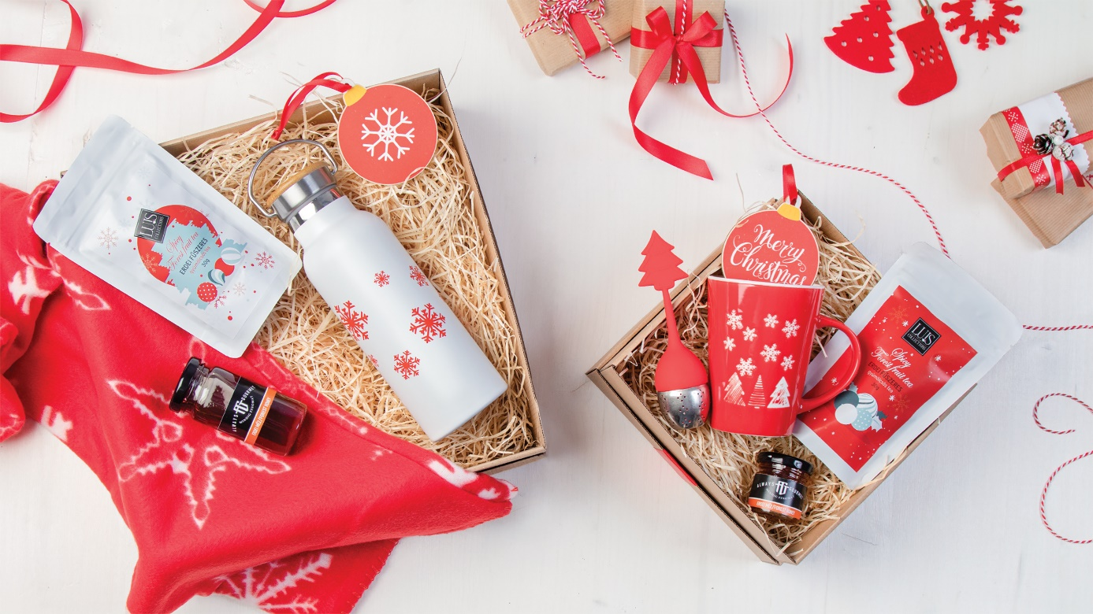
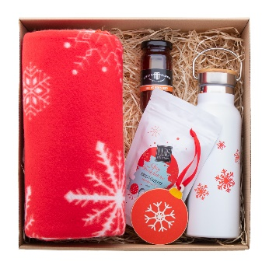
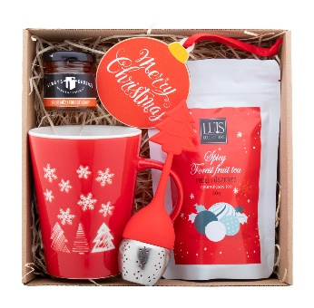
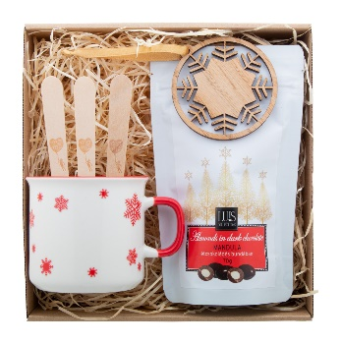
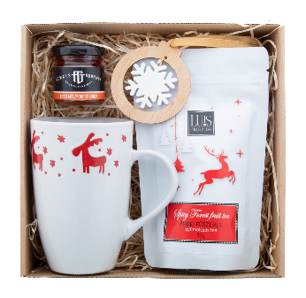
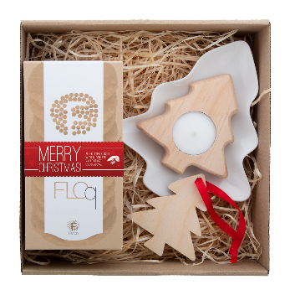
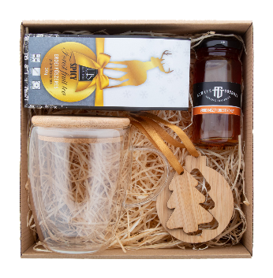
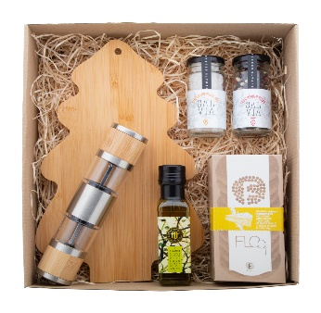
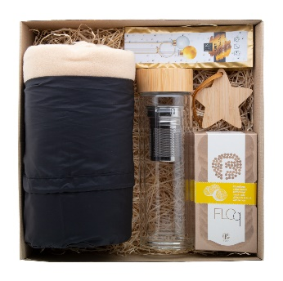
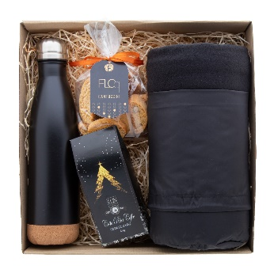
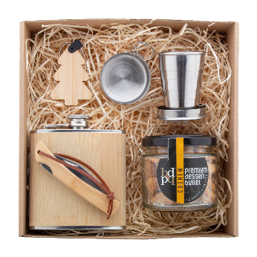
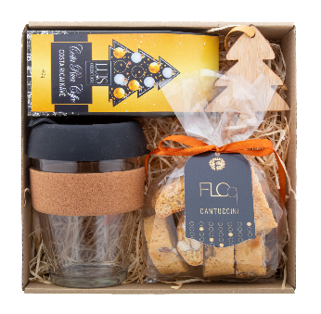
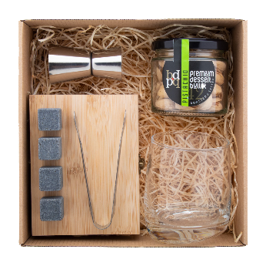
Place your contact details here!
Let us handle the gift list
Find the most fitting Christmas gift set for your promotional goals and surprise everyone with a charming package. Browse from our most successful products and tastiest snacks in simple but elegant packaging.
Kultala AP689918
Travel gift set in kraft cardboard gift box with wood wool filling and red ribbon. Including: "Uppsala" Christmas blanket; "Manaslu" Christmas vacuum flask; "Luis" spiced forest fruit tea (30 g); "Always Gourmet" forest honey (125g); "Skaland" Christmas tree ornament.
0,000 EUR
Julete AP689912
Tea gift set in kraft cardboard gift box with wood wool filling and red ribbon. Including: "Perala" Christmas mug; "Luis" spiced forest fruit tea (30 g); "Always Gourmet" forest honey (50g); "Strobus" tea infuser; "Skaland" Christmas tree ornament.
0,000 EUR
Sjokolade AP689922
Hot chocolate gift set in kraft cardboard gift box with wood wool filling and red ribbon. Including: "Nakkala" Christmas mug; "Choc-O-Lait" hot chocolate spoons - 3 pcs; "Luis" dark chocolate almonds (70 g); "Lundamo" Christmas tree ornament.
0,000 EUR
Teehetki AP689913
Tea gift set in kraft cardboard gift box with wood wool filling and red ribbon. Including: "Lempaa" Christmas mug; "Luis" spiced forest fruit tea (30 g); "Always Gourmet" forest honey (50g); "DoubleTree" Christmas tree ornament.
0,000 EUR
Smorka AP689914
Biscuit gift set in kraft cardboard gift box with wood wool filling and red ribbon. Including: "Jokkmokk" snack plate; "Floq" handmade all-butter biscuit with chocolate (160 g); "Deram" candle; "Woxmas" Christmas tree ornament.
0,000 EUR
Stamsund AP689915
Tea gift set in kraft cardboard gift box with wood wool filling and red ribbon. Including: "Grobina" glass thermo mug; "Luis" spiced forest fruit tea (30 g); "Always Gourmet" forest honey (125g); "Jerpstad" Christmas tree ornament.
0,000 EUR
Havarti AP689917
Cheese serving gift set in kraft cardboard gift box with wood wool filling and red ribbon. Including: "Shiba" bamboo cutting board; "Floq" handmade all-butter biscuit with cheddar cheese & rosemary (150 g); "Always Gourmet" rosemary olive oil (100 ml); "Muntok" salt and pepper mill; "Salvia" white Himalayan salt (100 g); "Salvia" four pepper blend (50g).
0,000 EUR
Hokoku AP689919
Travel gift set in kraft cardboard gift box with wood wool filling and red ribbon. Including: "Kayla" RPET polar blanket; "Andina" glass thermo battle; "Luis" spiced forest fruit tea (30 g); "Floq" handmade all-butter biscuits with lemon (150 g); "Holonda" Christmas tree ornament.
0,000 EUR
Schwarzwald AP689920
Travel gift set in kraft cardboard gift box with wood wool filling and red ribbon. Including: "Kayla" RPET polar blanket; "Vancouver" vacuum flask; "Luis" Costa Rica coffee (40 g); "Floq" artisan cantuccini (100g).
0,000 EUR
Jagare AP689911
Spirit gift set in kraft cardboard gift box with wood wool filling and red ribbon. Including: "Borester" hip flask; "Nautilus" foldable cup; "Premium Dessert Bullet" roasted-salted cashews (90 g); "Sultan" pocket knife; "Fjerny" Christmas keyring.
0,000 EUR
Kahvippa AP689916
Coffee gift set in kraft cardboard gift box with wood wool filling and red ribbon. Including: "Tarkol" glass travel mug; "Luis" Costa Rica coffee (40 g); "Floq" artisan cantuccini (100g); "Holonda" Christmas tree ornament.
0,000 EUR
Highlands AP689921
Whisky serving gift set in kraft cardboard gift box with wood wool filling and red ribbon. Including: "Merzex" whisky glass; "Bourbon" stone ice cube set; "Premium Dessert Bullet" roasted-salted pistachios (85g); "Roley" jigger.
0,000 EUR
Find more gift ideas in our Christmas catalogue!
Place your promotional conditions here!
.......
.......
.......
www.WriteYourWebsiteHere.com

