Slide 1
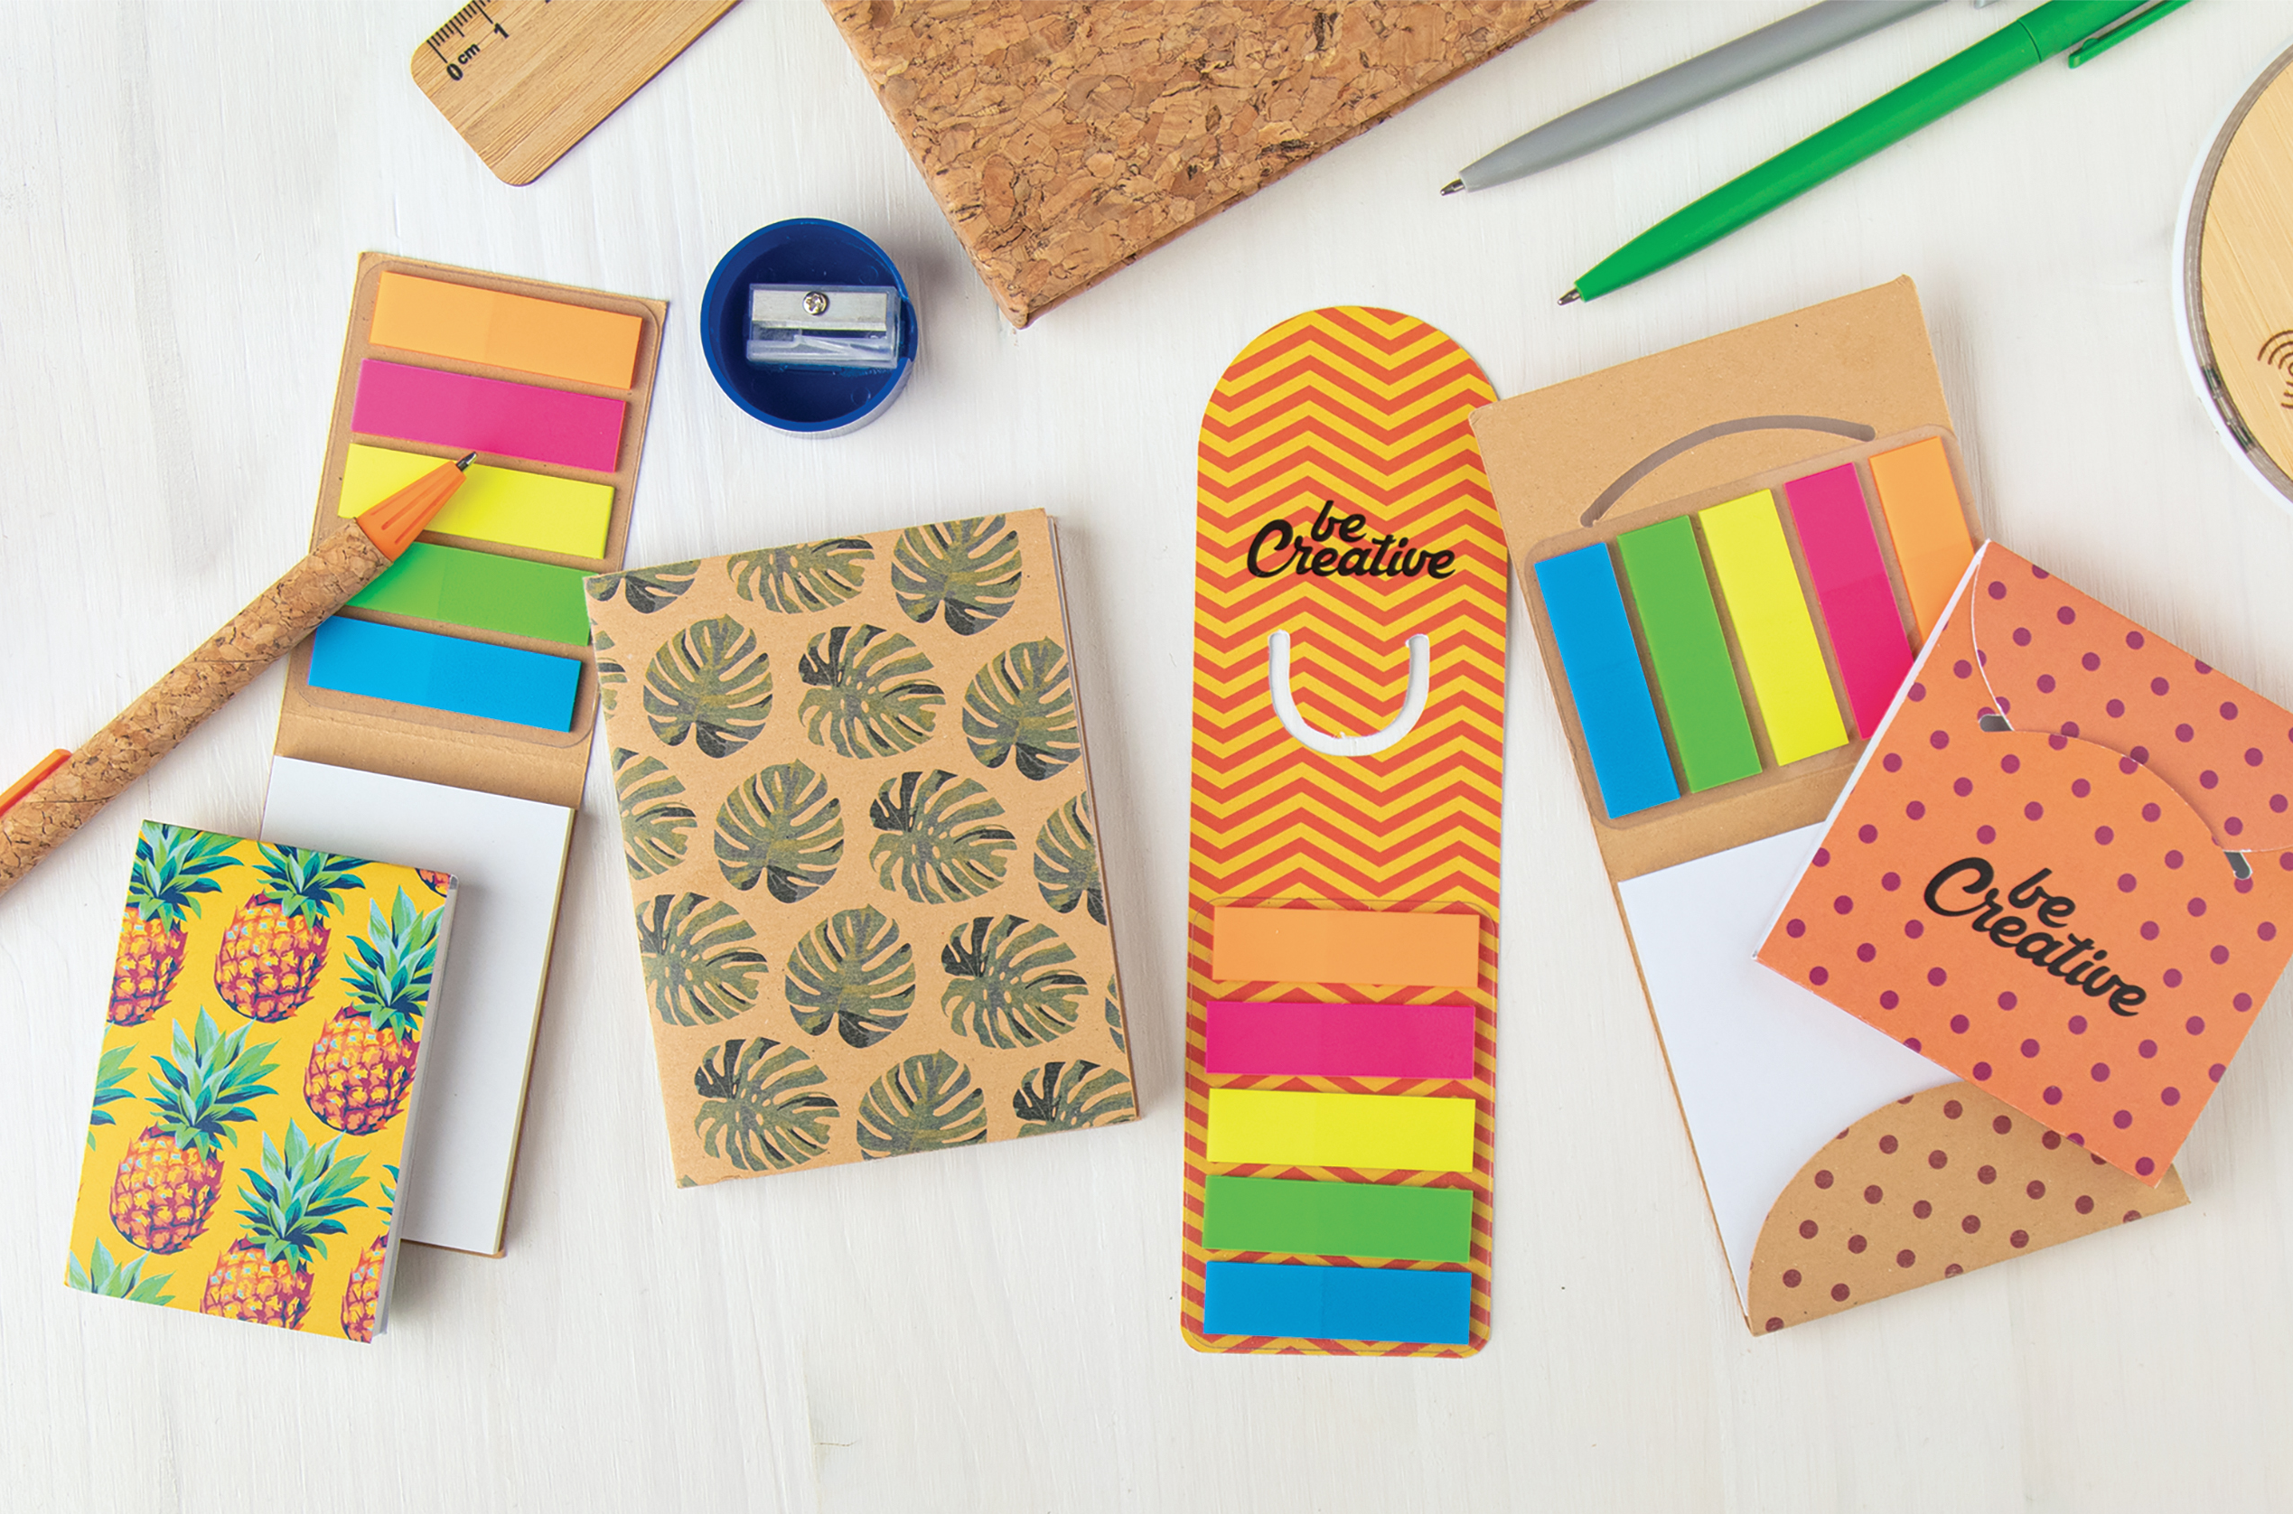
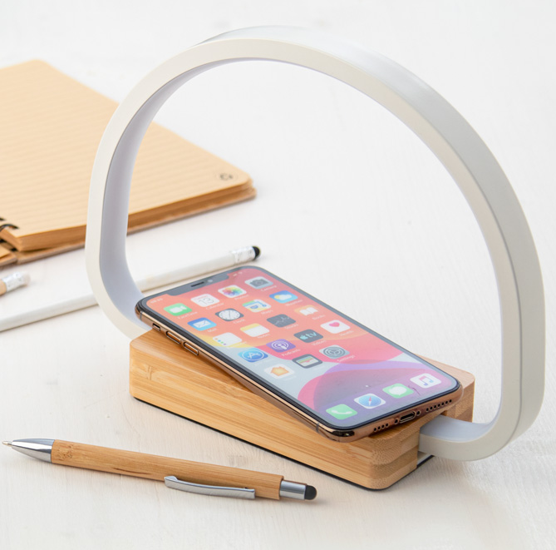
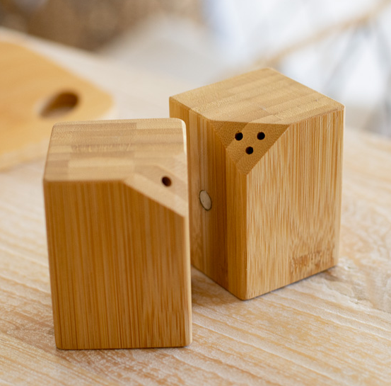
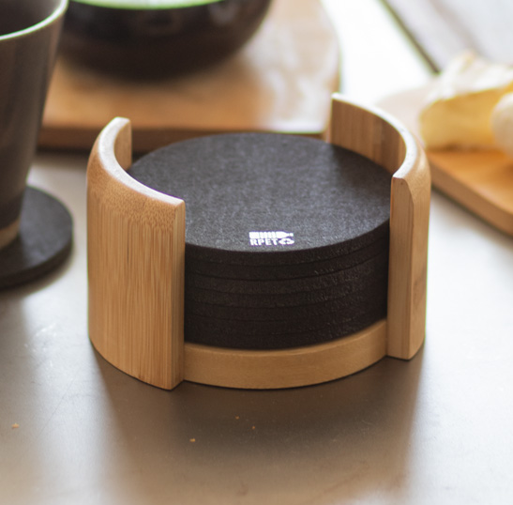
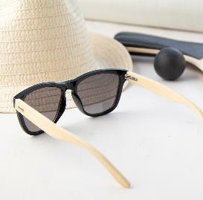
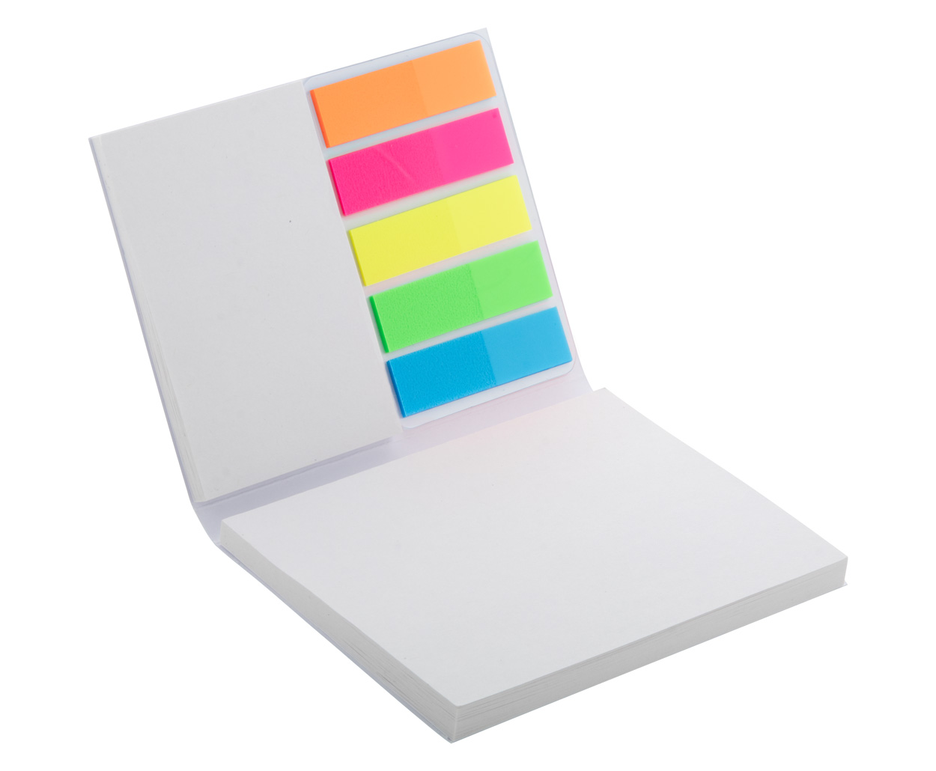
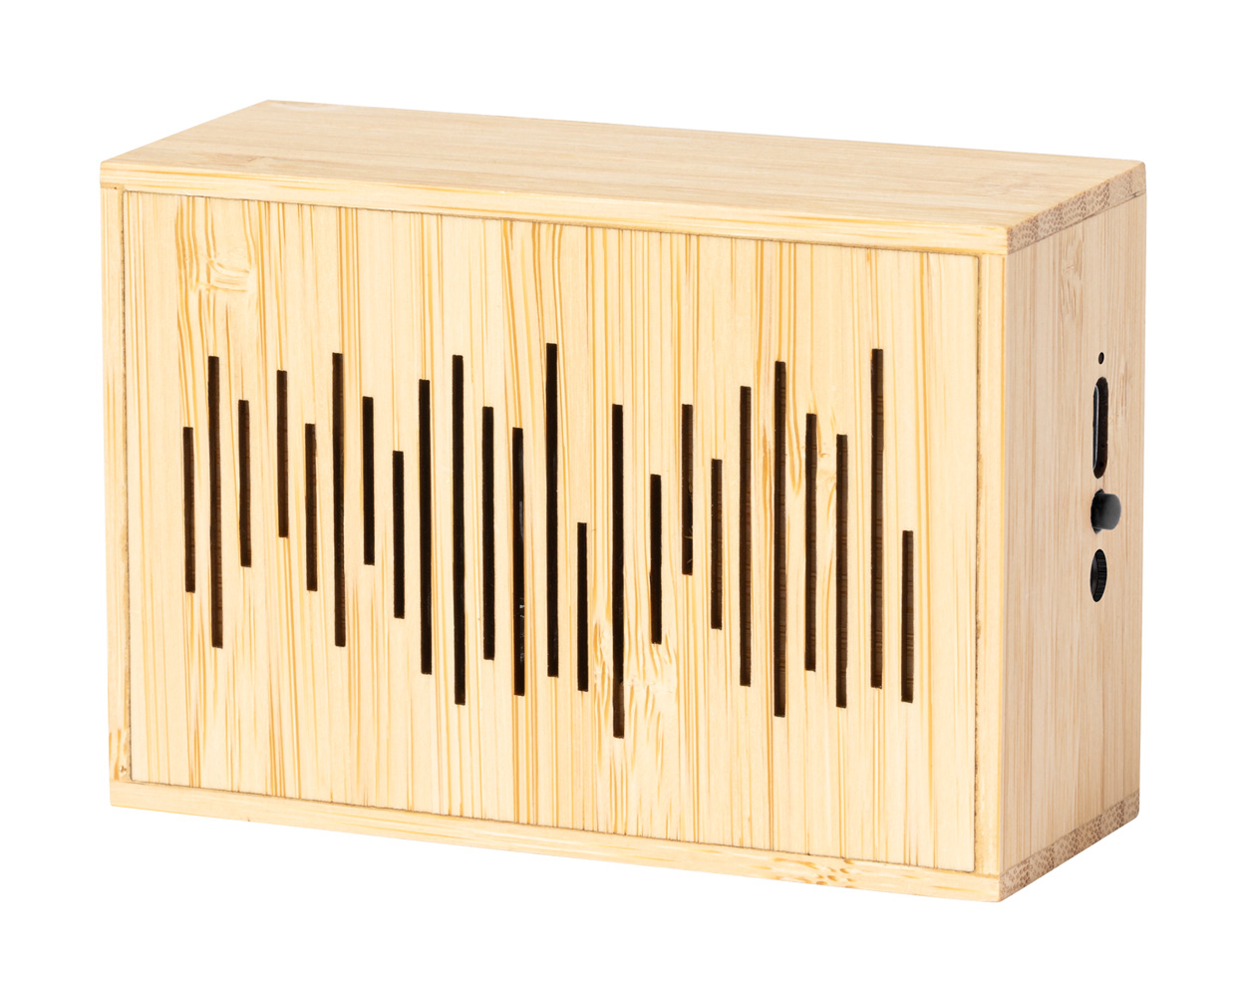
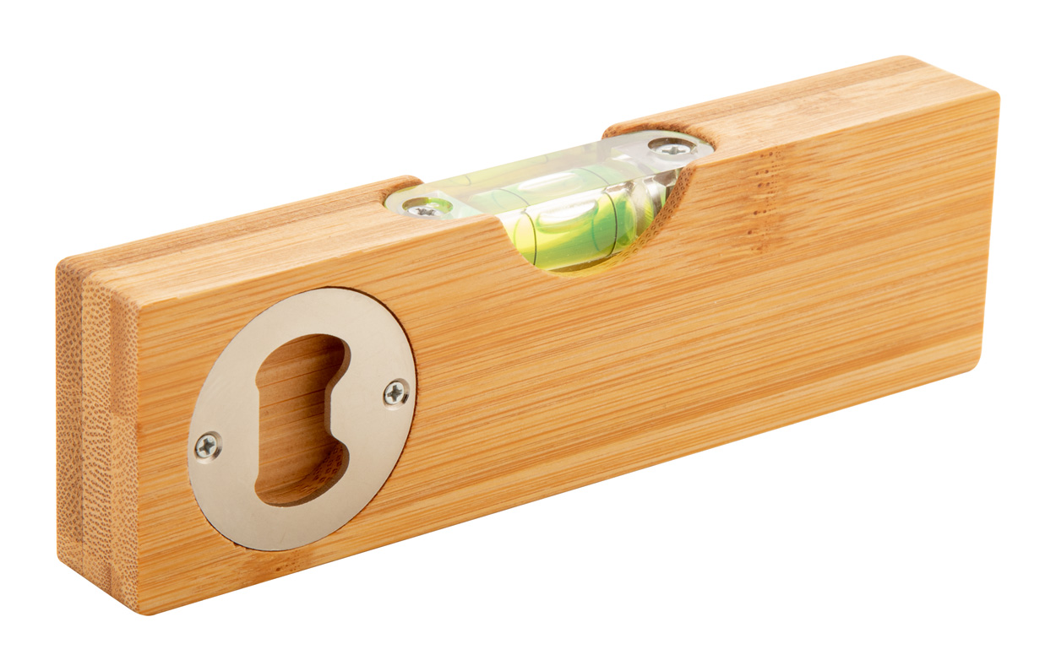
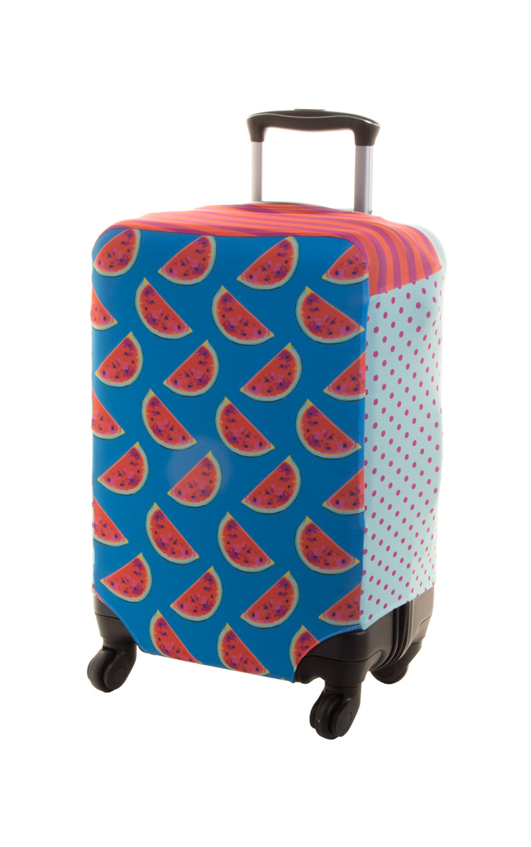
Place your contact details here!
Move with
the times
Promote your company with something new and trendy. Impress your customers with practical and stylish promotional gifts that are suitable for every facet of life and make your corporate image the most memorable.
Labrum AP722494
Multifunctional bamboo desk lamp with 25 LEDs and adjustable brightness. With built-in wireless fast charger (10W) and USB charger port for charging 2 devices simultaneously (1 wirelessly and 1 via cable). Max. output: 1000 mA. Including USB charger cable.
00,00 EUR
Kerala AP800476
2 pc bamboo salt and pepper shaker set. The set conveniently seals at the center thanks to magnets positioned on the side of the shakers.
00,00 EUR
Chiang AP808040-10
10 pc RPET felt coaster set in bamboo desk holder. With distinctive RPET logo on each coaster.
00,00 EUR
CreaStick Page A
AP716546
Custom made, paper covered page markers. 100 plastic film page markers in 5 colours, and full colour printed outside cover.
00,00 EUR
Laurens
AP722543
Bluetooth speaker in bamboo housing with built-in solar charger and rechargeable battery. Including USB charger cable.
00,00 EUR
Spiroo
AP800477
Bamboo spirit level with bottle opener.
00,00 EUR
BagSave M
AP716532
Custom made, polyester luggage cover with velcro closure. Fits medium sized suitcases up to 42x62x26 cm.
00,00 EUR
Find more gift ideas in our Christmas catalogue!
Place your promotional conditions here!
.......
.......
.......
www.WriteYourWebsiteHere.com

